Slide 1
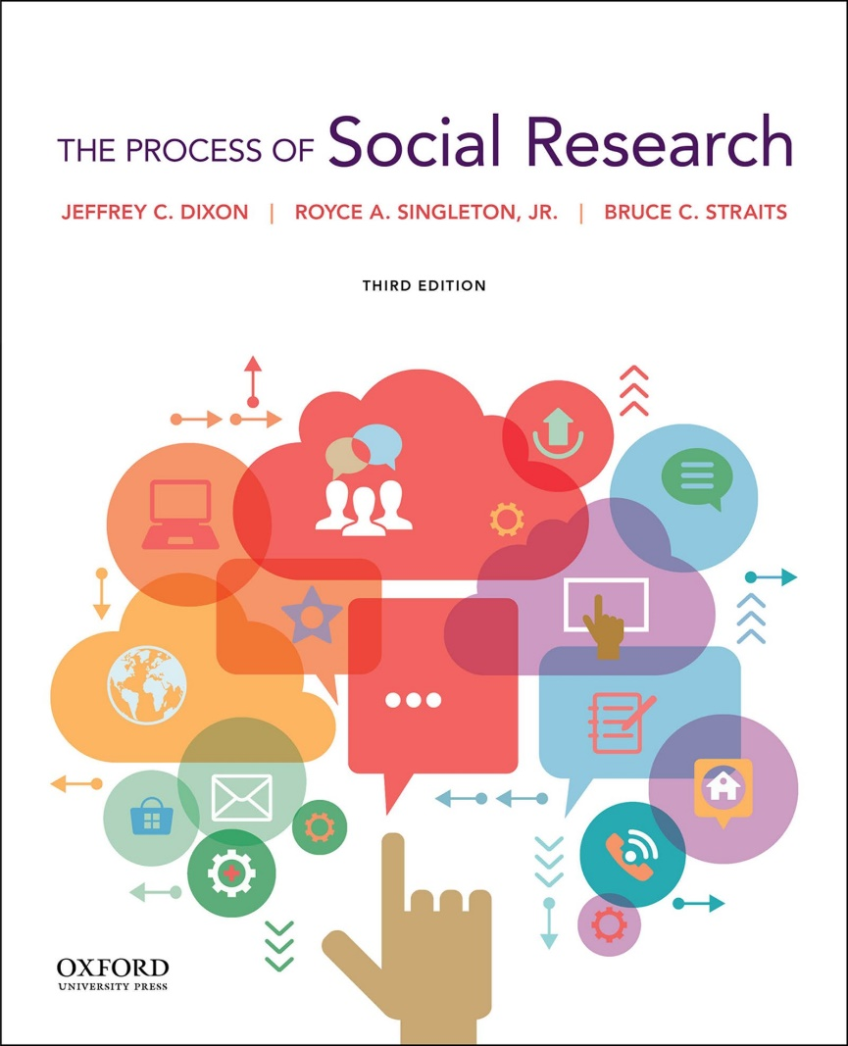
Chapter 3: The Ethics and Politics of Research
Doing What’s “Right”

Slide 2
Chapter Learning Objectives
Explain the four major ethical issues in the treatment of research participants: potential harm, informed consent, deception, and privacy invasion.
Use federal regulations and professional guidelines concerning the ethical treatment of research participants.
Apply the process of ethical decision-making to your own research.
Discuss the relationship between politics and social research.
Describe how ethics and politics may be related in social research.

Slide 3
Chapter Outline
Overview: Ethics
Ethical Issues in the Treatment of Research Participants
Federal and Professional Ethical Guidelines
The Process of Ethical Decision-Making
Politics and Social Research
The Intersection of Ethics and Politics in Social Research

Slide 4
Ethics and Social Research
What are ethics?
  Standards of conduct that distinguish right from wrong
What are research ethics?
  Ethical standards that apply to conducting and reporting research

Slide 5
Ethics and Social Research (2)
What are the sources of ethical standards?
  Norms and values of the larger society
  Professional codes of conduct
  Federal ethical regulations
Many ethical standards are not clear-cut
  They depend on the situation and are subject to interpretation

Slide 6
Ethical Issues in the Treatment of Research Participants
Potential harm
  Personal safety is the right of every research participant
  Harm may be physical or psychological
Informed consent
  Arises from the value placed on freedom of choice
  Research participants must be given enough information about the research, including risks and benefits, to make a rational decision about whether to participate
  Participation must be voluntary

Slide 7
Ethical Issues in the Treatment of Research Participants (2)
Deception
  Intentionally misleading or misinforming participants about a study
  Usage is controversial
Invasion of privacy
  Individuals have the right to decide when, where, to whom, and to what extent personal information is revealed

Slide 8
Federal Ethical Regulations
Belmont Report identified three ethical principles that underlie federal regulations
  Respect for persons: individuals must have the freedom to decide what happens to them
  Beneficence: research procedures should maximize benefits and minimize costs
  Justice: benefits and burdens of research should be fairly distributed

Slide 9
Federal Ethical Regulations (2)
Federal regulations are codified in the Common Rule
  Provides information about the application of regulations and criteria to approve research
  Applies to all federally funded research
  Applies at virtually all U.S. colleges and universities

Slide 10
Professional Ethical Guidelines
Provide principles that apply to research in a particular discipline
  American Psychology Association’s Ethical Principles of Psychologists and Code of Conduct
  American Sociological Association’s Code of Ethics
  Statement on Ethics: Principles of Professional Responsibility of the American Anthropological Association
Protect the welfare of research participants
Guide researchers in making ethically responsible choices

Slide 11
Evaluating Potential Harm
What are the federal criteria for evaluating potential harm?
Level of risk to participants
  Level of risk should be minimized
  Special precautions required for research that poses more than minimal risk
  Minimal risk does not exceed the likelihood or magnitude of harm experienced in everyday life

Slide 12
Evaluating Potential Harm (2)
Risks of the research in relation the benefits
  Benefits may accrue to researchers, participants, and the larger society
  If there is little to no scientific value from a study that exposes participants to harm, the study should not be done
  Assessment of risks and benefits an important first step in evaluating the ethics of a study

Slide 13
Minimizing Harm
Researchers should follow these guidelines to minimize harm:
  Inform participants of any reasonable or foreseeable risks before study begins.
  Screen out research participants who might be harmed.
  If stress or harm is likely, plan measures to assess the harm after the study and provide resources to ameliorate it.

Slide 14
Informed Consent Procedures
Federal regulations ordinarily require written consent, with some exceptions in social research:
  Participation involves no more than minimal risk
  Not obtaining written consent will not adversely affect rights and welfare of participants
Participants must be given enough information, including potential risks, to make an informed decision about whether to participate
Participation must be voluntary
Information about the study must be conveyed clearly

Slide 15
Informed Consent Checklist for Social Research
A statement that the study involves research
An explanation of the purposes of the research
The expected duration of the participant’s participation
A description of the procedures to be followed
A description of any reasonably foreseeable risks or discomforts to the participant
A description of any benefits to the participant or to others which may reasonably be expected from the research

Slide 16
Informed Consent Checklist for Social Research (2)
A statement describing how, if applicable, the confidentiality of records will be maintained
An explanation of whom to contact for answers to pertinent questions about the research and research participants’ rights and whom to contact in the event of a research-related injury to the participant
A statement that participation is voluntary, refusal to participate will involve no penalty or loss of benefits to which the participant is otherwise entitled, and the participant may discontinue participation at any time without penalty or loss of benefits

Slide 17
Deception Ground Rules
APA and ASA ethical codes rule out deception when there is substantial risk of harm or stress.
However, the same codes allow deception under certain conditions:
  It is a method of “last resort”—when there is no effective alternative procedure
  Participants must be informed of the deception at the conclusion of their participation

Slide 18
Debriefing
A short interview between investigator and research participants at the conclusion of their participation
Why is debriefing important?
  Serves both educational and methodological purposes
    Researchers gain valuable information about the participants’ interpretation of research procedures
  Essential when a study involves deception
    Participants must be fully informed about how they were deceived
    Participants should not leave the experiment feeling worse about themselves than before they began

Slide 19
Protecting Privacy: Anonymity and Confidentiality
How is privacy protected?
Anonymity: participants cannot be identified
  Best means of protection but difficult to achieve
  Possible in self-administered surveys and some forms of existing data
Confidentiality: data from participants are not shared with others without their permission; may be insured by:
  Removing names and other identifying information from the data
  Keeping data in a secure place
  Not disclosing participants’ identities in reports
  Not divulging participants’ identities to authorities
  Using fictitious names

Slide 20
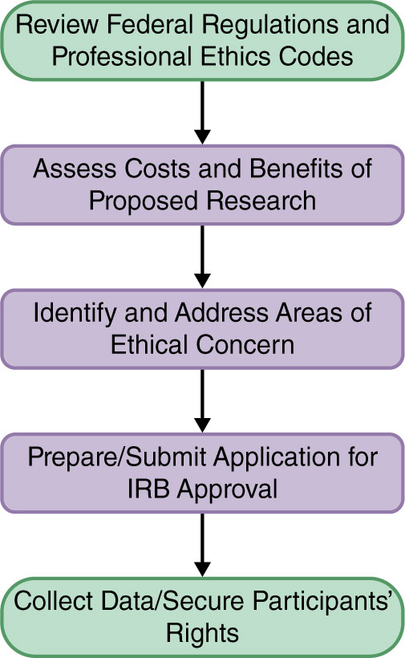
Figure 3.2 The Process of Ethical Decision-Making

Slide 21
Institutional Review Board (IRB)
Committee which exists at nearly all U.S. colleges and universities
Required to assure compliance with federal regulations
Researchers must submit a research proposal to IRB
  Specify how participants’ rights are protected
  May be judged as exempt, approved, disapproved, or require modification

Slide 22
Principles and Recommendations for Ethical Data Collection and Analysis
Integrity is a guiding principle of the APA and ASA ethical codes.
Research misconduct violates integrity and can include:
  Fabrication
  Falsification
  Plagiarism
  Careless and/or poorly conducted research
Integrity can be promoted and enhanced by:
  Discussing work with others at all stages
  Providing detailed information in the research reporting about how data was collected, processed, and analyzed
  Quality checks
  Share data with others

Slide 23
Politics and Social Research
Politics involves value judgments
Politics may influence research at an individual or structural level
  Personal values and political ideology
  Groups, professional organizations, and political systems at all levels
Max Weber’s position on value neutrality: personal values should not influence the collection and analysis of data
In reality, value-neutrality is difficult to achieve

Slide 24
Topic Selection, Political Ideology, and Research Funding
How does politics shape topic selection?
  Personal values of the researcher
  Values and, therefore, topic selection are products of the culture and time
  Progressivism of sociology has had a continuing influence
Politics of research funding
  Most social research requires financial support
  Sources of support prioritize particular topics
  Coburn amendment to 2013 spending bill is an example

Slide 25
Data Analysis and Interpretation and Political Ideology
Despite controls for investigator bias, political ideology can affect data analysis and interpretation.
Research on same-sex parenting
  Researchers with political views hostile to homosexual adoption are likely to report more negative outcomes for children of same-sex than opposite-sex parents
  Researchers sympathetic to homosexual adoption are likely to report no differences in children raised by same- and opposite-sex parents
  Analysis shows some differences, particularly in gender and sexual preferences and behavior

Slide 26
Dissemination of Research Findings: Science, Politics, and Public Policy
What are the researcher’s obligations regarding the dissemination of research findings?
Social scientists need to consider how others may use their research findings
  They should speak out against misuses
  They may choose to offer their expert testimony when appropriate
Professional associations may choose to present consensus research findings in court cases

Slide 27
Regnerus Study
Research question: Do children raised by same-sex parents have more negative outcomes than children raised by opposite-sex parents?
Conducted online survey of adults aged 18 to 39
Results showed that compared to young adults growing up in intact families, young adults with lesbian or gay parents had more negative outcomes
This study was controversial, received significant media coverage, and the results were contested

Slide 28
Intersection of Ethics and
Politics in Social Research
How do ethics and politics intersect?
  Conflict of interest: conflict between the goal of producing unbiased knowledge and other motives such as financial gain and political interests
  Social responsibility: researchers’ ethical obligation to be aware of and provide direction to how others use their findings

