Slide 1
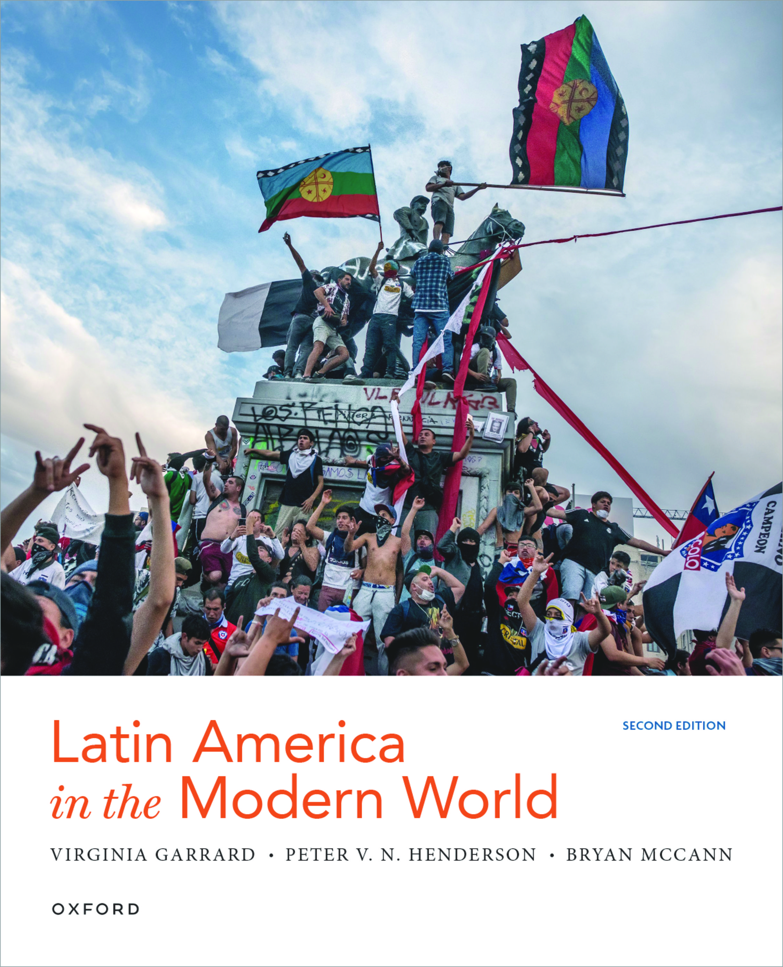

LATIN AMERICA IN THE MODERN WORLD
by Virginia Garrard, Peter V. N. Henderson , and Bryan Mccann

Slide 2
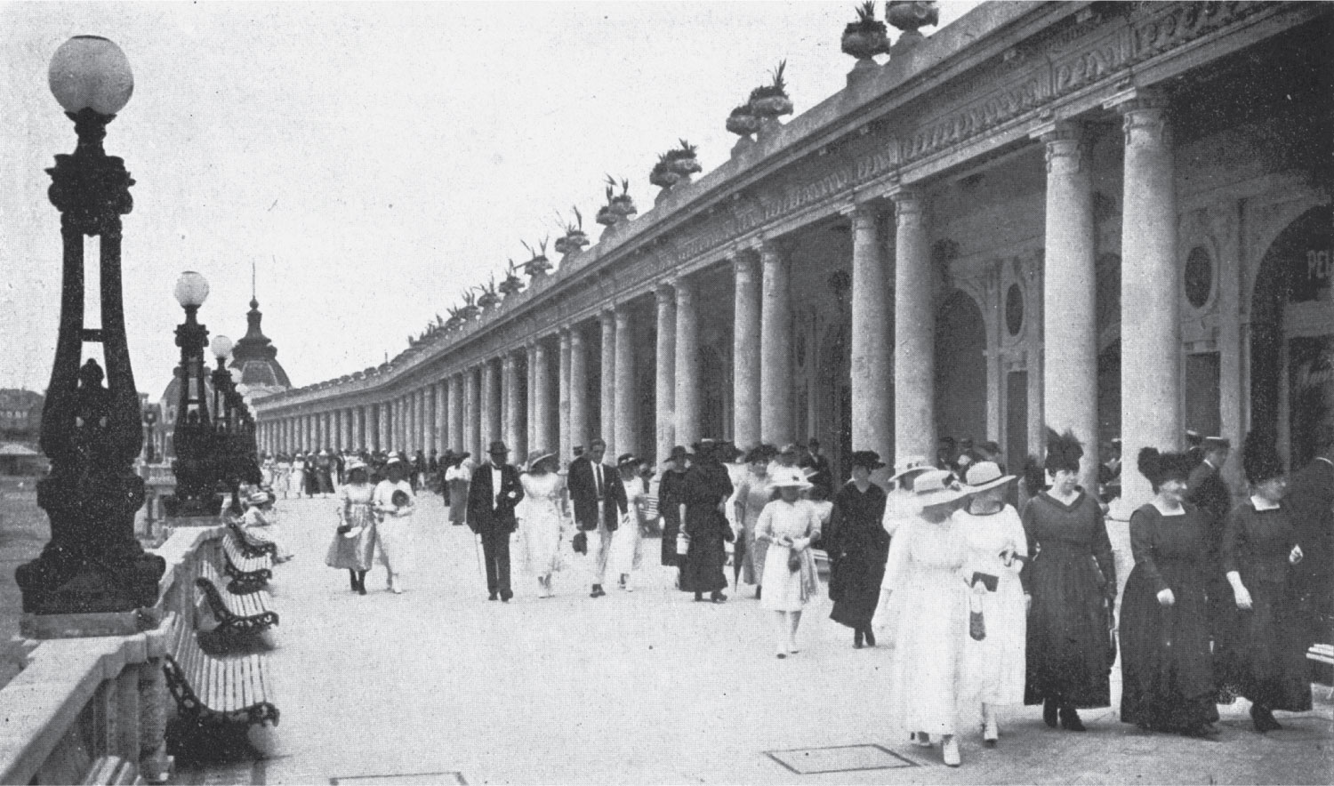
10
1

Slide 3
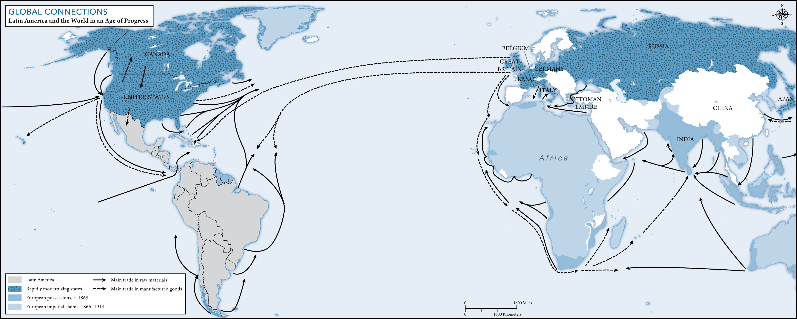
3
1

Slide 4
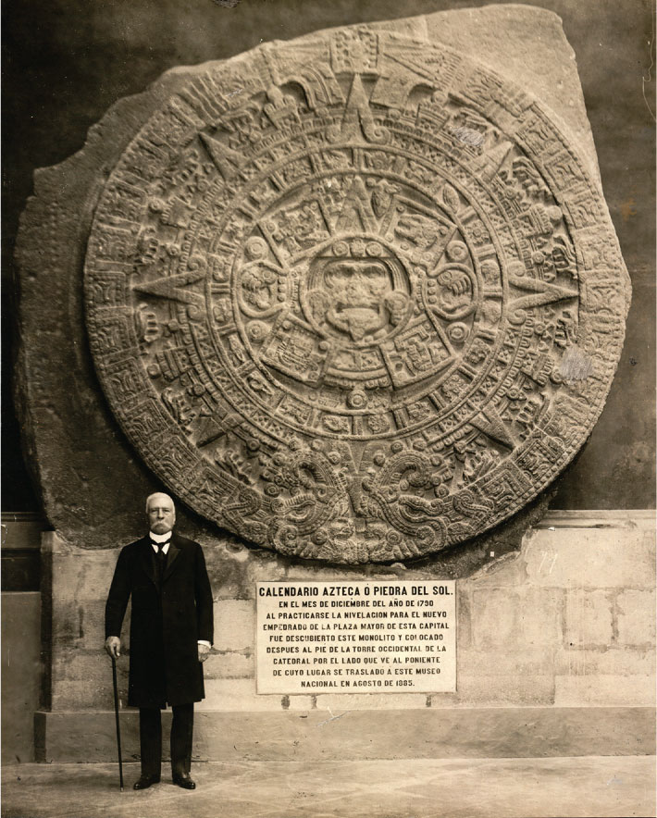
4
1

Slide 5
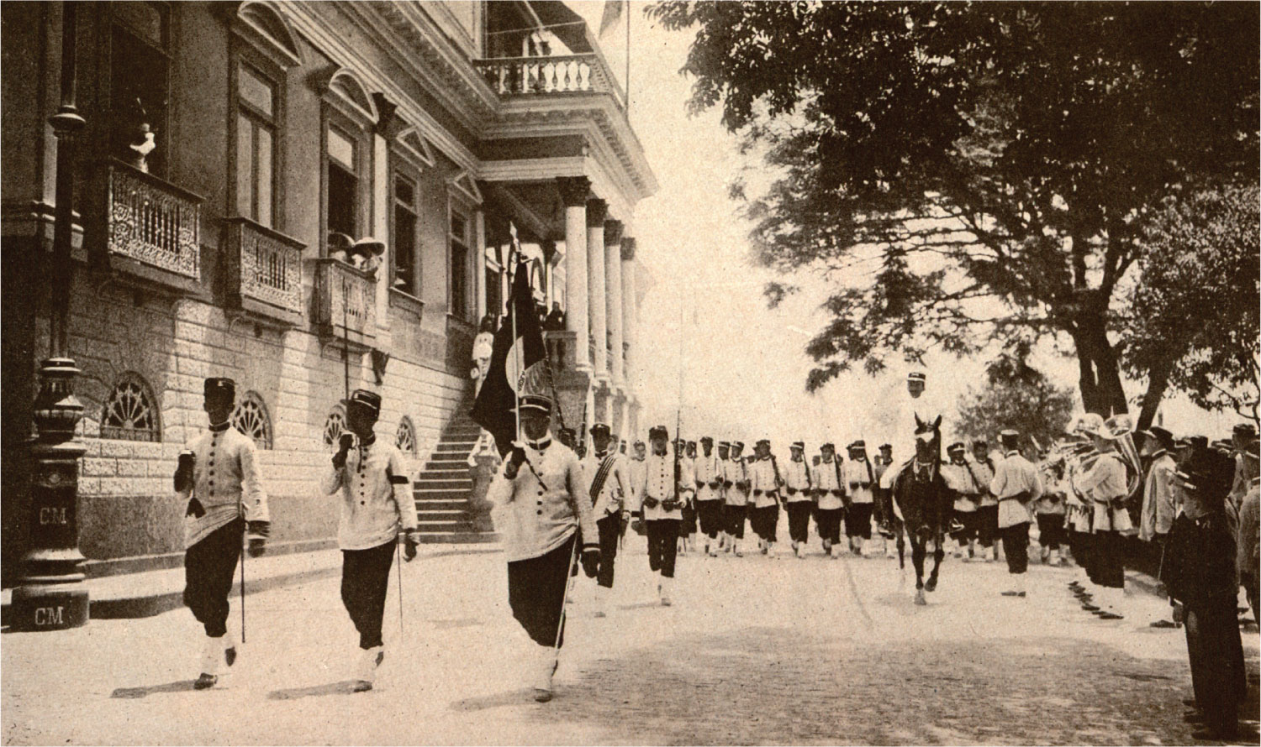
5
1

Slide 6
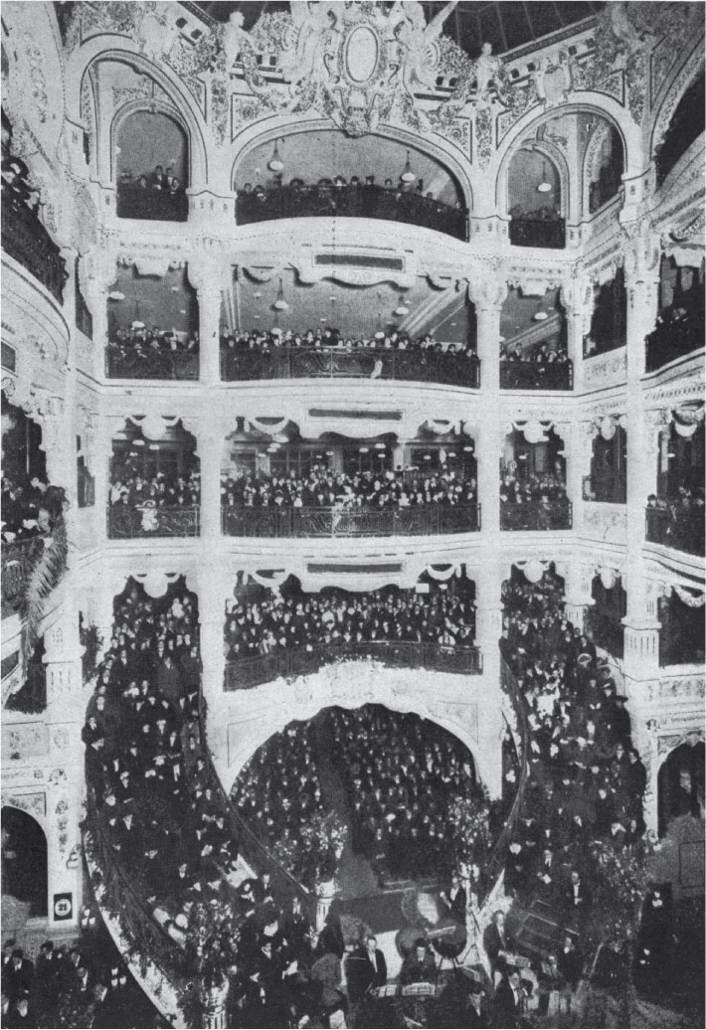
6
1

Slide 7
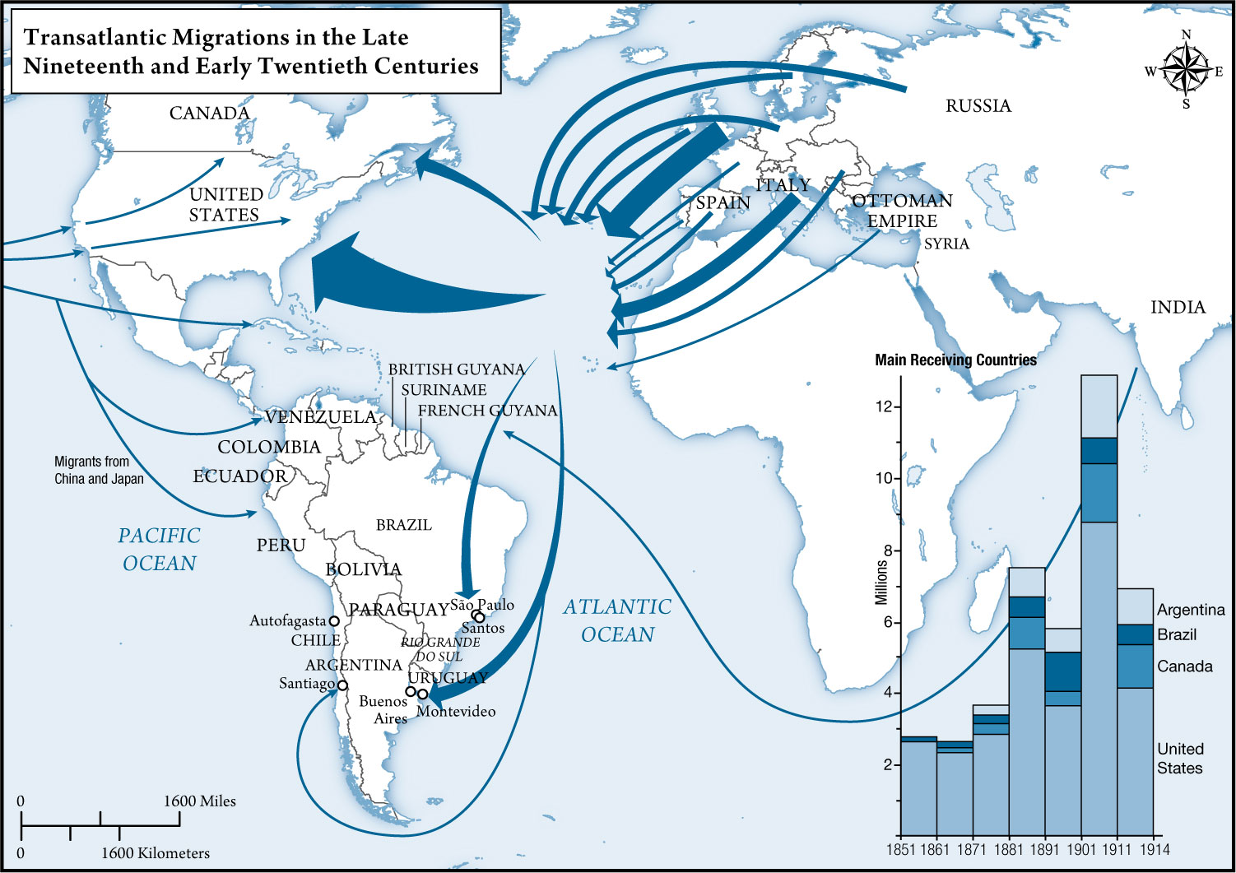
MAP 4.1

Slide 8
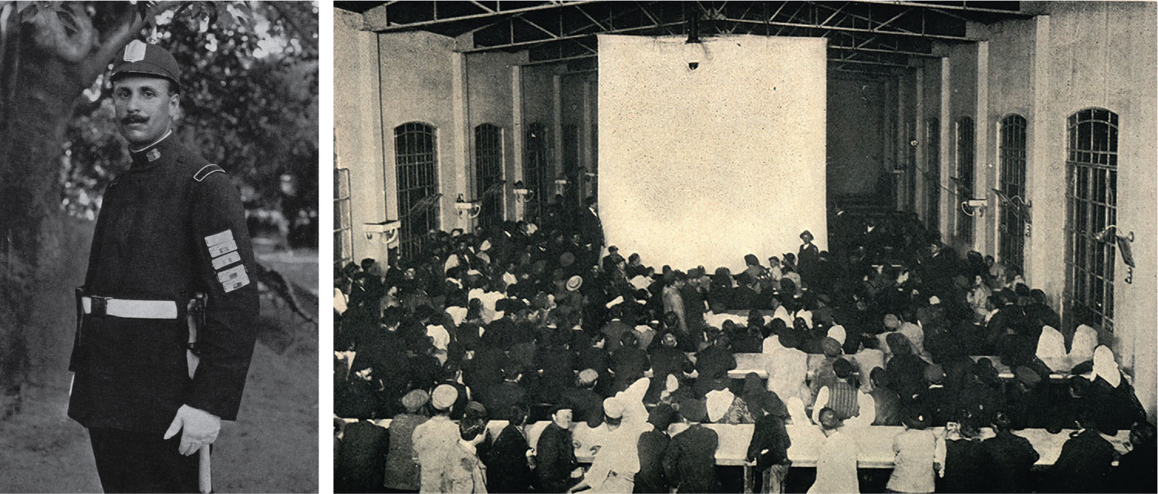
8
1

Slide 9
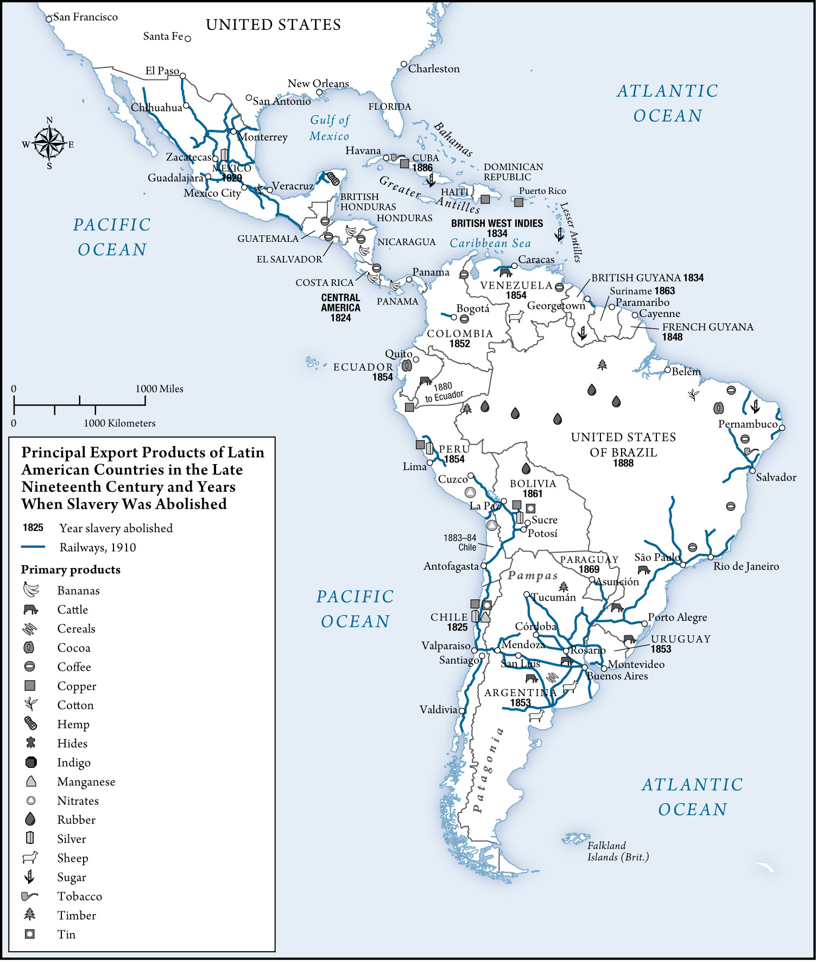
MAP 4.2

Slide 10
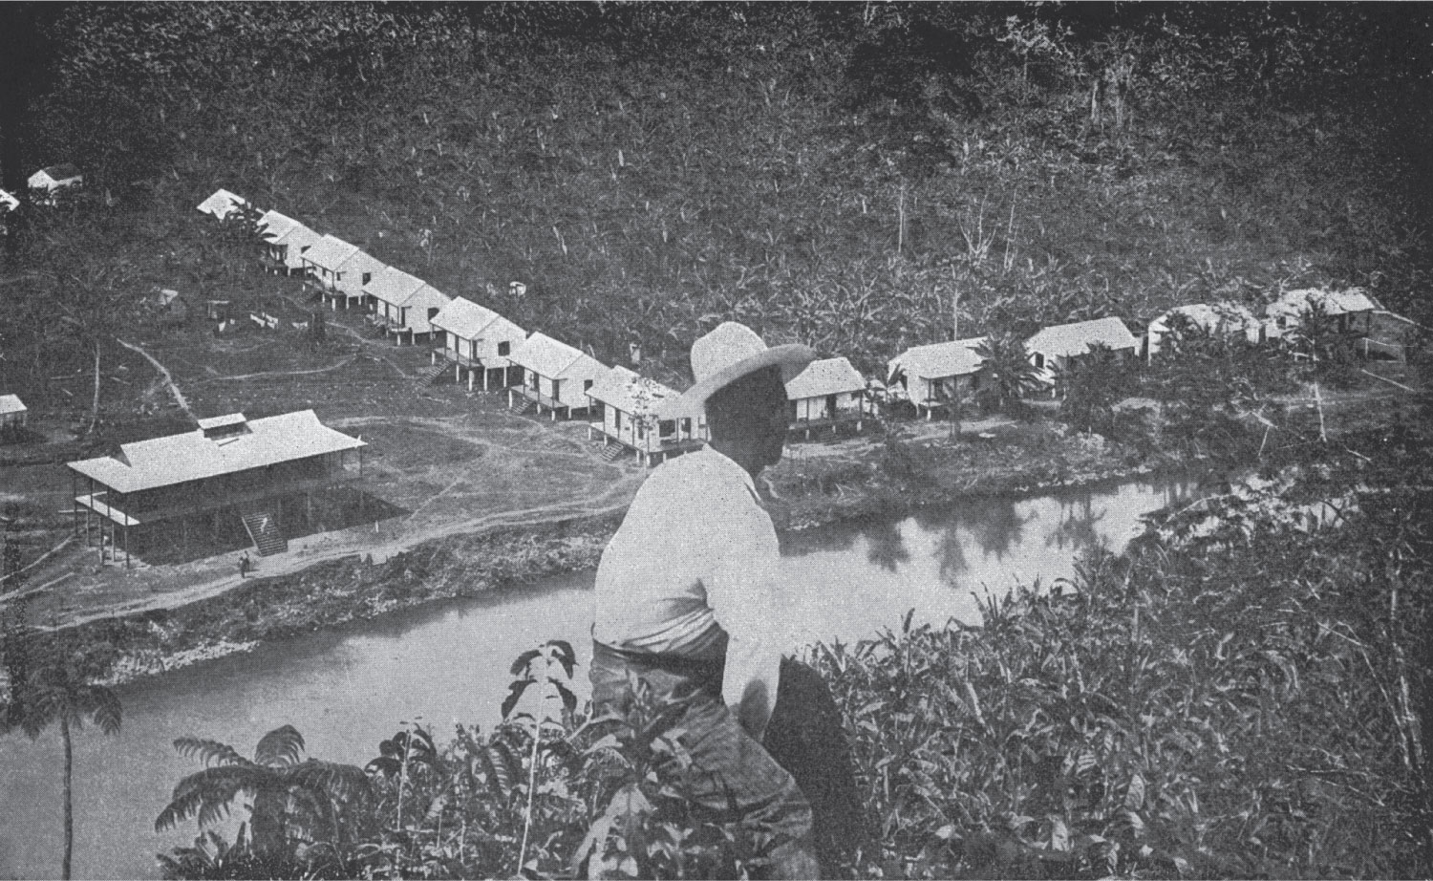
11
1

Slide 11
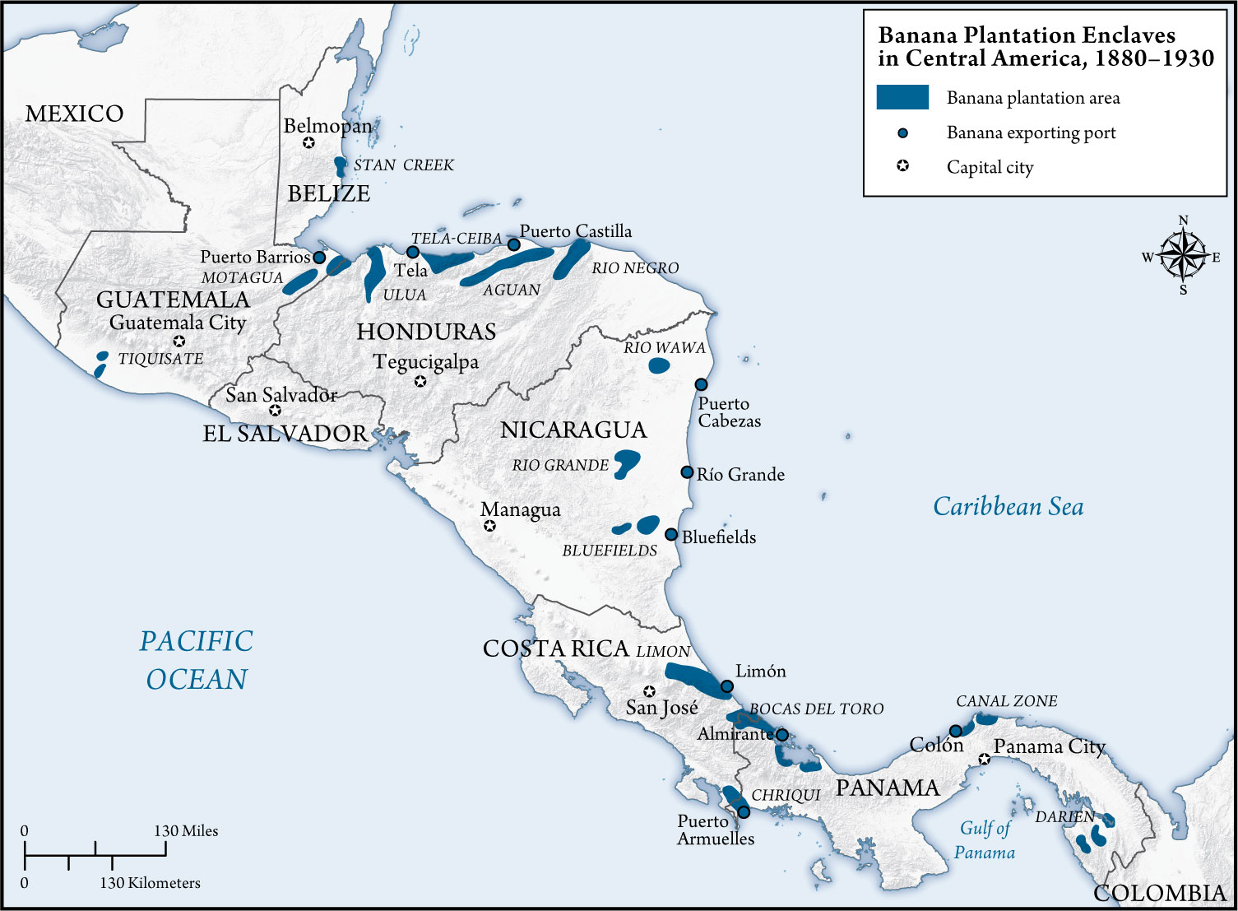
MAP 4.3

Slide 12
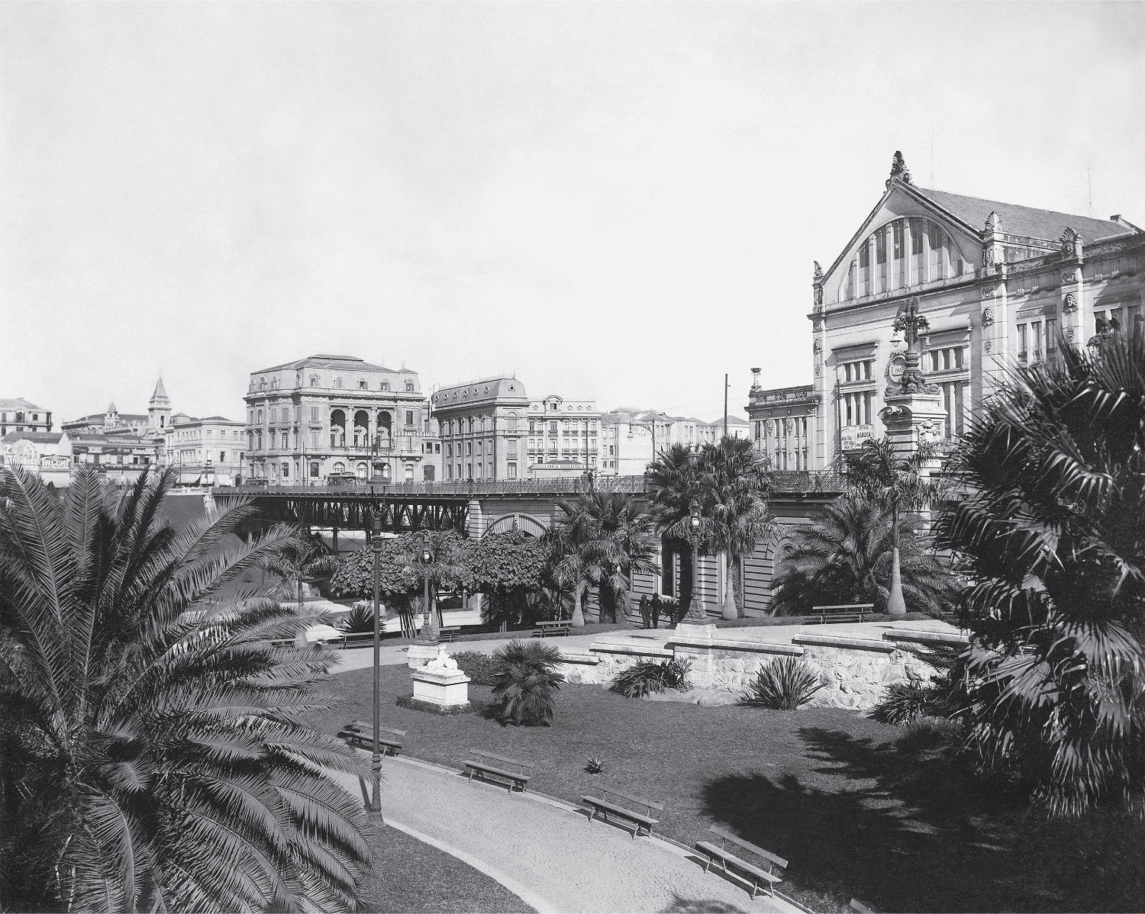
12
1

Slide 13
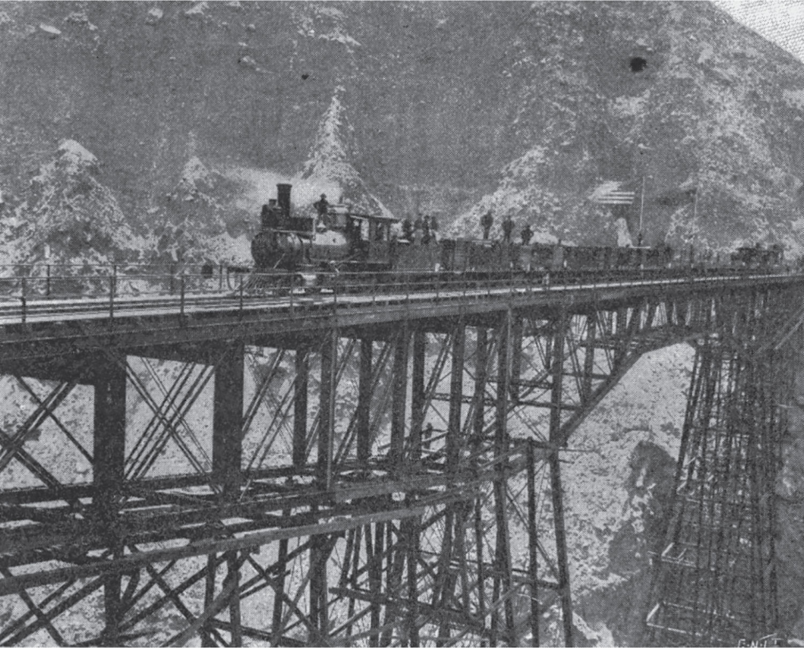
13
1

Slide 14
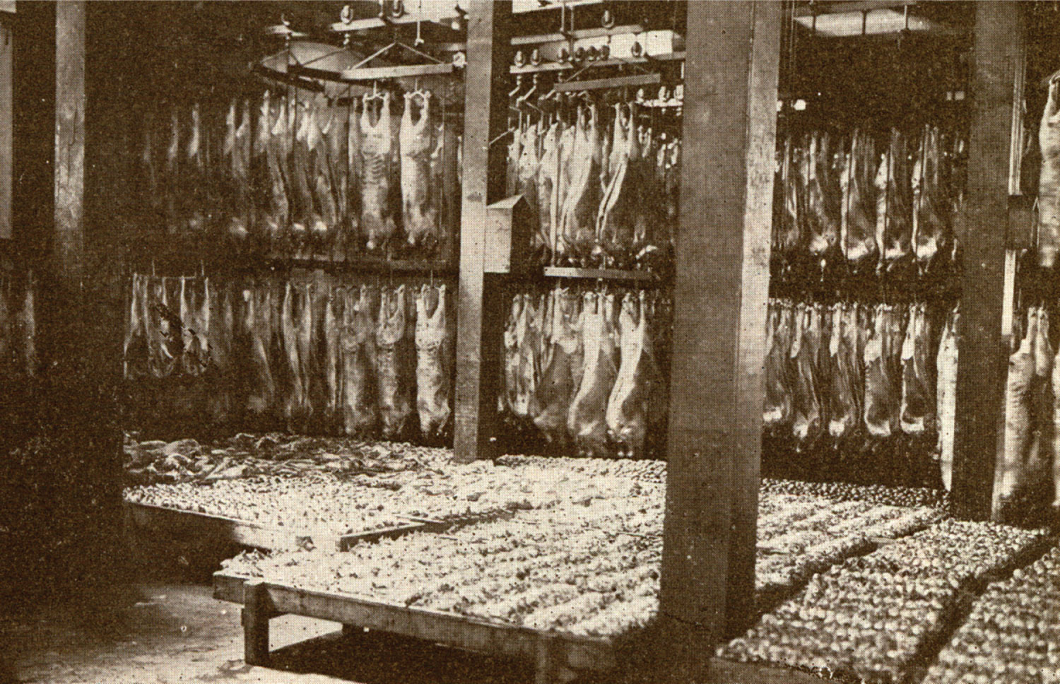
14
1

Slide 15

15
1

