Slide 1
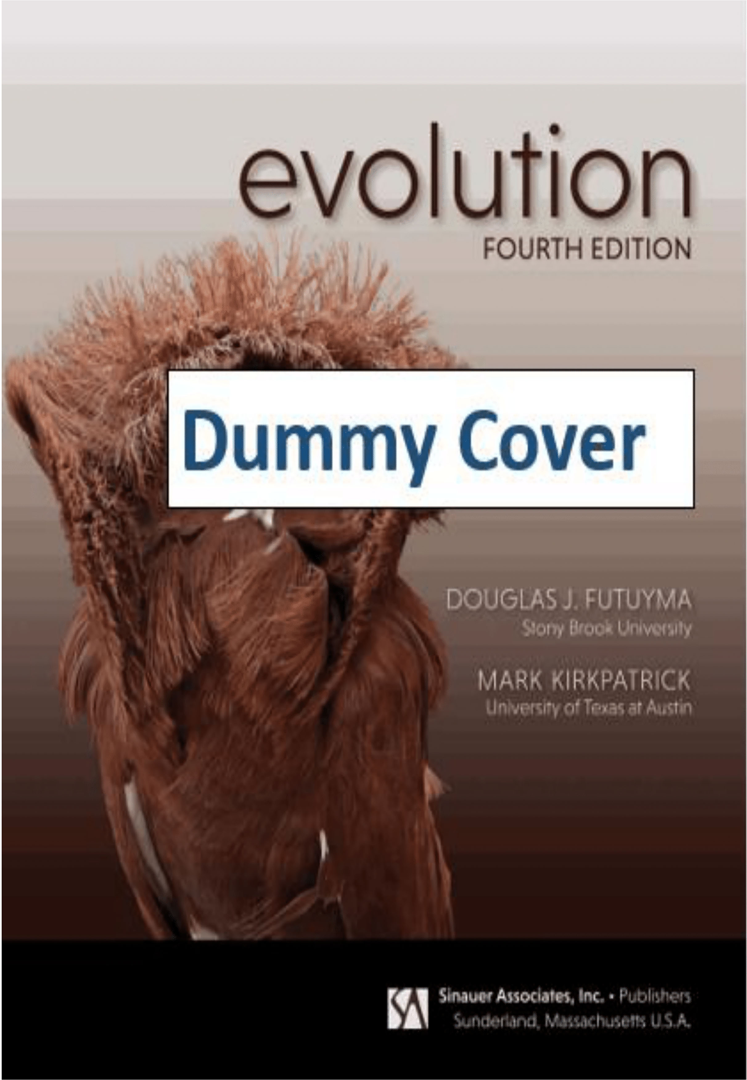
EVOLUTION
Fifth Edition
by Douglas J. Futuyma and Mark Kirkpatrick

Slide 2
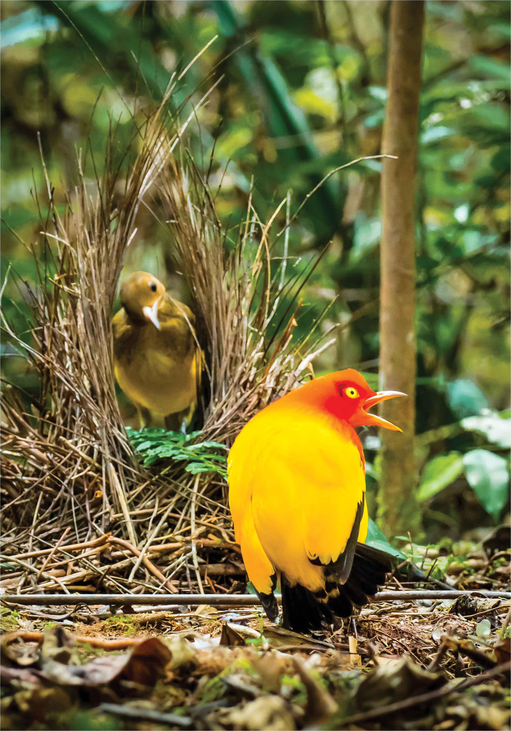
Chapter 12 Opener
Notes:
Chapter 12 Opener

Slide 3
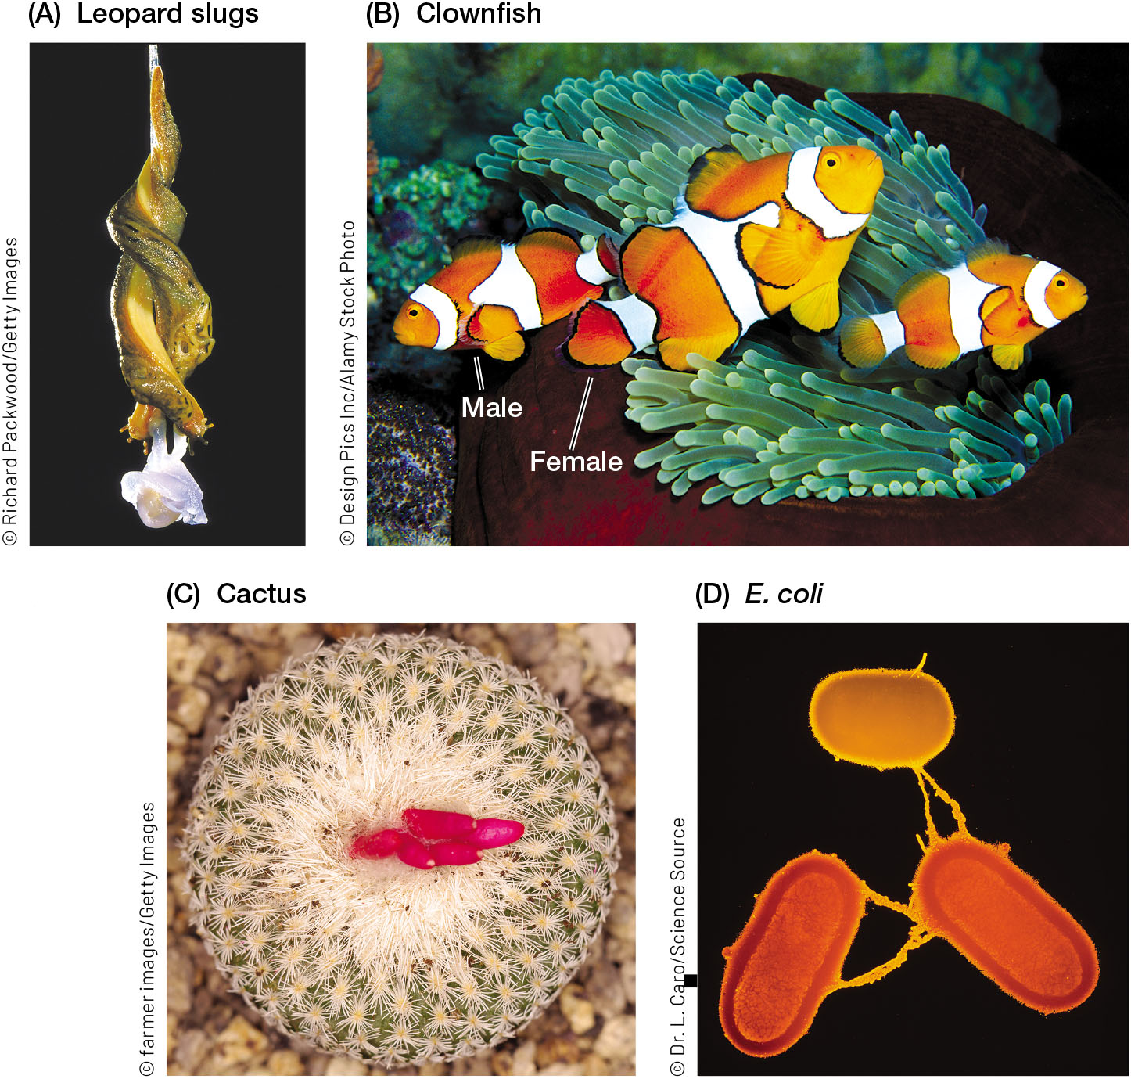
FIGURE 12.1 Sexual reproduction is remarkably diverse
Notes:
FIGURE 12.1 Sexual reproduction is remarkably diverse. (A) This pair of leopard slugs (Limax maximus) are hermaphrodites—simultaneously male and female. They are copulating while hanging from a mucus thread. (B) Clownfishes (genus Amphiprion) are sequential hermaphrodites that first mature as males and later change sex to become females. (C) The cactus Epithelantha micromeris has flowers that do not open. It is one of the few species that reproduce almost entirely by self-fertilization. (D) Bacteria, such as these E. coli, use several mechanisms to exchange DNA.

Slide 4
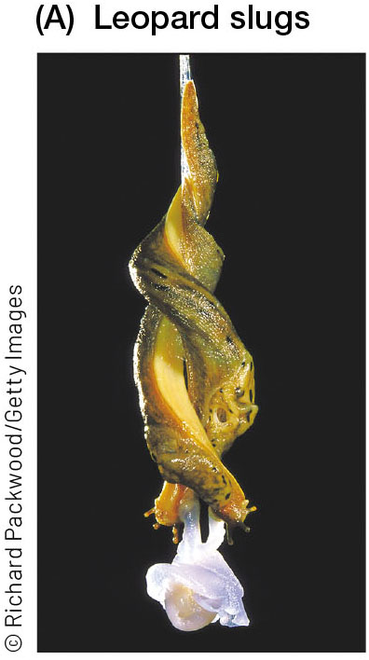
FIGURE 12.1 Sexual reproduction is remarkably diverse (1)
Notes:
FIGURE 12.1 Sexual reproduction is remarkably diverse. (A) This pair of leopard slugs (Limax maximus) are hermaphrodites—simultaneously male and female. They are copulating while hanging from a mucus thread. (B) Clownfishes (genus Amphiprion) are sequential hermaphrodites that first mature as males and later change sex to become females. (C) The cactus Epithelantha micromeris has flowers that do not open. It is one of the few species that reproduce almost entirely by self-fertilization. (D) Bacteria, such as these E. coli, use several mechanisms to exchange DNA.

Slide 5
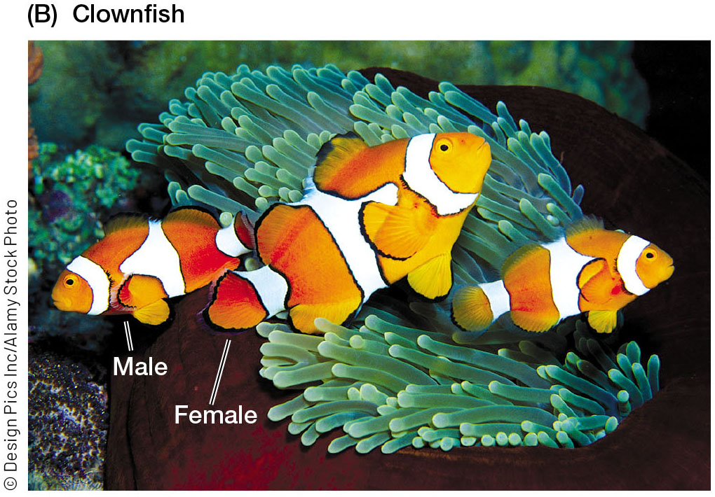
FIGURE 12.1 Sexual reproduction is remarkably diverse (2)
Notes:
FIGURE 12.1 Sexual reproduction is remarkably diverse. (A) This pair of leopard slugs (Limax maximus) are hermaphrodites—simultaneously male and female. They are copulating while hanging from a mucus thread. (B) Clownfishes (genus Amphiprion) are sequential hermaphrodites that first mature as males and later change sex to become females. (C) The cactus Epithelantha micromeris has flowers that do not open. It is one of the few species that reproduce almost entirely by self-fertilization. (D) Bacteria, such as these E. coli, use several mechanisms to exchange DNA.

Slide 6
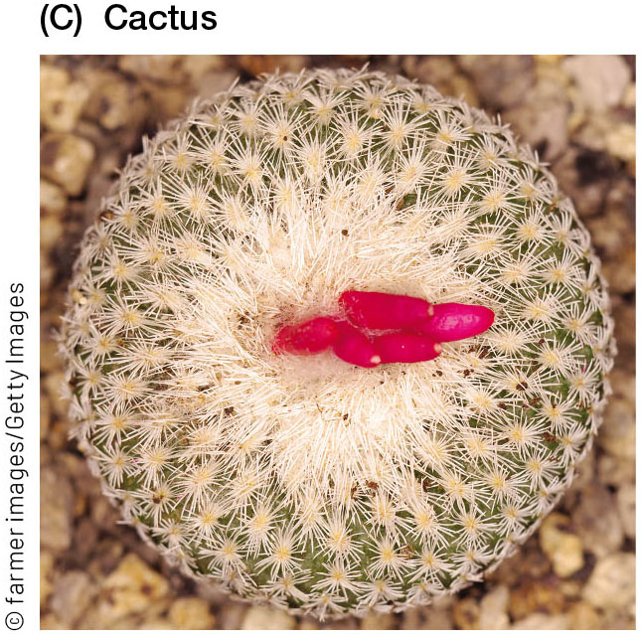
FIGURE 12.1 Sexual reproduction is remarkably diverse (3)
Notes:
FIGURE 12.1 Sexual reproduction is remarkably diverse. (A) This pair of leopard slugs (Limax maximus) are hermaphrodites—simultaneously male and female. They are copulating while hanging from a mucus thread. (B) Clownfishes (genus Amphiprion) are sequential hermaphrodites that first mature as males and later change sex to become females. (C) The cactus Epithelantha micromeris has flowers that do not open. It is one of the few species that reproduce almost entirely by self-fertilization. (D) Bacteria, such as these E. coli, use several mechanisms to exchange DNA.

Slide 7
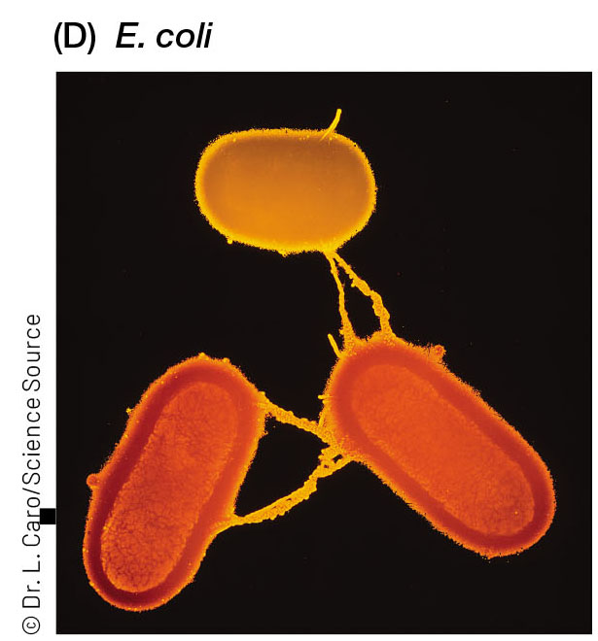
FIGURE 12.1 Sexual reproduction is remarkably diverse (4)
Notes:
FIGURE 12.1 Sexual reproduction is remarkably diverse. (A) This pair of leopard slugs (Limax maximus) are hermaphrodites—simultaneously male and female. They are copulating while hanging from a mucus thread. (B) Clownfishes (genus Amphiprion) are sequential hermaphrodites that first mature as males and later change sex to become females. (C) The cactus Epithelantha micromeris has flowers that do not open. It is one of the few species that reproduce almost entirely by self-fertilization. (D) Bacteria, such as these E. coli, use several mechanisms to exchange DNA.

Slide 8
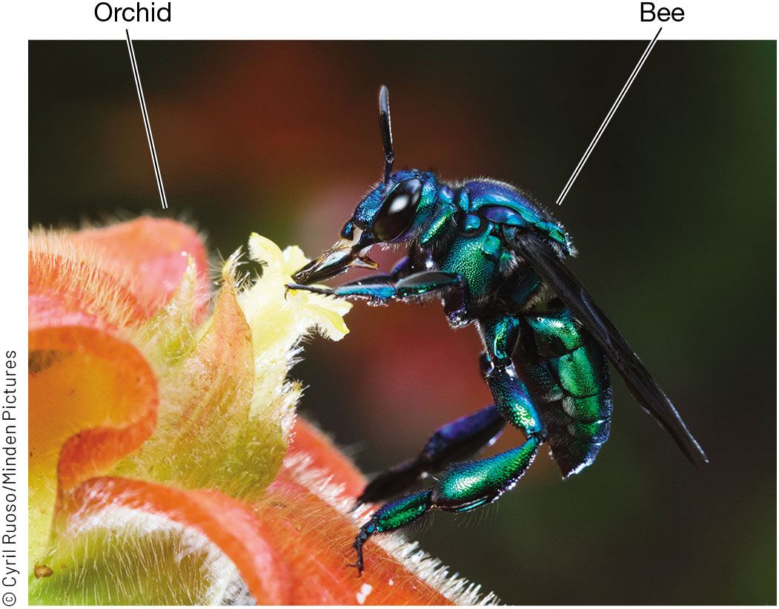
FIGURE 12.2 Many animals use sex pheromones to attract mates
Notes:
FIGURE 12.2 Many animals use sex pheromones to attract mates. In tropical America, male orchid bees collects scent from certain flowers and use it as their sex pheromone. Here a brilliantly colored Euglossa imperialis collects scent from an orchid flower in Costa Rica.

Slide 9
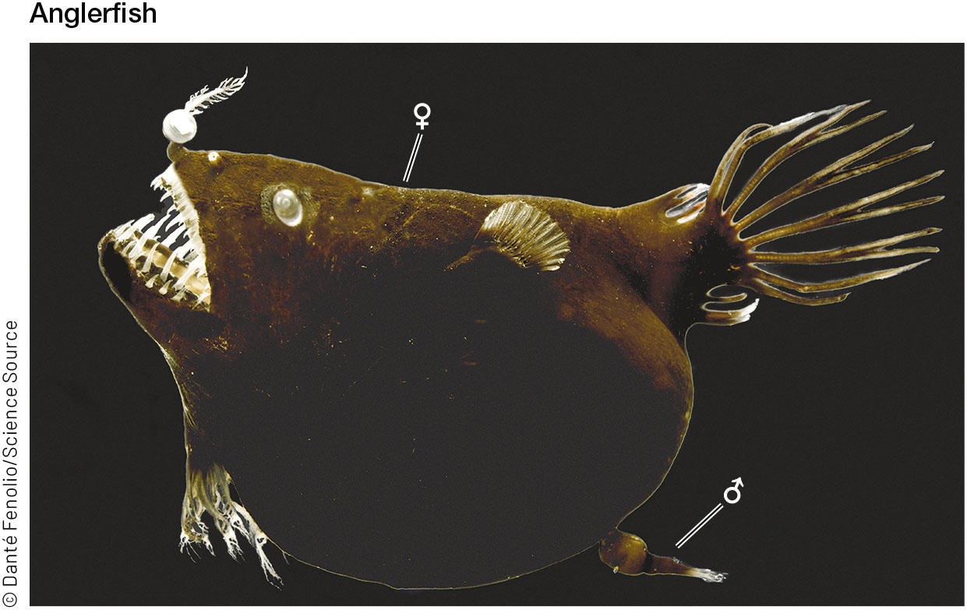
FIGURE 12.3 Anglerfishes (suborder Ceratioidei) have extreme sexual dimorphism
Notes:
FIGURE 12.3 Anglerfishes (suborder Ceratioidei) have extreme sexual dimorphism. This female has a male attached to her.

Slide 10
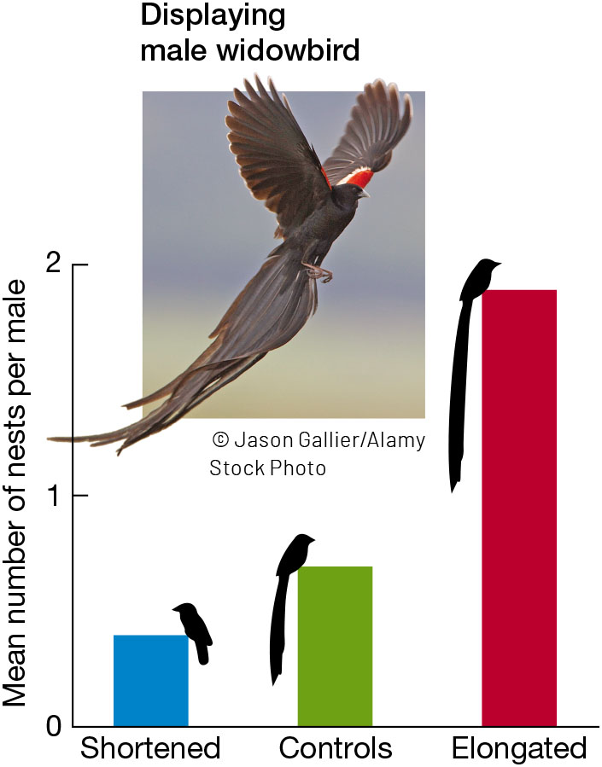
FIGURE 12.4 An experimental test of Darwin’s hypothesis that secondary sexual traits increase mating success
Notes:
FIGURE 12.4 An experimental test of Darwin’s hypothesis that secondary sexual traits increase mating success. Male long-tailed widowbirds (Euplectes progne) with experimentally elongated feathers are more attractive to females. (After M. Andersson. 1982. Nature 299: 818–820.)

Slide 11
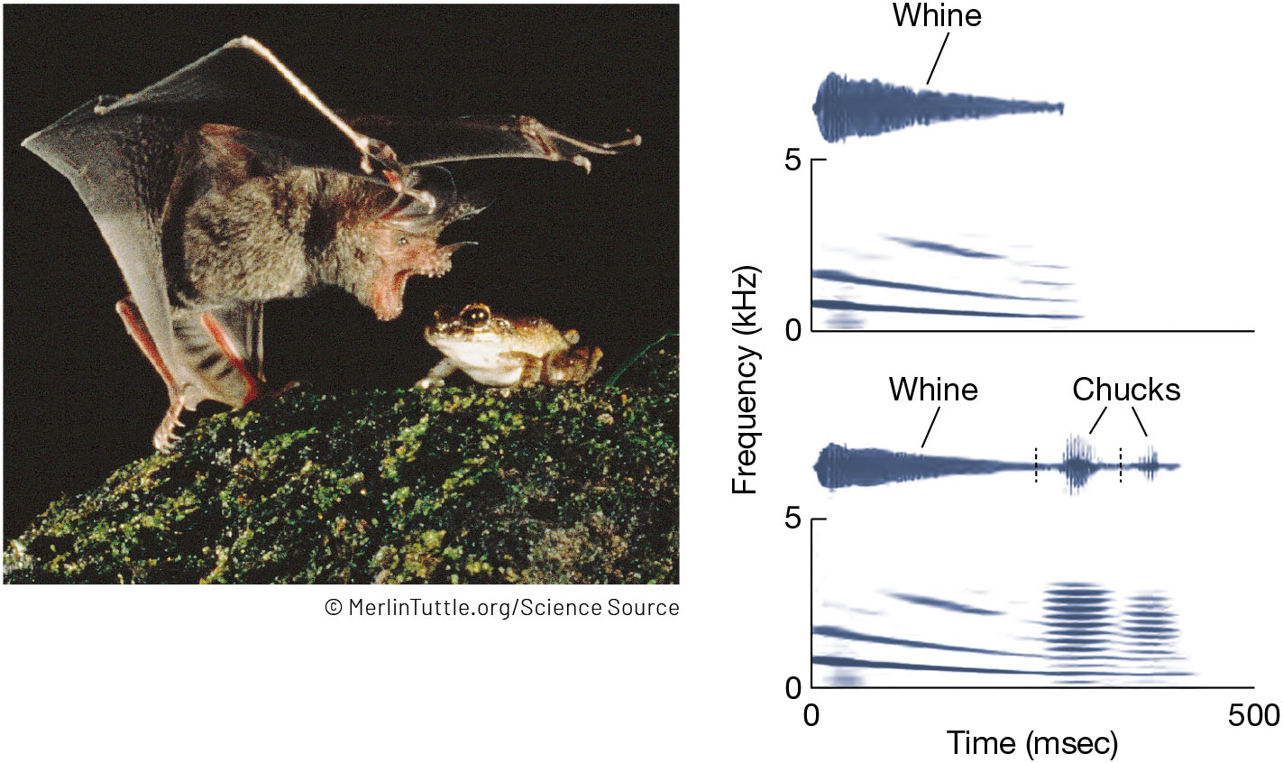
FIGURE 12.5 Calls of the male túngara frog (Physalaemus pustulosus) attract females for mating, but they also attract bat predators
Notes:
FIGURE 12.5 Calls of the male túngara frog (Physalaemus pustulosus) attract females for mating, but they also attract bat predators. (Left) A male is attacked by a fringe-lipped bat (Trachops cirrhosus) that has located the frog by his calls. (Right) Sonograms of male calls that plot frequency through time. (Sonograms from R. A. Page et al. 2014. In K. Yasukawa [ed.], Animal Behavior, vol. 3, pp. 123–154. New York: Praeger.)

Slide 12
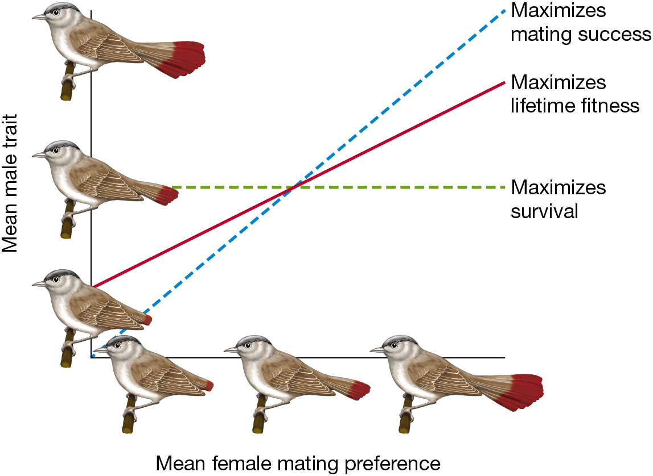
FIGURE 12.6 Selection favors mating displays that maximize a male’s lifetime fitness, which is a compromise between the optimum for survival and the optimum for mating success
Notes:
FIGURE 12.6 Selection favors mating displays that maximize a male’s lifetime fitness, which is a compromise between the optimum for survival and the optimum for mating success. In this schematic, male survival is maximized by a tail of intermediate length that optimizes aerodynamics. Male mating success depends on the mean female mating preference (on the x-axis). If most females prefer long tails, then males with long tails will have the greatest mating success. Tails will evolve to an equilibrium that is longer than what maximizes survival. If females prefer very short tails (at left), tails will evolve to a length shorter than what maximizes survival. (After M. Kirkpatrick and M. J. Ryan. 1991. Nature 350: 33–38.)

Slide 13
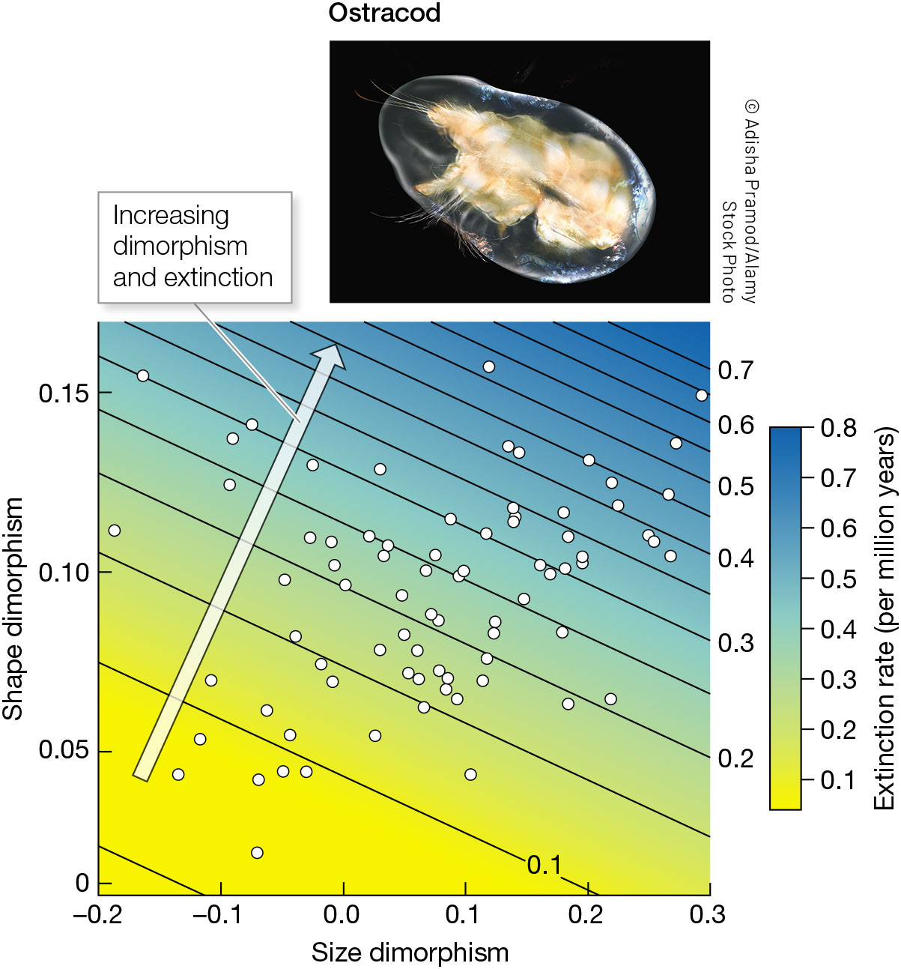
FIGURE 12.7 The fossil ostracods from between 100 and 66 Ma show that species that were most sexually dimorphic had high extinction rates
Notes:
FIGURE 12.7 The fossil ostracods from between 100 and 66 Ma show that species that were most sexually dimorphic had high extinction rates. (Graph after M. J. F. Martins et al. 2018. Nature 556: 366–369.)

Slide 14
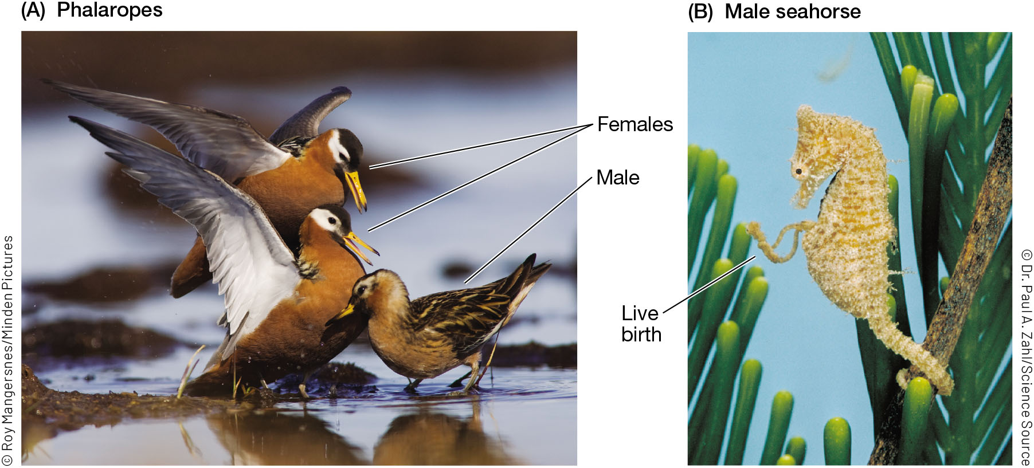
FIGURE 12.8 Sex role reversal
Notes:
FIGURE 12.8 Sex role reversal. (A) Two female red phalaropes (Phalaropus fulicarius) fight to mate with the smaller, duller male. (B) A male Australian seahorse (Hippocampus breviceps) giving birth from his pouch.

Slide 15
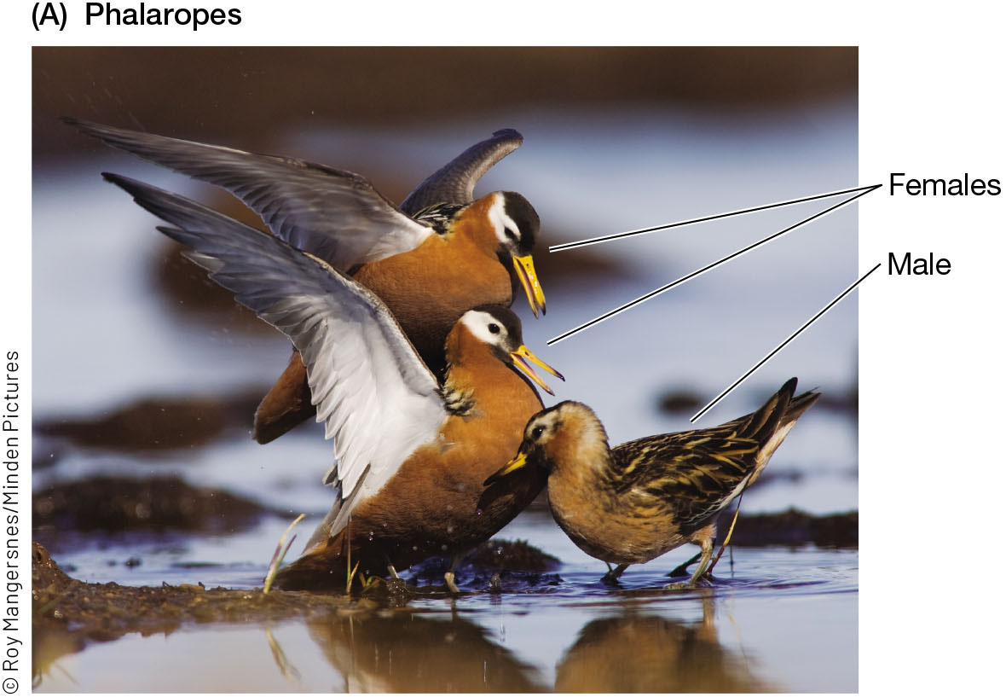
FIGURE 12.8 Sex role reversal (1)
Notes:
FIGURE 12.8 Sex role reversal. (A) Two female red phalaropes (Phalaropus fulicarius) fight to mate with the smaller, duller male. (B) A male Australian seahorse (Hippocampus breviceps) giving birth from his pouch.

Slide 16
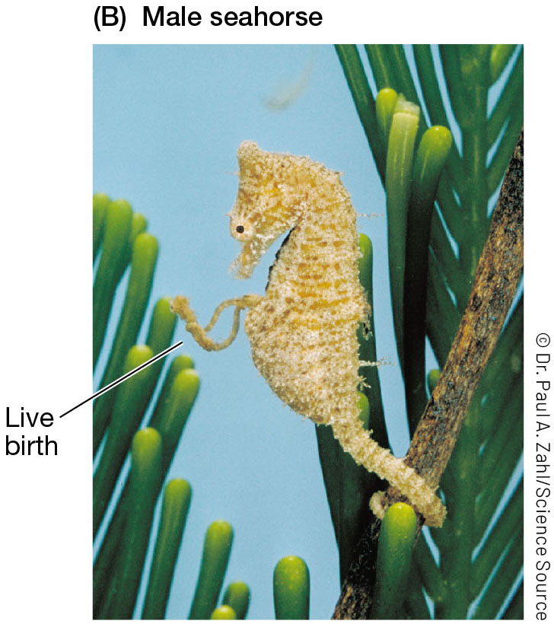
FIGURE 12.8 Sex role reversal (2)
Notes:
FIGURE 12.8 Sex role reversal. (A) Two female red phalaropes (Phalaropus fulicarius) fight to mate with the smaller, duller male. (B) A male Australian seahorse (Hippocampus breviceps) giving birth from his pouch.

Slide 17
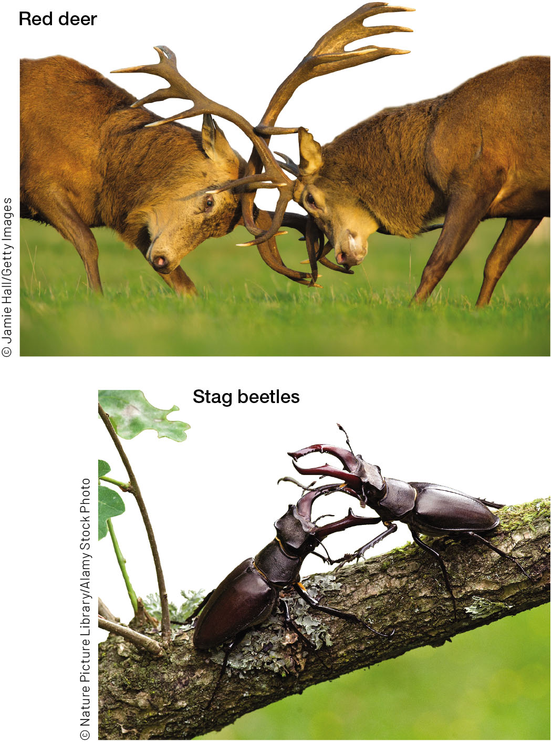
FIGURE 12.9 Males of many animals have evolved weapons that they use to fight with for reproductive access to females
Notes:
FIGURE 12.9 Males of many animals have evolved weapons that they use to fight with for reproductive access to females. Male red deer (Cervus elaphus) fight during the breeding season. Male stag beetles (Lucanus cervus) fight to defend the sites where females will lay their eggs after they mate.

Slide 18
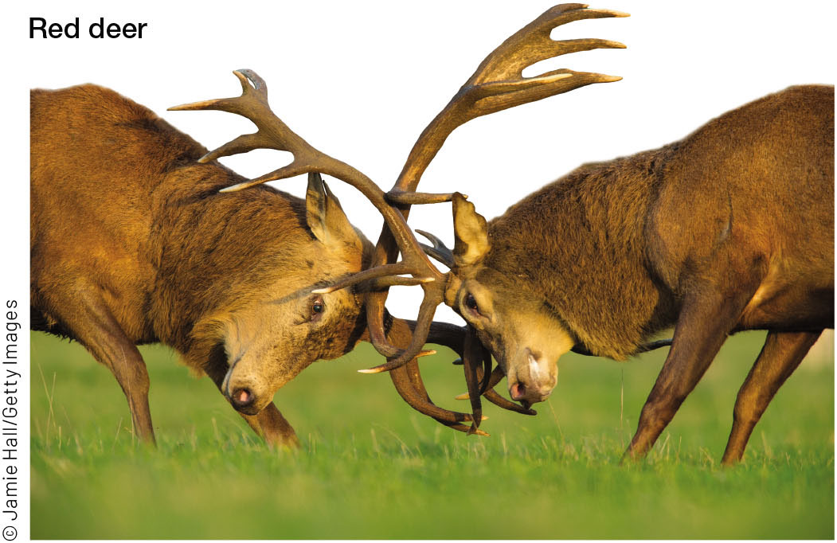
FIGURE 12.9 Males of many animals have evolved weapons that they use to fight with for reproductive access to females (1)
Notes:
FIGURE 12.9 Males of many animals have evolved weapons that they use to fight with for reproductive access to females. Male red deer (Cervus elaphus) fight during the breeding season. Male stag beetles (Lucanus cervus) fight to defend the sites where females will lay their eggs after they mate.

Slide 19
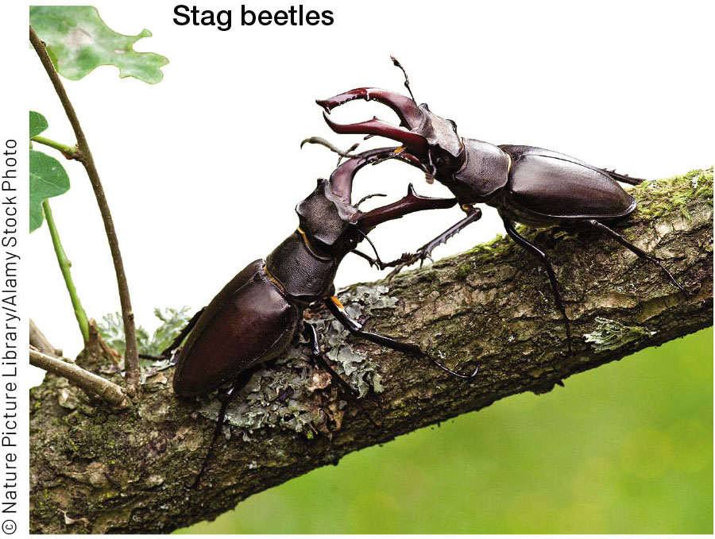
FIGURE 12.9 Males of many animals have evolved weapons that they use to fight with for reproductive access to females (2)
Notes:
FIGURE 12.9 Males of many animals have evolved weapons that they use to fight with for reproductive access to females. Male red deer (Cervus elaphus) fight during the breeding season. Male stag beetles (Lucanus cervus) fight to defend the sites where females will lay their eggs after they mate.

Slide 20
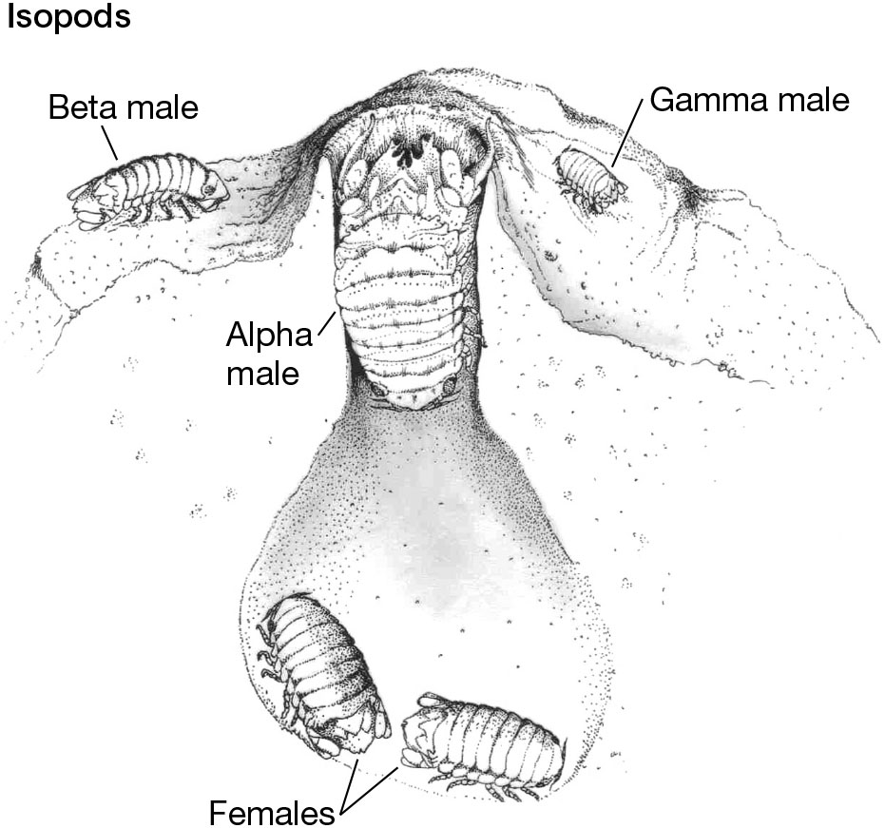
FIGURE 12.10 Isopods (Paracerceis sculpta) have three male morphs that use different behaviors to mate with females
Notes:
FIGURE 12.10 Isopods (Paracerceis sculpta) have three male morphs that use different behaviors to mate with females. (From S. M. Shuster and M. J. Wade. 1991. Nature 350: 608–610, illustration by Marco Leon.)

Slide 21
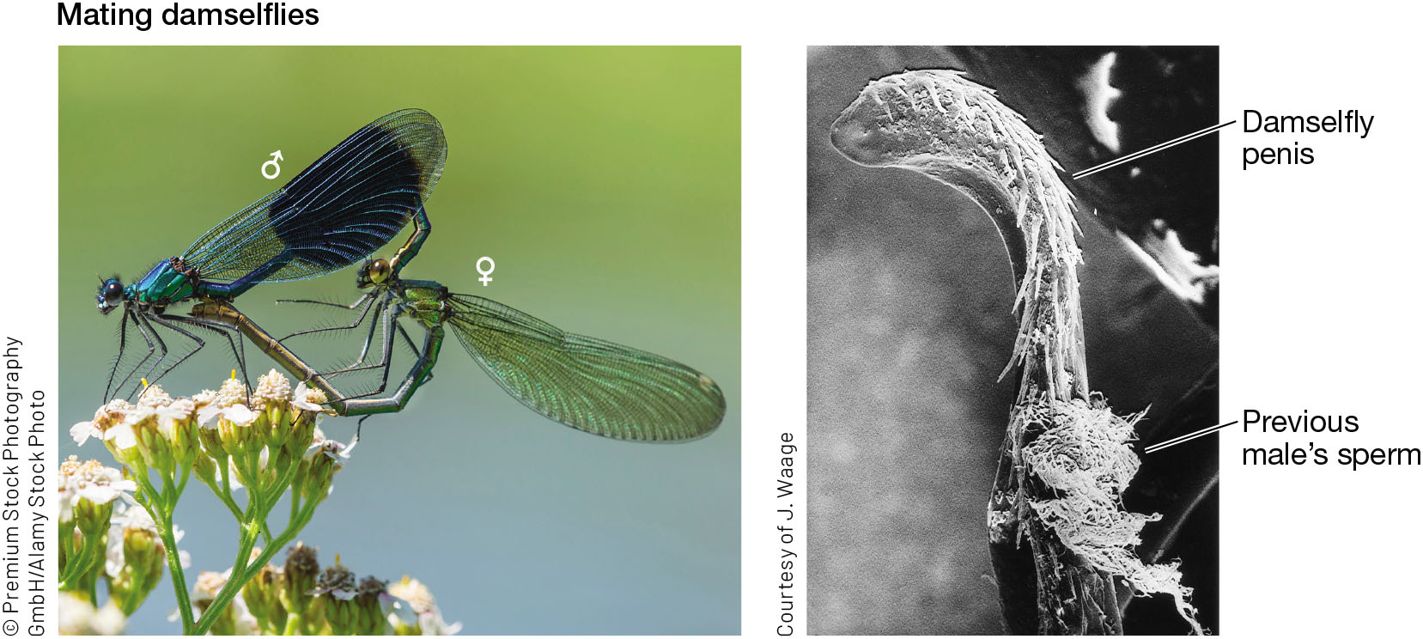
FIGURE 12.11 A male damselfly removes the sperm of a female’s previous mates before depositing his own
Notes:
FIGURE 12.11 A male damselfly removes the sperm of a female’s previous mates before depositing his own. A scoop-like structure on the male’s penis removes the sperm of males that copulated with the female earlier.

Slide 22
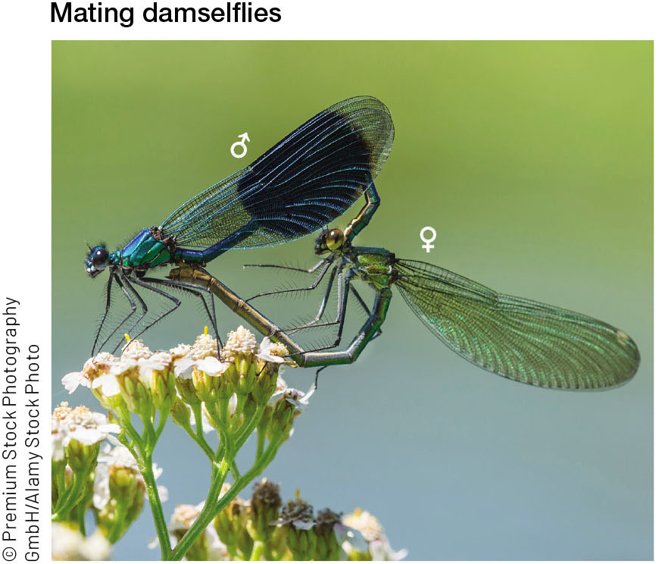
FIGURE 12.11 A male damselfly removes the sperm of a female’s previous mates before depositing his own (1)
Notes:
FIGURE 12.11 A male damselfly removes the sperm of a female’s previous mates before depositing his own. A scoop-like structure on the male’s penis removes the sperm of males that copulated with the female earlier.

Slide 23
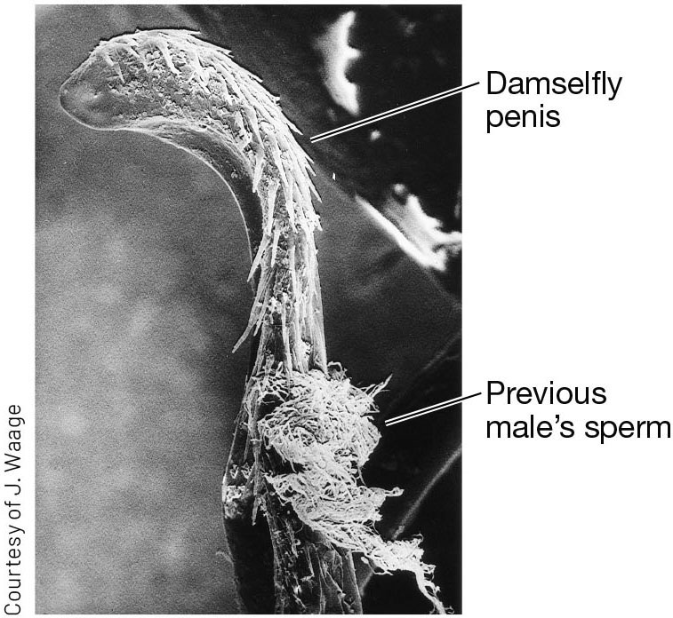
FIGURE 12.11 A male damselfly removes the sperm of a female’s previous mates before depositing his own (2)
Notes:
FIGURE 12.11 A male damselfly removes the sperm of a female’s previous mates before depositing his own. A scoop-like structure on the male’s penis removes the sperm of males that copulated with the female earlier.

Slide 24
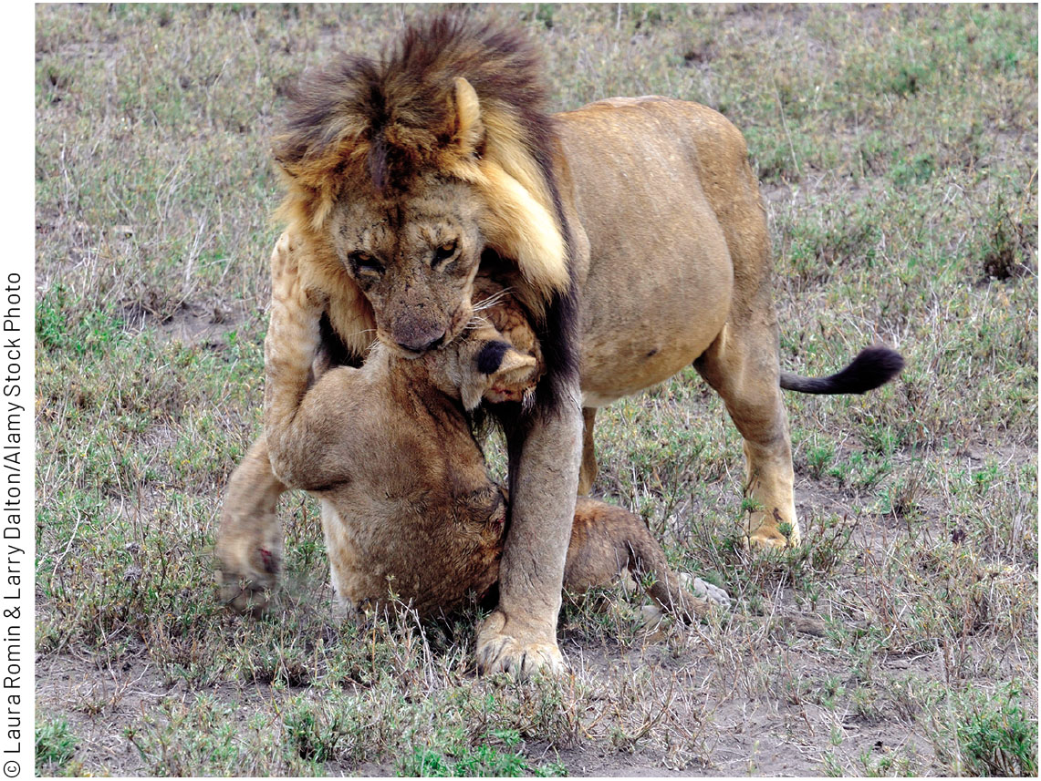
FIGURE 12.12 This male lion has just killed a cub
Notes:
FIGURE 12.12 This male lion has just killed a cub. Infanticide also occurs in many other species of mammals.

Slide 25
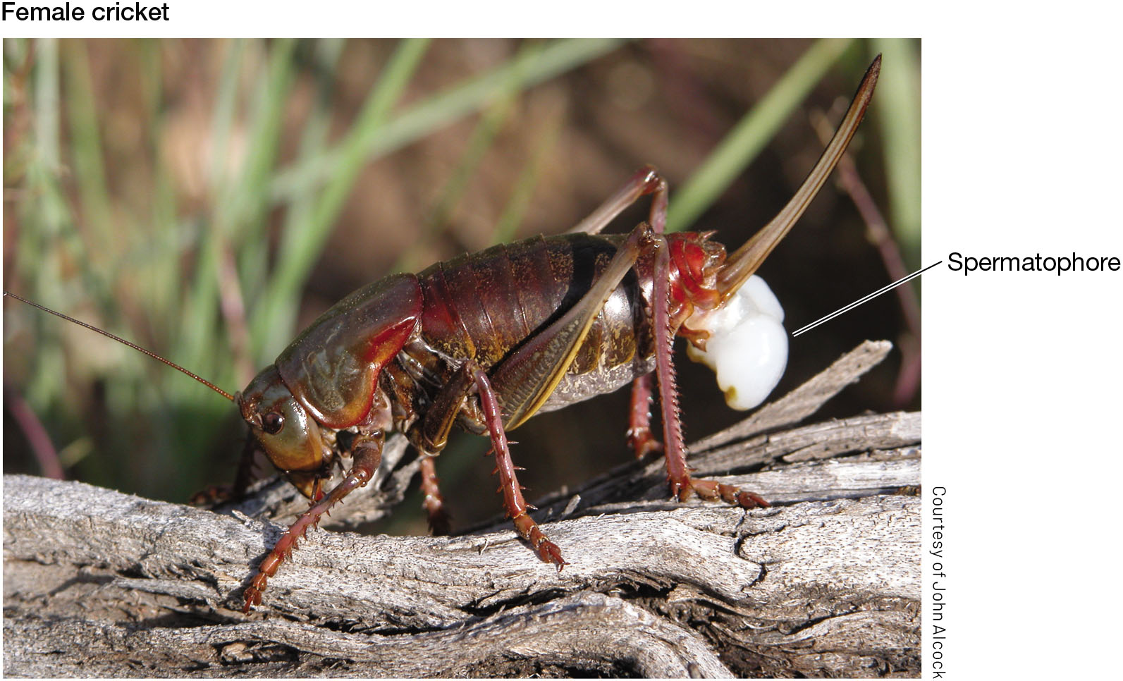
FIGURE 12.13 Males of some species provide direct benefits to females
Notes:
FIGURE 12.13 Males of some species provide direct benefits to females. This female Mormon cricket (Anabrus simplex) will eat the large white spermatophore her mate has placed in her genital opening.

Slide 26
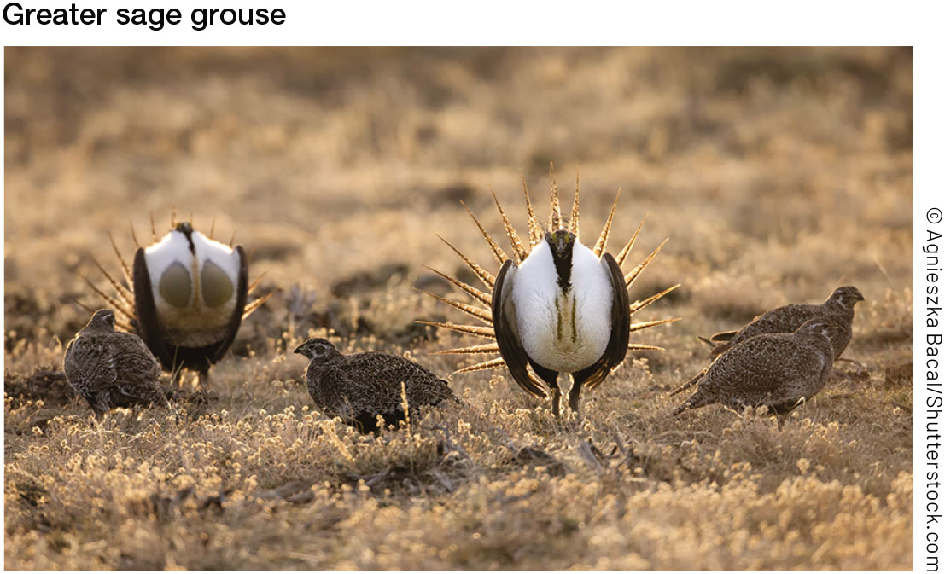
FIGURE 12.14 Males of the greater sage grouse perform mating displays together on a lek
Notes:
FIGURE 12.14 Males of the greater sage grouse perform mating displays together on a lek.

Slide 27
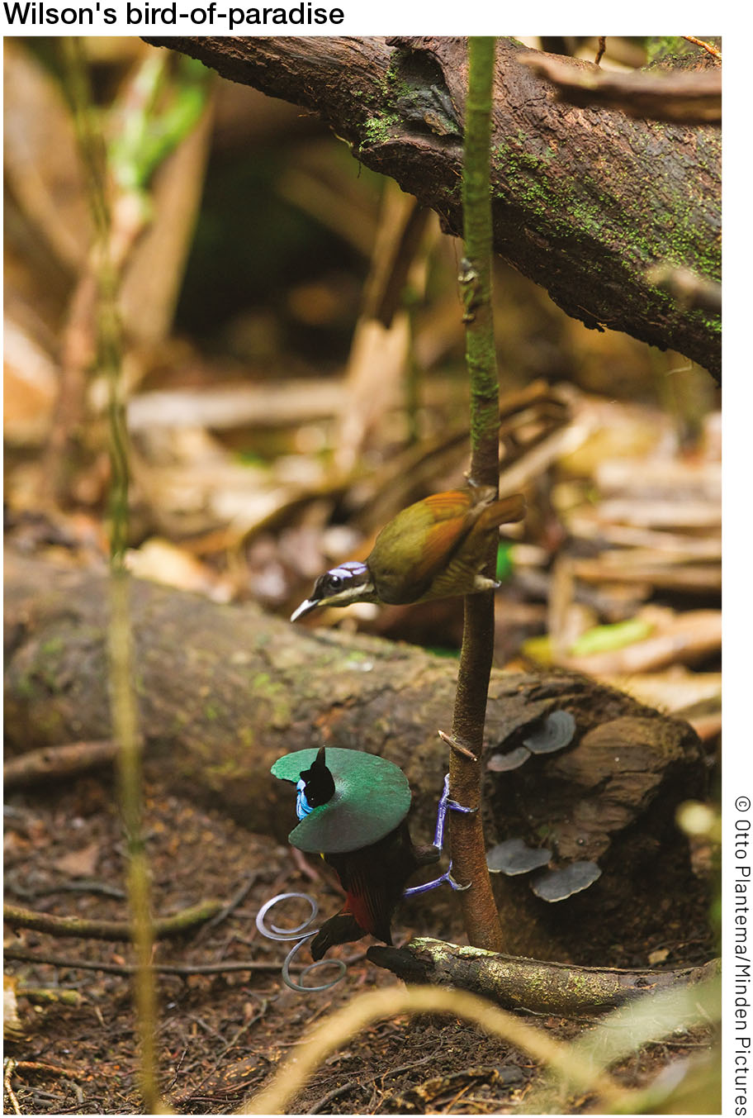
FIGURE 12.15 A male Wilson’s bird-of-paradise (Cicinnurus respublica) displays to a female
Notes:
FIGURE 12.15 A male Wilson’s bird-of-paradise (Cicinnurus respublica) displays to a female.

Slide 28
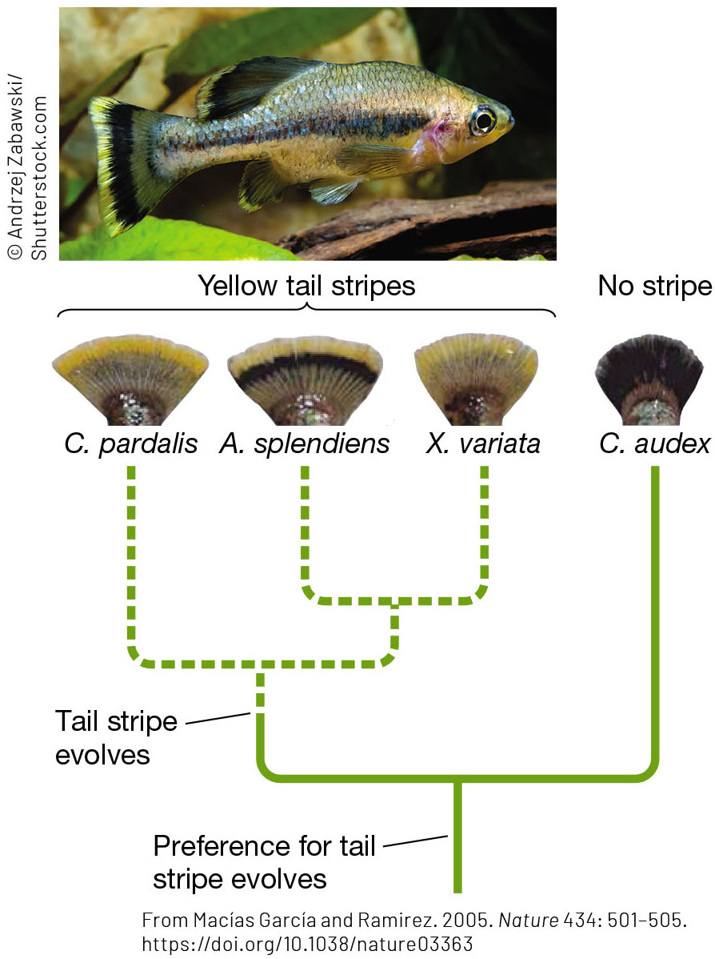
FIGURE 12.16 A female mating preference in splitfin fishes (family Goodeidae) originally evolved to attract both sexes toward prey
Notes:
FIGURE 12.16 A female mating preference in splitfin fishes (family Goodeidae) originally evolved to attract both sexes toward prey. The males of several species have yellow tail stripes that are attractive to females of their own species and also of a stripeless species. This shows the female preference evolved before the stripe did. Both males and females mistake the tail stripe for prey (such as damselfly larvae) and try to bite it. Males mate with females when they approach the tail stripe, mistaking it for food.

Slide 29
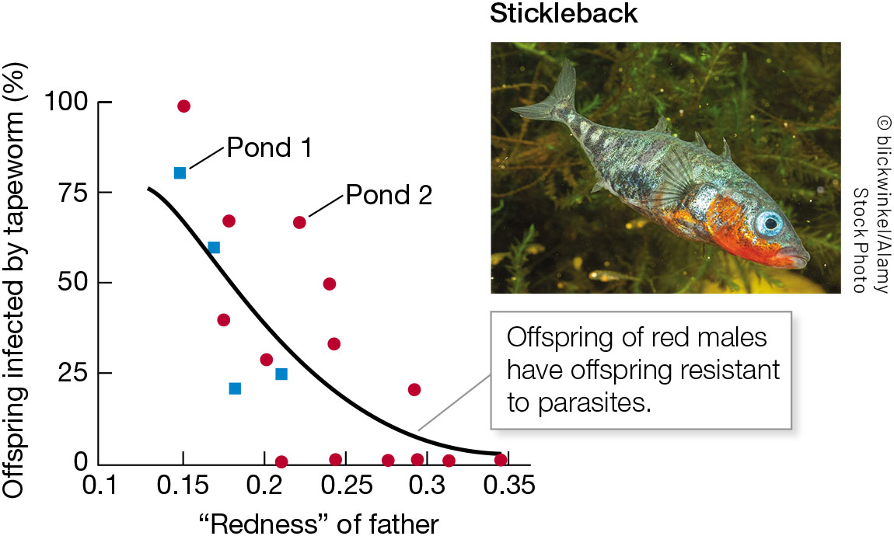
FIGURE 12.17 Experimental evidence for the good genes mechanism
Notes:
FIGURE 12.17 Experimental evidence for the good genes mechanism. Males of the three-spined stickleback (Gasterosteus aculeatus) that were more red had offspring that were infected less often when exposed to tapeworms. (After I. Barber et al. 2001. Proc R Soc London B 268: 71–76.)

Slide 30
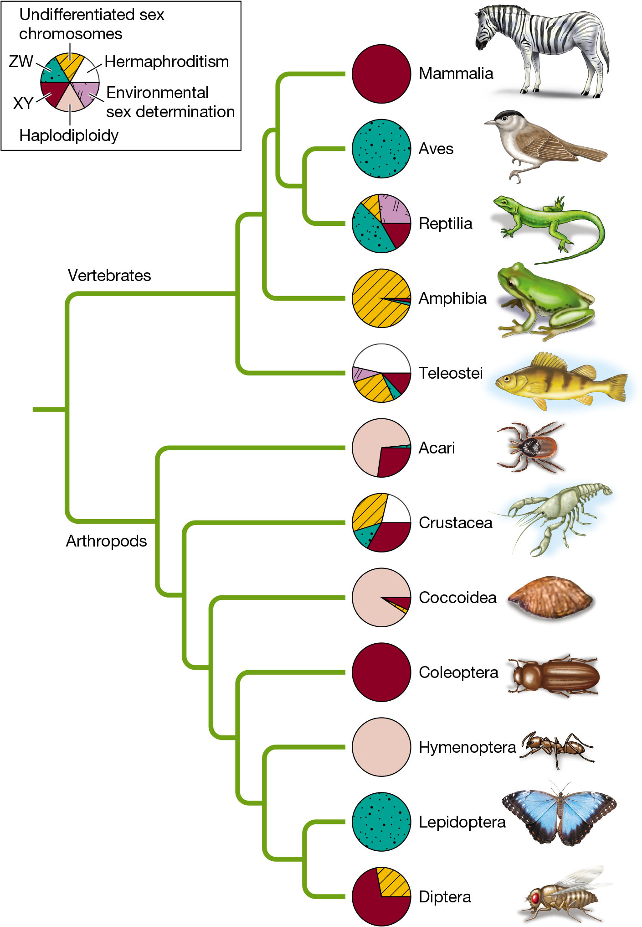
FIGURE 12.18 Animals have diverse mechanisms that determine an individual’s sex
Notes:
FIGURE 12.18 Animals have diverse mechanisms that determine an individual’s sex. X and Y sex chromosomes are found in all mammals, but they are not very common among other vertebrates. The most common sexual system in teleost fishes is hermaphroditism. Birds and butterflies have Z and W sex chromosomes. All Hymenoptera (ants, bees, wasps, and their relatives) determine sex by haplodiploidy. (After D. Bachtrog et al. 2014. PLOS Biol 12: e1001899.)

Slide 31
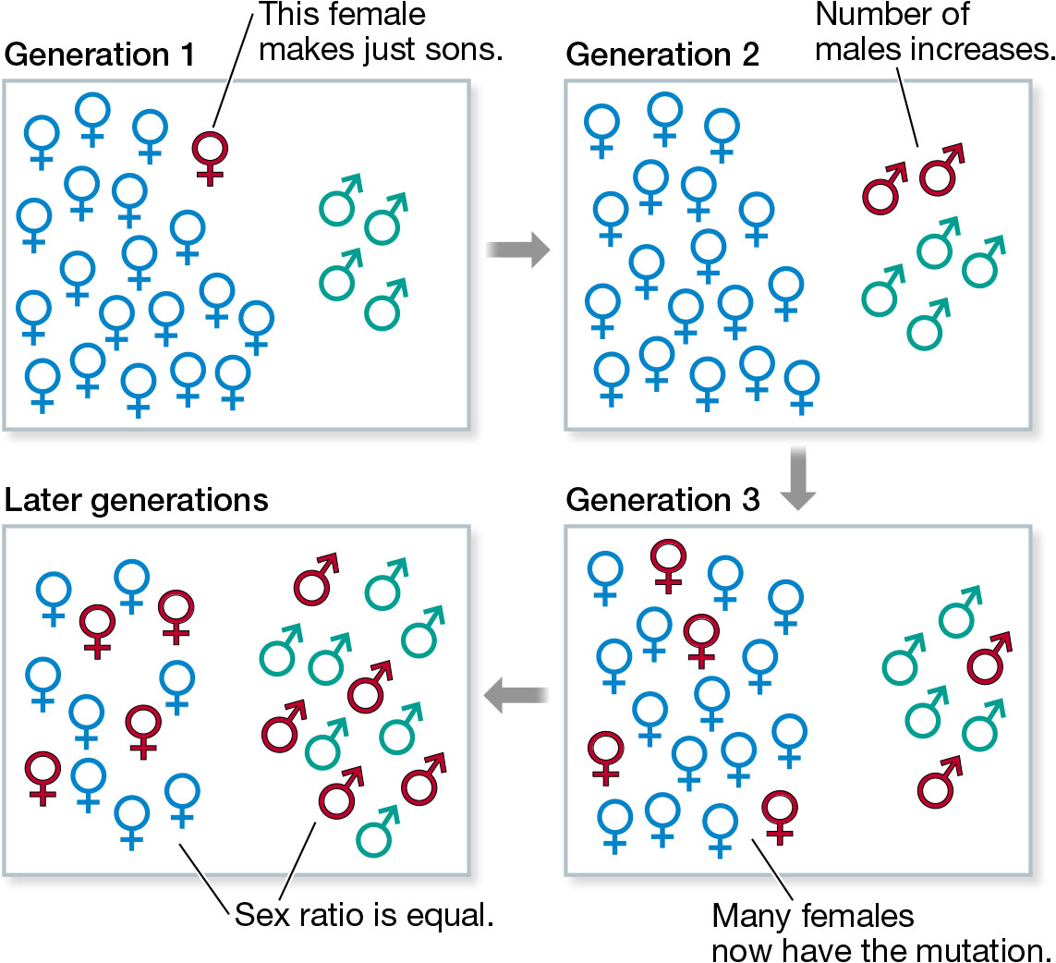
FIGURE 12.19 Selection usually favors a sex ratio with nearly equal numbers of males and females
Notes:
FIGURE 12.19 Selection usually favors a sex ratio with nearly equal numbers of males and females. Here, females initially produce more daughters than sons, so the sex ratio is biased towards females. (Generation 1) A mutation occurs in one female that causes her to produce only sons. (Generation 2) The mutation is now carried by her two sons. They make up one-third of all males, so one-third of the next generation will be their children. (Generation 3) The number of females with the mutation increases. (Later generations) The mutation spreads until there are equal numbers of males and females.

Slide 32
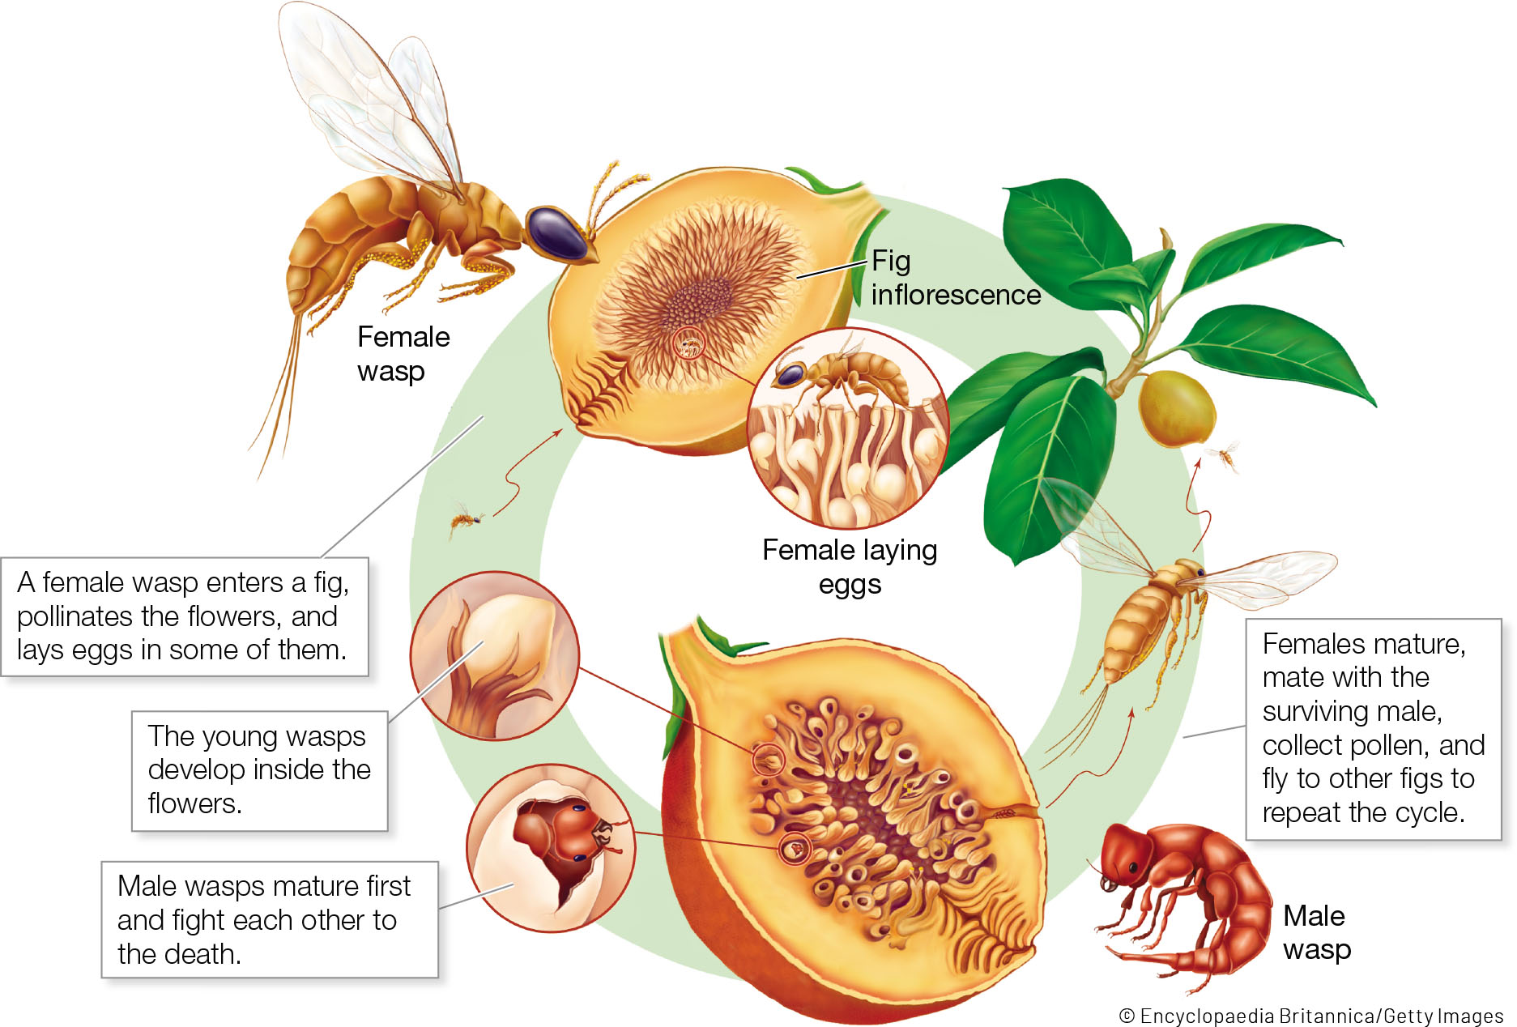
FIGURE 12.20 The fig wasp Tetrapus costaricensis is highly sexually dimorphic
Notes:
FIGURE 12.20 The fig wasp Tetrapus costaricensis is highly sexually dimorphic. Females lay their eggs inside a fig. When the offspring hatch, the males fight each other, and the winner then mates with the females inside the fig—many or all of which are his sisters. Only females disperse, so families that have many more daughters than sons are most successful.

Slide 33
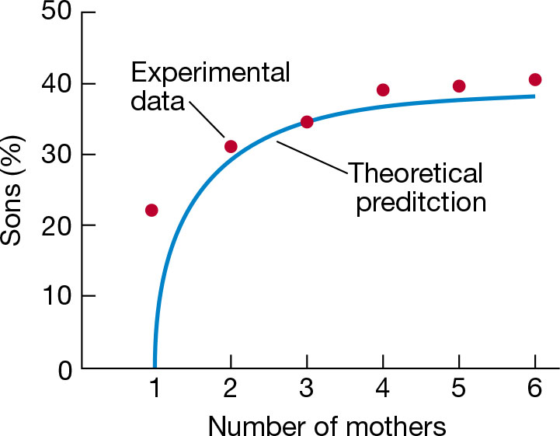
FIGURE 12.21 The sex ratio among the offspring of fig wasps agrees well with the prediction of a mathematical model
Notes:
FIGURE 12.21 The sex ratio among the offspring of fig wasps agrees well with the prediction of a mathematical model. (After E. A. Herre. 1985. Science 228: 896–898.)

Slide 34
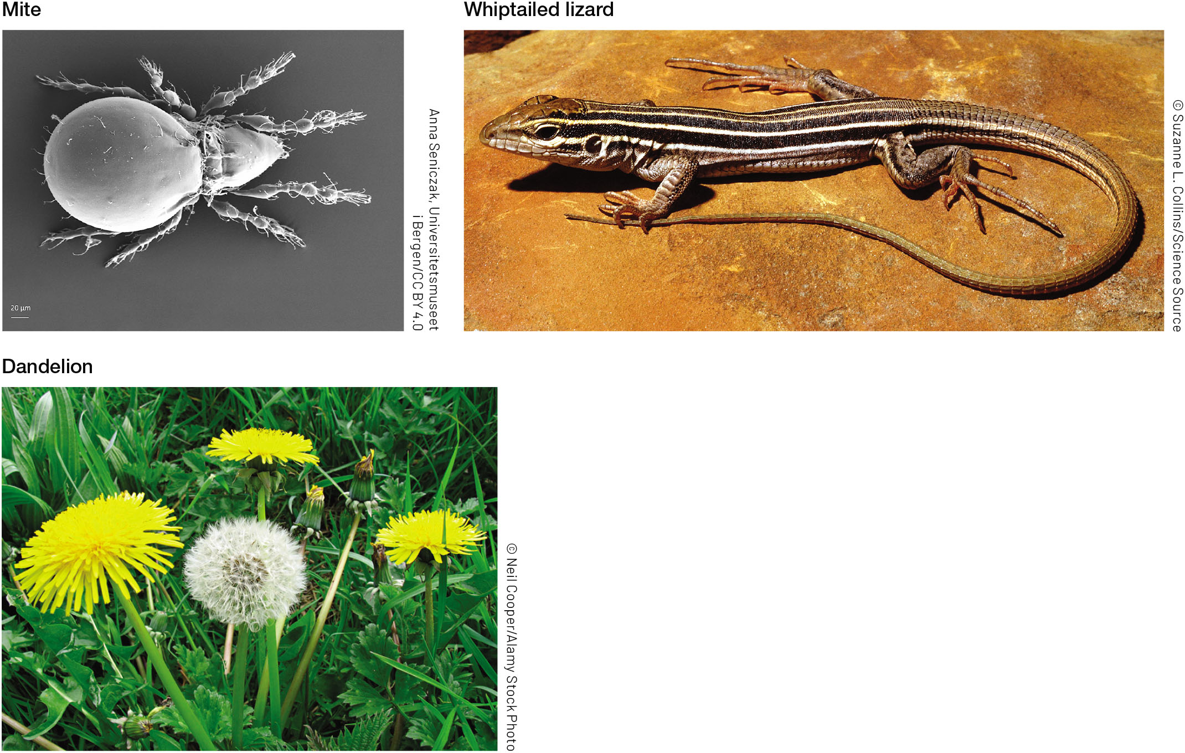
FIGURE 12.22 Parthenogenesis (asexual reproduction) is very rare among animals and plants
Notes:
FIGURE 12.22 Parthenogenesis (asexual reproduction) is very rare among animals and plants. Examples include a distant relative of spiders, the mite Oppiella nova [13]; some whiptail lizards (such as Aspidoscelis uniparens); and the common dandelion (Taraxacum officinale).

Slide 35
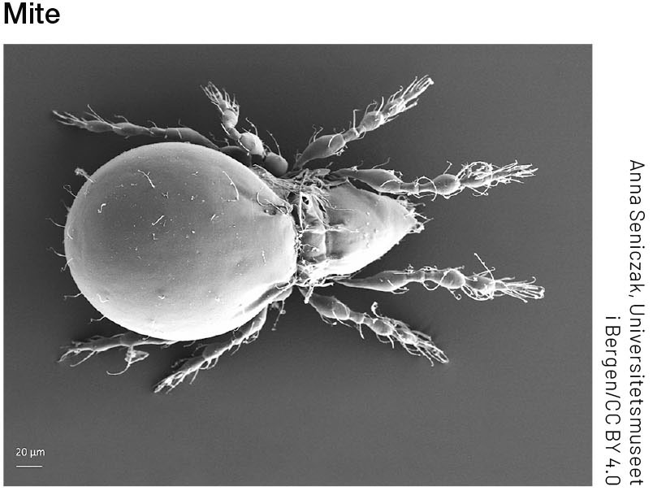
FIGURE 12.22 Parthenogenesis (asexual reproduction) is very rare among animals and plants (1)
Notes:
FIGURE 12.22 Parthenogenesis (asexual reproduction) is very rare among animals and plants. Examples include a distant relative of spiders, the mite Oppiella nova [13]; some whiptail lizards (such as Aspidoscelis uniparens); and the common dandelion (Taraxacum officinale).

Slide 36
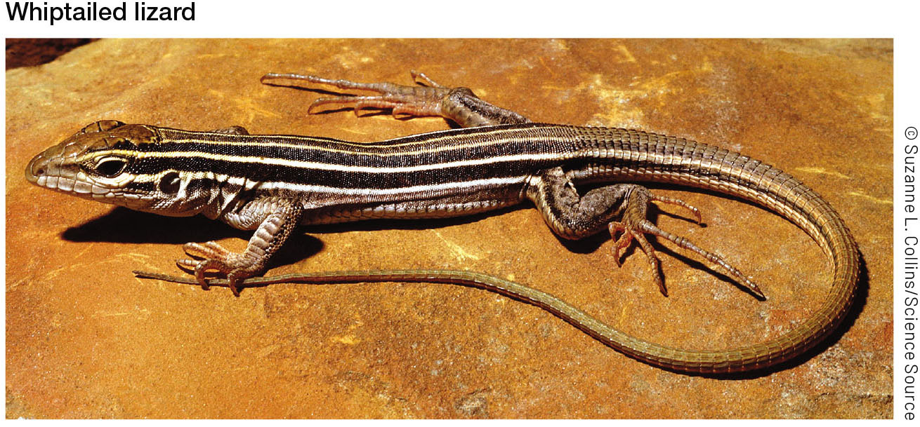
FIGURE 12.22 Parthenogenesis (asexual reproduction) is very rare among animals and plants (2)
Notes:
FIGURE 12.22 Parthenogenesis (asexual reproduction) is very rare among animals and plants. Examples include a distant relative of spiders, the mite Oppiella nova [13]; some whiptail lizards (such as Aspidoscelis uniparens); and the common dandelion (Taraxacum officinale).

Slide 37
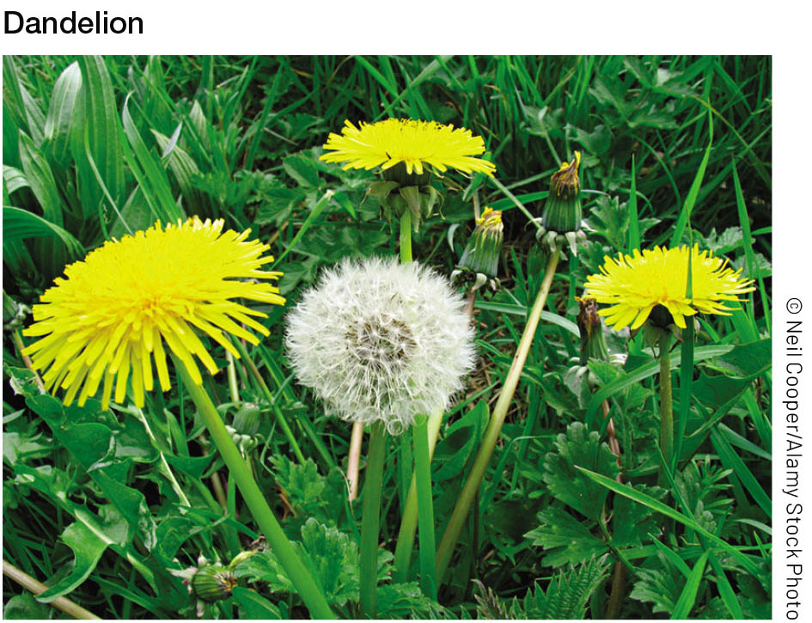
FIGURE 12.22 Parthenogenesis (asexual reproduction) is very rare among animals and plants (3)
Notes:
FIGURE 12.22 Parthenogenesis (asexual reproduction) is very rare among animals and plants. Examples include a distant relative of spiders, the mite Oppiella nova [13]; some whiptail lizards (such as Aspidoscelis uniparens); and the common dandelion (Taraxacum officinale).

Slide 38
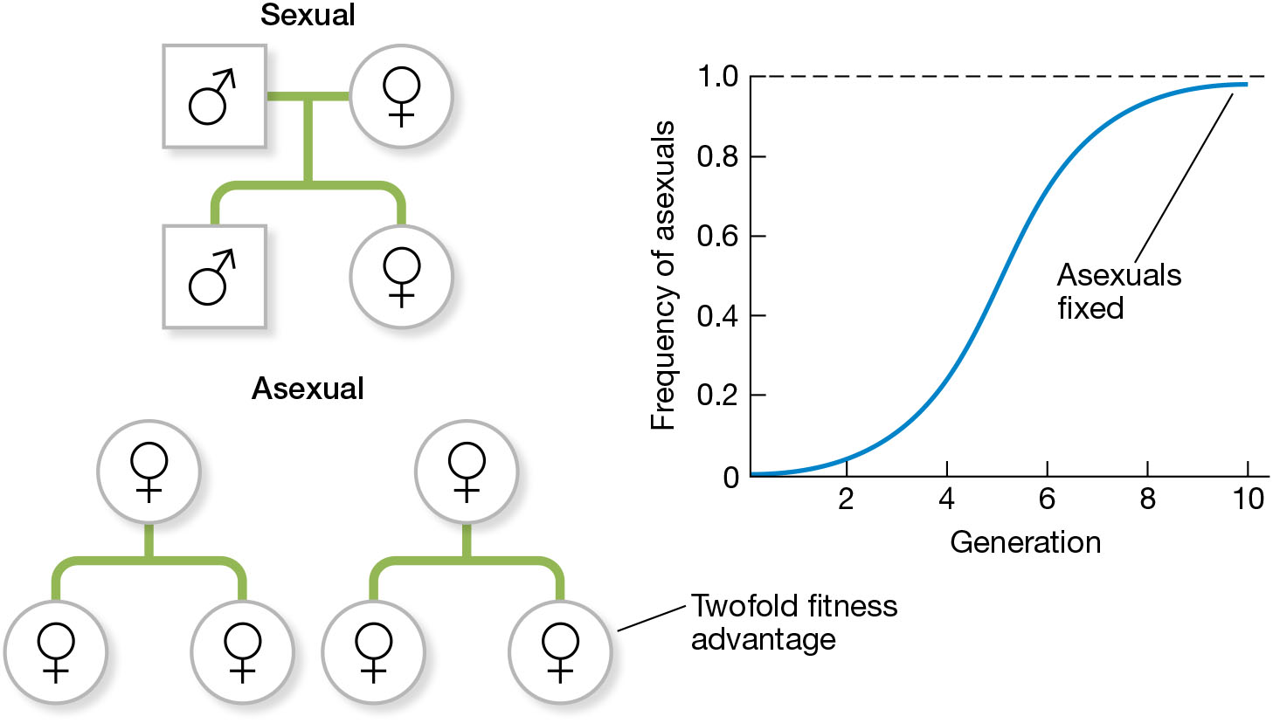
FIGURE 12.23 The biggest evolutionary disadvantage of sexual reproduction is the twofold cost of males
Notes:
FIGURE 12.23 The biggest evolutionary disadvantage of sexual reproduction is the twofold cost of males. If all else is equal, an asexual population will grow twice as quicky as a sexual population, driving the sexuals to extinction in just a few generations.

Slide 39
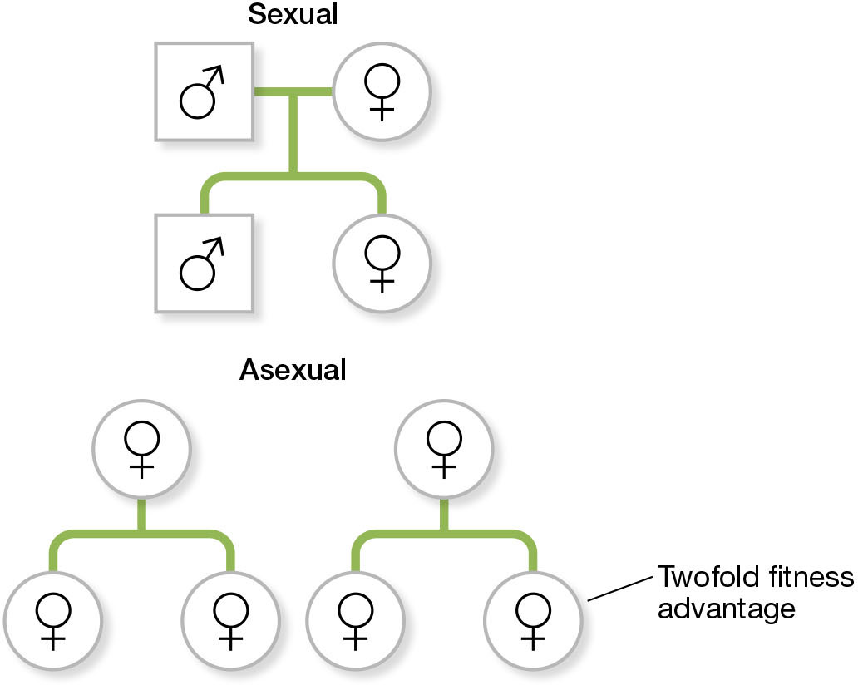
FIGURE 12.23 The biggest evolutionary disadvantage of sexual reproduction is the twofold cost of males (1)
Notes:
FIGURE 12.23 The biggest evolutionary disadvantage of sexual reproduction is the twofold cost of males. If all else is equal, an asexual population will grow twice as quicky as a sexual population, driving the sexuals to extinction in just a few generations.

Slide 40
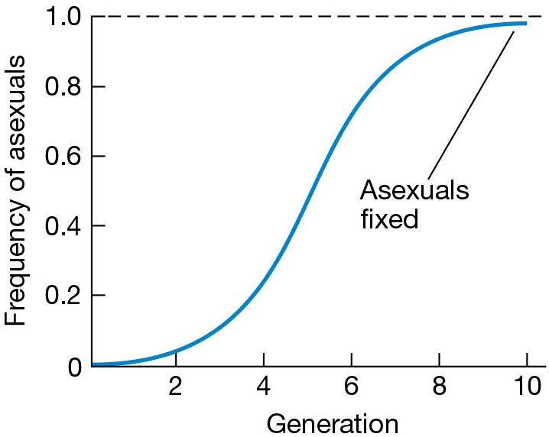
FIGURE 12.23 The biggest evolutionary disadvantage of sexual reproduction is the twofold cost of males (2)
Notes:
FIGURE 12.23 The biggest evolutionary disadvantage of sexual reproduction is the twofold cost of males. If all else is equal, an asexual population will grow twice as quicky as a sexual population, driving the sexuals to extinction in just a few generations.

Slide 41
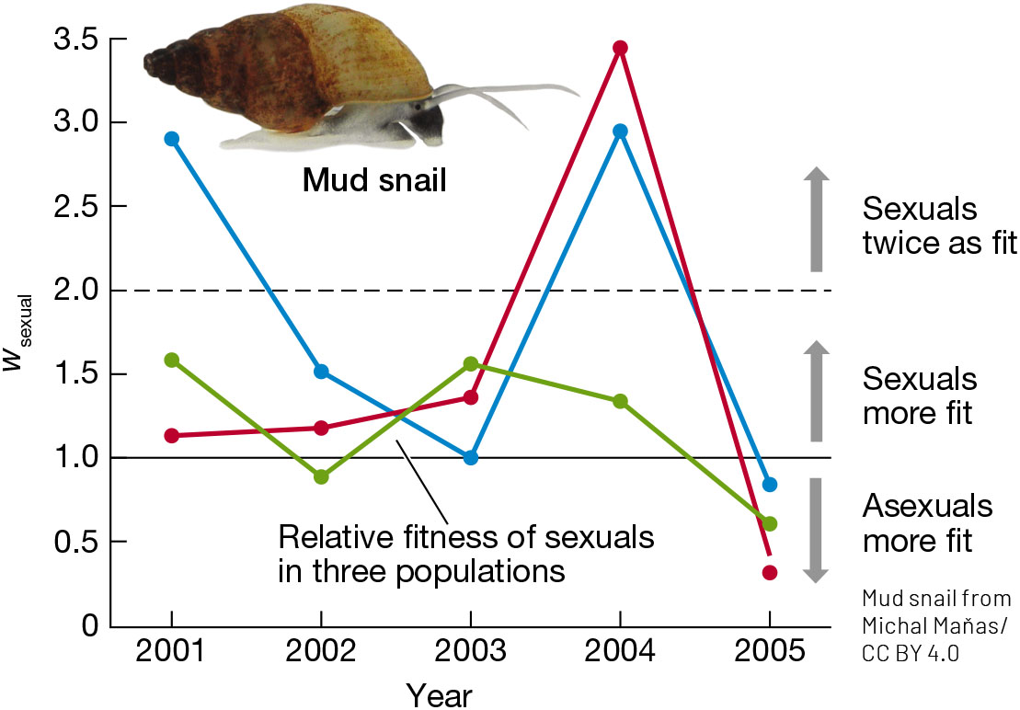
FIGURE 12.24 Attacks by parasites give an evolutionary advantage to sexual reproduction in the New Zealand mud snail (Potamopyrgus antipodarum), as predicted by the Red Queen hypothesis
Notes:
FIGURE 12.24 Attacks by parasites give an evolutionary advantage to sexual reproduction in the New Zealand mud snail (Potamopyrgus antipodarum), as predicted by the Red Queen hypothesis. (After D. Vergara et al. 2014. Am Nat 184: S22–S30.)

Slide 42
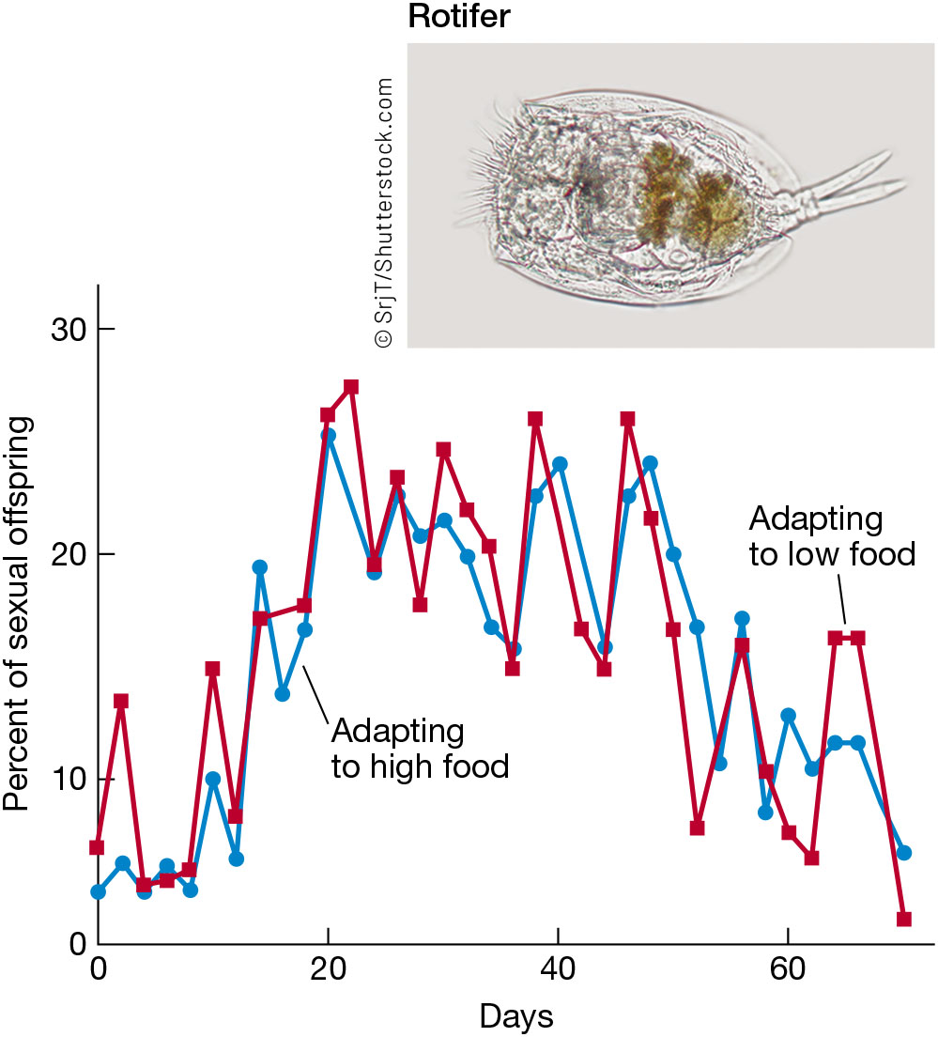
FIGURE 12.25 When populations of a rotifer (Brachionus calyciflorus) adapted to new environments, sexual reproduction became much more common
Notes:
FIGURE 12.25 When populations of a rotifer (Brachionus calyciflorus) adapted to new environments, sexual reproduction became much more common. Asexual reproduction again spread through the populations once they became adapted. (After L. Becks and A. F. Agrawal. 2012. PLOS Biol 10: e1001317)

Slide 43
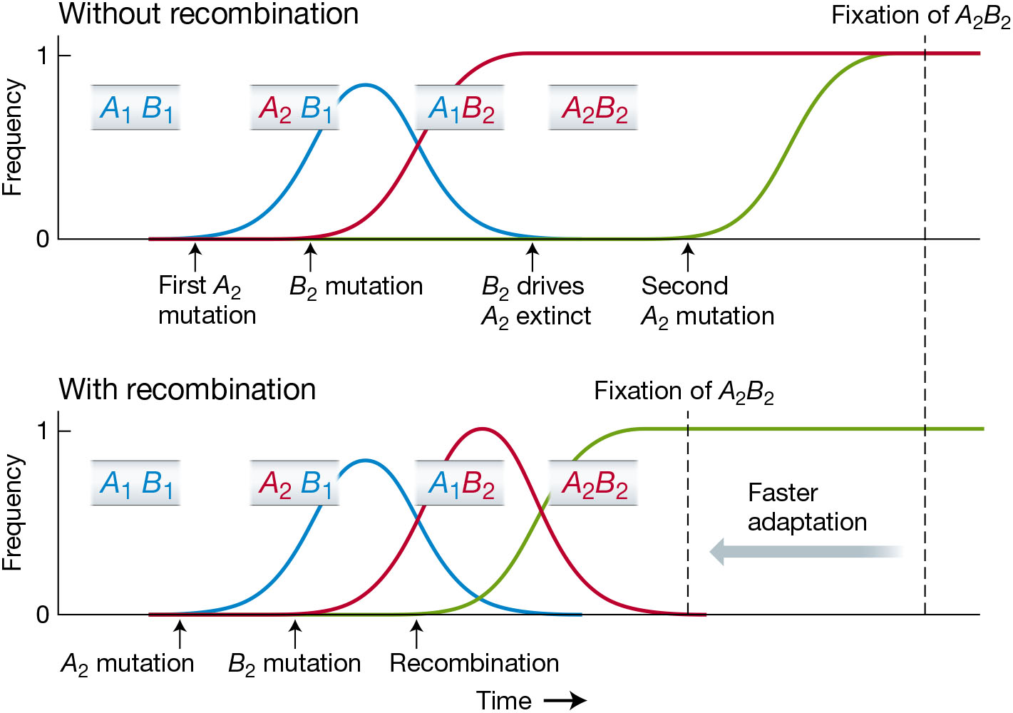
FIGURE 12.26 Recombination lets sexual populations escape clonal interference and adapt more quickly than asexual populations without recombination
Notes:
FIGURE 12.26 Recombination lets sexual populations escape clonal interference and adapt more quickly than asexual populations without recombination. Without recombination, the beneficial mutations A₂ and B₂ are in different clones that compete, and the less fit A₂ clone is driven to extinction. A second A₂ mutation is needed to produce the high-fitness A₂B₂ genotype. With recombination, the A₂ and B₂ mutations can be brought together by recombination, which speeds adaptation.

Slide 44
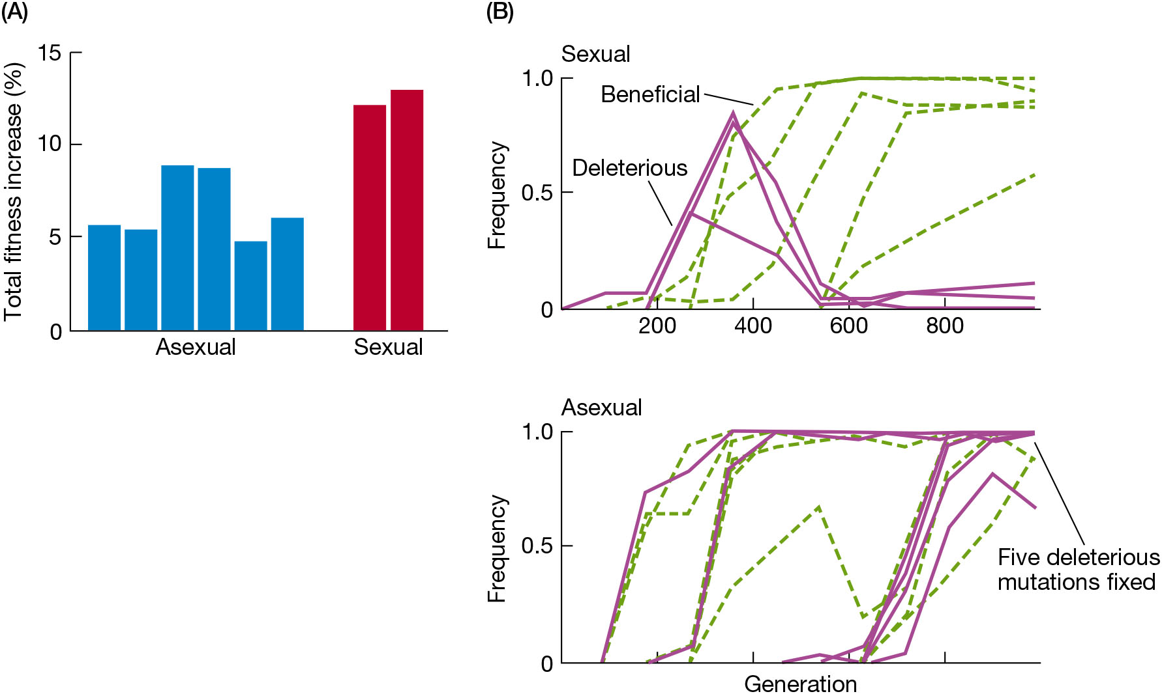
FIGURE 12.27 Experiments with yeast (Saccharomyces cerevisiae) show that recombination prevents deleterious mutations from becoming fixed by evolutionary traction
Notes:
FIGURE 12.27 Experiments with yeast (Saccharomyces cerevisiae) show that recombination prevents deleterious mutations from becoming fixed by evolutionary traction. (A) After 1000 generations of adaptation to a laboratory environment, the fitness of the sexual populations increased about twice as much as that of the asexual populations. (B) DNA sequencing at different time points followed the frequencies of beneficial and deleterious mutations spreading in a sexual and an asexual population. (After M. J. McDonald et al. 2016. Nature 531: 233–236.)

Slide 45
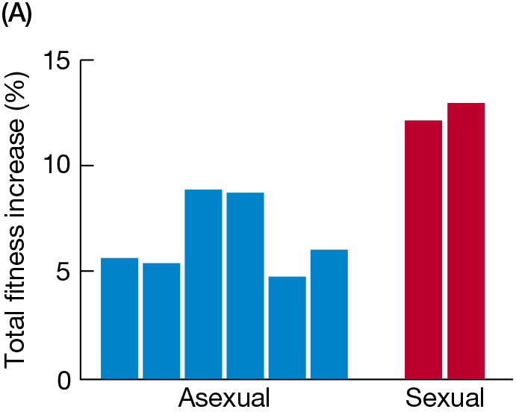
FIGURE 12.27 Experiments with yeast (Saccharomyces cerevisiae) show that recombination prevents deleterious mutations from becoming fixed by evolutionary traction (1)
Notes:
FIGURE 12.27 Experiments with yeast (Saccharomyces cerevisiae) show that recombination prevents deleterious mutations from becoming fixed by evolutionary traction. (A) After 1000 generations of adaptation to a laboratory environment, the fitness of the sexual populations increased about twice as much as that of the asexual populations. (B) DNA sequencing at different time points followed the frequencies of beneficial and deleterious mutations spreading in a sexual and an asexual population. (After M. J. McDonald et al. 2016. Nature 531: 233–236.)

Slide 46
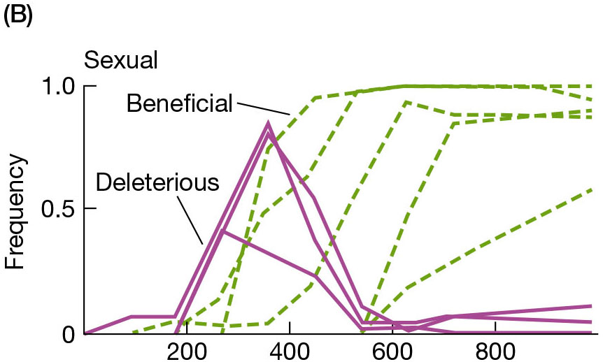
FIGURE 12.27 Experiments with yeast (Saccharomyces cerevisiae) show that recombination prevents deleterious mutations from becoming fixed by evolutionary traction (2)
Notes:
FIGURE 12.27 Experiments with yeast (Saccharomyces cerevisiae) show that recombination prevents deleterious mutations from becoming fixed by evolutionary traction. (A) After 1000 generations of adaptation to a laboratory environment, the fitness of the sexual populations increased about twice as much as that of the asexual populations. (B) DNA sequencing at different time points followed the frequencies of beneficial and deleterious mutations spreading in a sexual and an asexual population. (After M. J. McDonald et al. 2016. Nature 531: 233–236.)

Slide 47
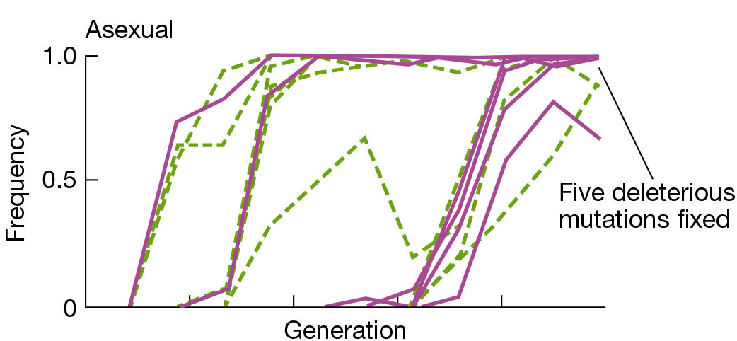
FIGURE 12.27 Experiments with yeast (Saccharomyces cerevisiae) show that recombination prevents deleterious mutations from becoming fixed by evolutionary traction (3)
Notes:
FIGURE 12.27 Experiments with yeast (Saccharomyces cerevisiae) show that recombination prevents deleterious mutations from becoming fixed by evolutionary traction. (A) After 1000 generations of adaptation to a laboratory environment, the fitness of the sexual populations increased about twice as much as that of the asexual populations. (B) DNA sequencing at different time points followed the frequencies of beneficial and deleterious mutations spreading in a sexual and an asexual population. (After M. J. McDonald et al. 2016. Nature 531: 233–236.)

Slide 48
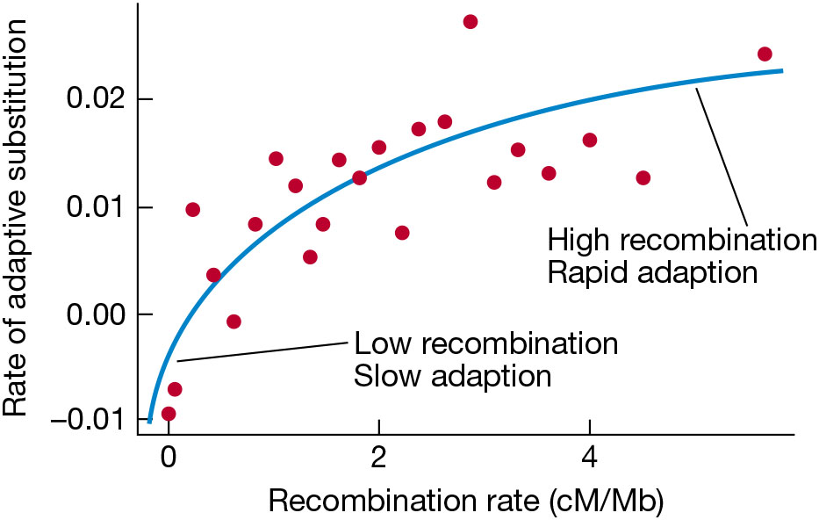
FIGURE 12.28 Rates of adaptation in Drosophila melanogaster are highest in parts of the genome that have high recombination rates
Notes:
FIGURE 12.28 Rates of adaptation in Drosophila melanogaster are highest in parts of the genome that have high recombination rates. Recombination is measured in units of centimorgans (cM) per megabase (Mb) of DNA. (After D. Castellano et al. 2016. Mol Biol Evol
33: 442–455.)

Slide 49
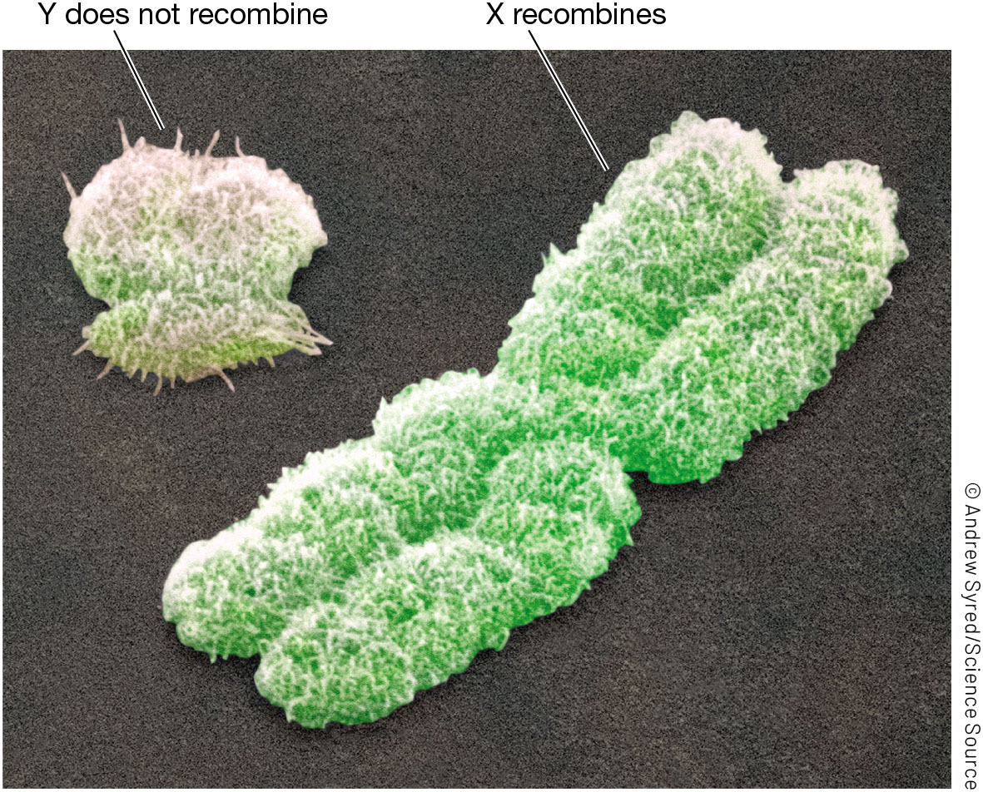
FIGURE 12.29 The human sex chromosomes, as seen in a scanning electron micrograph
Notes:
FIGURE 12.29 The human sex chromosomes, as seen in a scanning electron micrograph. The Y chromosome has degenerated by deletions and other deleterious mutations since it stopped recombining with the X about 180 Ma.

Slide 50
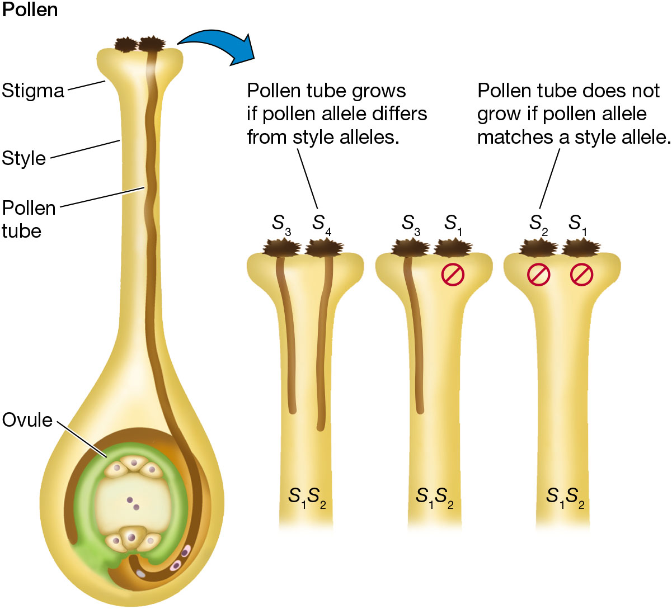
FIGURE 12.30 Self-incompatibility in flowering plants prevents fertilization of ovules by pollen from the same plant
Notes:
FIGURE 12.30 Self-incompatibility in flowering plants prevents fertilization of ovules by pollen from the same plant. Gametophytic incompatibility allows growth of the pollen tube only if the pollen allele (e.g., S₃) differs from the stigma alleles (e.g., S₁ and S₂).

Slide 51

FIGURE 12.31 Inbreeding depression reduces the fitness of offspring produced by matings between relatives
Notes:
FIGURE 12.31 Inbreeding depression reduces the fitness of offspring produced by matings between relatives. Experimental crosses were made with the white campion (Silene latifolia), using plants with different degrees of relatedness, ranging from unrelated (at left) to 0.38 related (which is more closely related than first cousins, but less related than full siblings). The y-axis measures the probability that the seed germinates, which is a key fitness component. The fitness of the most inbred individuals is reduced by more than 80% compared with offspring produced by unrelated parents. (After C. M. Richards. 2000. Am Nat 155: 383–394.)

