Slide 1
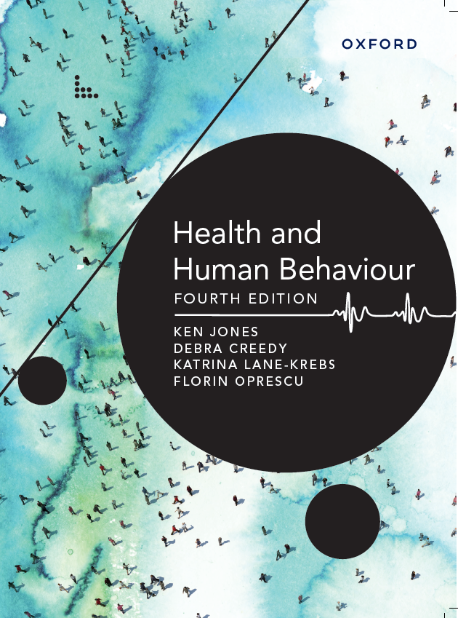
Lecture/workshop slide decks
Health and Human Behaviour
Fourth Edition
Ken Jones, Debra Creedy, Katrina Lane-Krebs, Florin Oprescu
Power Point Slides based on content from Health and Human Behaviour, fourth edition
USER AGREEMENT
These slides include resources from Health and Human Behaviour, fourth edition, and are made available for teaching use only to those using the book as a text in their courses. Users are free to copy and modify the material as needed for teaching purposes (e.g. incorporating them into lecture notes/slides or student handouts), provided that the authors are acknowledged. The slides can be placed on university-controlled unit or subject-related websites (that are password protected), as long as these are restricted to student use and not accessible to the public at large. Permission from the publisher should be sought to use the slides in any other manner.
© Oxford University Press 2022

Slide 2
CHAPTER 15 – health literacy
Learning objectives
define health literacy and its various components
describe the cognitive, psychological and cultural factors associated with poor health literacy
understand principles from cognitive psychology and learning theories that help explain why some people have difficulty learning, remembering and applying health information in their lives
appreciate health education strategies to enhance individuals’ health literacy levels and promote behaviour change
Behaviours
Emotions
Cognitions

Slide 3
CHAPTER 15 – health literacy
KEY CONCEPTS
» cognitive load
» cultural literacy
» electronic (e-Health) literacy
» health literacy
» Health Literacy Questionnaire
» learning
» mastery learning
» schema
» scientific literacy
» teach to goal
» teach-back
» working memory

Slide 4
CHAPTER 15 – health literacy
Health literacy
Health literacy
The ability to read, comprehend and use medical information to make health decisions, and effectively interact with the health care system and health professionals.
Health literacy affects the ways in which health information is accessed, understood and shared with others. It also affects the health and well-being of individuals and the delivery of health care services.
There are over 20 different forms of literacy. Each of these types of literacy contributes to health.

Slide 5
CHAPTER 15 – health literacy
Health literacy
Scientific literacy. The ability to understand scientific (including medical) concepts.
Electronic health (e-Health) literacy. The ability to navigate through the vast (and sometimes misleading) online world.
Cultural literacy. The ability to identify, understand and respect the collective beliefs and customs of diverse groups in the community.
All of the above are important for clients and also very important for health professionals.

Slide 6
CHAPTER 15 – health literacy
Health literacy
Adequate levels of health literacy in the population reduce health care costs, prevent illness and chronic disease, and can reduce rates of accidents and death .
The Adult Literacy and Life Skills Survey can be used to measure the literacy of adults aged 15 to 74.
The results of this scale identify skill levels categorised from Level 1 (lowest) to Level 5 (highest). Skill Level 3 is regarded as the minimum required for individuals to meet the demands of everyday life.
An Australian survey found that 19% of adults had Level 1 health literacy skills and 40% had Level 2. These people had difficulty reading information on a medicine bottle to find out the maximum number of days the medicine should be taken, or drawing a line on a container to indicate where one-third would be.
Only 41% of adults had adequate or better health literacy skills (Level 3 or above). At this level a person can combine written and numerical information (e.g. understanding data on a graph) to correctly assess the safety of a product for them (e.g. the recommended dose of a drug for their weight).

Slide 7
CHAPTER 15 – health literacy
Health literacy
The Health Literacy Questionnaire is a national survey in Australia that measures the health literacy of adults aged 18 and older across nine different domains. The Health Literacy Questionnaire reports a larger range of health literacy characteristics than the Adult Literacy and Life Skills Survey and is useful for individuals, practitioners/clinicians and policy-makers.
The nine domains are:
1 feeling understood and supported by health care providers; 2 having sufficient information to manage my health; 3 actively managing my health;
4 social support for health;
5 appraisal of health information;
6 ability to actively engage with health care providers;
7 navigating the health care system;
8 ability to find good health information;
9 understand health information well enough to know what to do.

Slide 8
CHAPTER 15 – health literacy
Socio-cultural factors associated with low health literacy
There are several social and cultural factors associated with health literacy
Age
Education
Income
Self-assessed health status
Employment status
Occupation
Being born overseas
Birth language
Relatively few health professionals are aware that rates of health literacy vary with age, or they may assume that young or old adults are well informed about health matters.
A study showed that around two-thirds of males and females aged 15–19 had inadequate or low health literacy.
The proportion of people with low health literacy decreased to around half of all people aged 20–49, before increasing again in older age groups.

Slide 9
CHAPTER 15 – health literacy
Socio-cultural factors associated with high health literacy
The relationship between education and health is well documented. People who complete higher levels of education are more likely to have higher rates of adequate health literacy.
Around 75% of people with a bachelor’s degree or higher have adequate to good health literacy compared with only 16% of people who finished their education at Year 10 .
Reflection time
Think about when you began your program of study to become a health professional. What terms were new to you?
How did your classes help you to better understand and remember these medical/scientific terms or concepts?
What learning strategies have you employed to increase your health literacy levels?

Slide 10
CHAPTER 15 – health literacy
Implications of low health literacy
Individuals with low health literacy may experience difficulty understanding what doctors, nurses, pharmacists and other health professionals tell them, as well as difficulty understanding written medical instructions.
Even when individuals can access good health services, a lack of understanding of relevant information can make it challenging for them and their families to manage illness or a condition and to make informed decisions.
Individuals with low health literacy are more likely to be hospitalised.
Importantly, people with low health literacy access less preventive health care (e.g. screening for cancer and cardiovascular disease) and are likely to attend emergency departments more often.

Slide 11
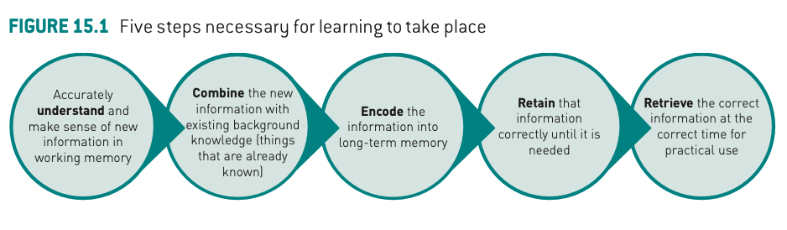
CHAPTER 15 – health literacy
Enhancing health literacy via learning
Several steps must occur for learning (including learning about health topics) to take place. This much be considered when working with clients and when learning new concepts, theories or procedures as a health professional.

Slide 12
CHAPTER 15 – health literacy
Enhancing health literacy via learning
Learning can be defined as a change in long-term memory.
When a person with a health condition successfully learns new information, this information is processed in working memory, combined with pre-existing knowledge, and placed into long-term memory as part of a connected system of ideas.
The act of combining new and existing knowledge helps a person build mental schemas.
A schema is a mental map of ideas about a topic or issue
As a person encounters new information, they revise and update their existing schema.
A new pattern of ideas is then encoded (stored) into long-term memory for retrieval at a later time when needed.

Slide 13
CHAPTER 15 – health literacy
Enhancing health literacy via learning
Learning requires memory.
Working memory allows individuals to temporarily store and use information in short-term memory.
Working memory also allows individuals to ignore non-essential information and thus avoid cognitive overload. Cognitive load is how much information a person can keep in their working memory.
Research indicates that the maximum number of elements that a person could remember and use was seven (plus or minus two). It is important to remember that the more a person has to learn in a short amount of time, the more difficult it is to process that information in working memory.
Thus, communicating health information may need to be spaced out according to individual capabilities, including the level of health literacy. Ideally, a health professional would objectively assess the health literacy of a person, using relevant existing measures, before providing complex health information.

Slide 14
CHAPTER 15 – health literacy
Enhancing health literacy via learning
The amount of information that can be stored in memory is much greater if the individual is familiar with the content being presented.
This is because related information is already available in long-term memory.
This stored information can be retrieved and placed into the working memory, allowing the individual to focus on making links between the new information and what they already know.
People who have limited knowledge of a health topic will experience greater cognitive load when learning about the topic because all the information is new to them.

Slide 15
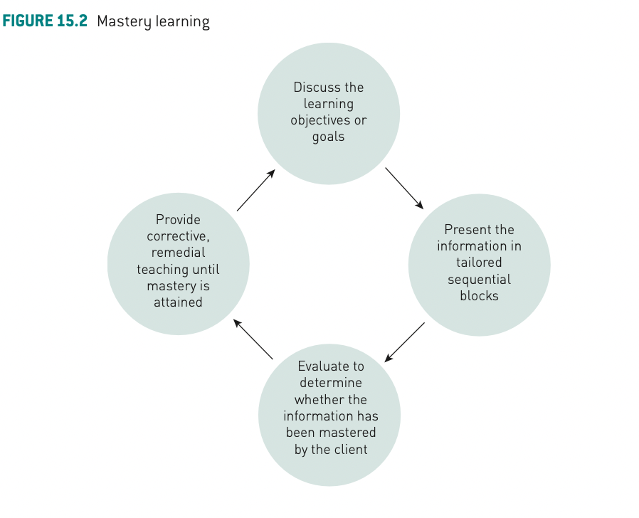
CHAPTER 15 – health literacy
Enhancing health literacy via learning
Mastery learning theory (Bloom, 1968) proposes that people learn at different rates but can master material if given multiple opportunities to process and practise information. Although the amount an individual can learn in a given time is relatively fixed, with repetition, most people can achieve mastery. It is essential to go through four key steps in a cyclical manner, as seen in the figure.

Slide 16
CHAPTER 15 – health literacy
Enhancing health literacy interventions
There are four specific design features of an intervention that can improve comprehension:
1 presenting essential information either by itself or first in a list;
2 presenting information so that the higher numbers represent better outcomes;
3 adding graphics to numerical information (e.g. a cartoon figure of a person where one figure represents 100 people);
4 adding visual resources (e.g. media clips, YouTube segments) to verbal discussions of topics.

Slide 17
CHAPTER 15 – health literacy
Enhancing health literacy interventions
Research indicates that nterventions about self-care and disease management delivered in a shorter timeframe (intensive mode, e.g. four sessions in a week rather than one session a week) reduced the likelihood of the disease getting worse.
People who received health education in an intensive way also had fewer emergency department visits and hospitalisations.
Interventions with multiple components showed most promise for addressing low health literacy in clinical practice. Multiple components include discussions, media clips, pictures, diagrams and practice sessions for skill development.

Slide 18
CHAPTER 15 – health literacy
Enhancing health literacy interventions
Common features of effective interventions that are likely to increase understanding of health information are:
frequent sessions within a shorter timeframe
using a framework (from learning theories) to inform the design of the intervention
doing a pilot test to identify any problems early on
an emphasis on skill-building
delivery by an expert health professional such as a pharmacist or a health educator

Slide 19
CHAPTER 15 – health literacy
Enhancing health literacy interventions
Considerations to keep in mind from a practical perspective are:
First assess a person’s level of health literacy
Second, discuss the best approach for them (how they learn best)
Third, tailor education sessions to each individual
Use simplified text
Use teach-back approaches

Slide 20
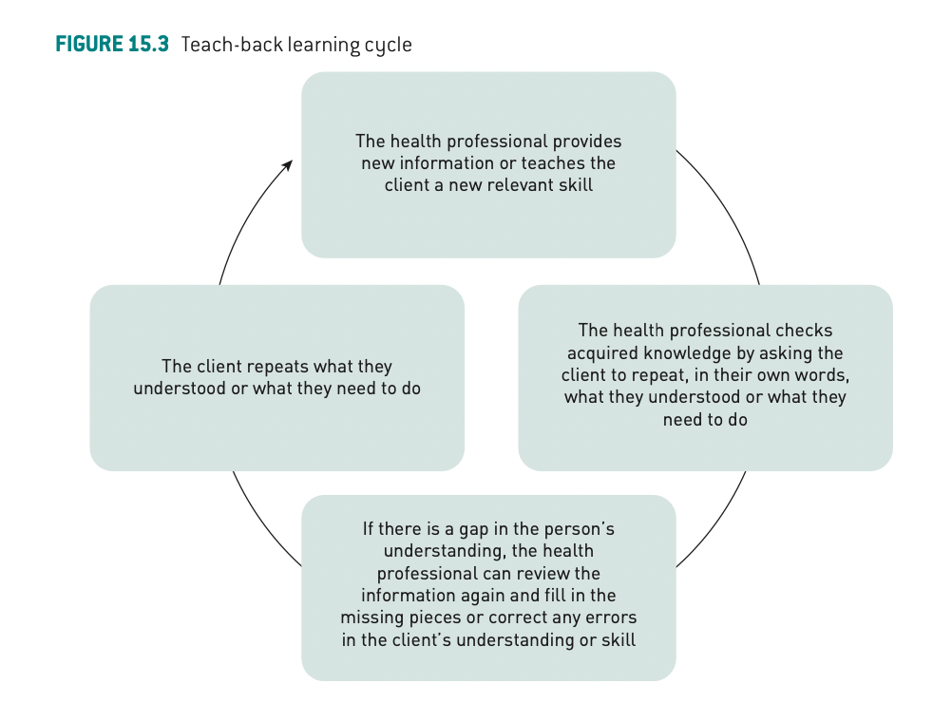
CHAPTER 15 – health literacy
Enhancing health literacy interventions
Teach-back. A learning cycle involving repetition and reinforcement of new learning.
Teach-back is a useful strategy for improving the understanding and recall of health information among people with low literacy.
Teach-back is a learning cycle
Teach-back is an effective way to support long-term learning because it slows down the learning process and allows for repetition and reinforcement of new information. Cognitive experiments have shown that repeating short sequences of information helps to activate the memory dedicated to storage and recall of information.

Slide 21
CHAPTER 15 – health literacy
Guiding principles for enhancing health literacy interventions
Establish a defined set of learning goals and develop the learning program.
Present information in discrete units.
Determine the optimal order for each topic.
Use simple language.
Use pictorial aids.
Confirm mastery of learning goals.
Link information to behaviour change.

Slide 22
CHAPTER 15 – health literacy
Guiding principles for enhancing visits to health professionals
write down their questions and concerns prior to the visit so they don’t forget anything;
take a trusted person, such as a family member or close friend, with them;
always ask questions if they don’t understand something. The health professional wants to make sure the patient knows about their condition and understands how to follow their medical instructions;
always bring an up-to-date list of all medications, including over-the-counter drugs and any natural or herbal preparations;
ask the health professional to write down the information and instructions that were discussed during the visit;
if they have hearing or sight difficulties, ask the doctor to provide information in large print or use other resources.

Slide 23
CHAPTER 15 – health literacy
Concluding thoughts
Individuals with low literacy have difficulty reading and understanding written information, comprehending numerical information, performing calculations, and understanding ranges of normal values (e.g. the normal range for blood pressure).
Inadequate health literacy is common among the young, the elderly, individuals with chronic conditions or disability, individuals who do not speak English as a first language and people with a mental health condition.
Many health professionals underestimate the prevalence of low health literacy, and often fail to identify individuals with low health literacy. Understanding health literacy and its importance is critical for effective provision of health care and health education.
Communication plays an important role in care. The health professional’s knowledge of characteristics associated with low health literacy influences interactions between the health care provider and the patient.

