Slide 1
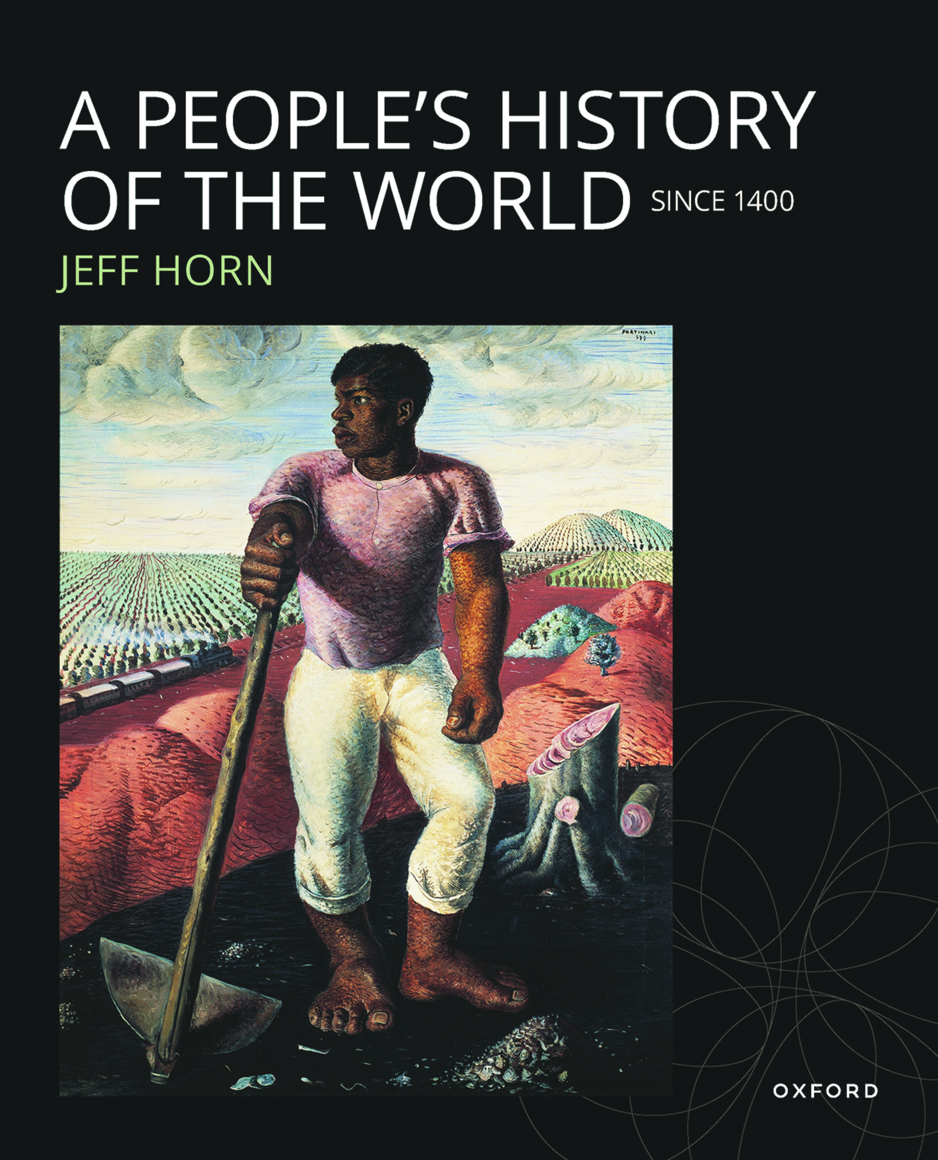
A PEOPLE’S HISTORY OF THE WORLD
Since 1400
by Jeff Horn

Slide 2
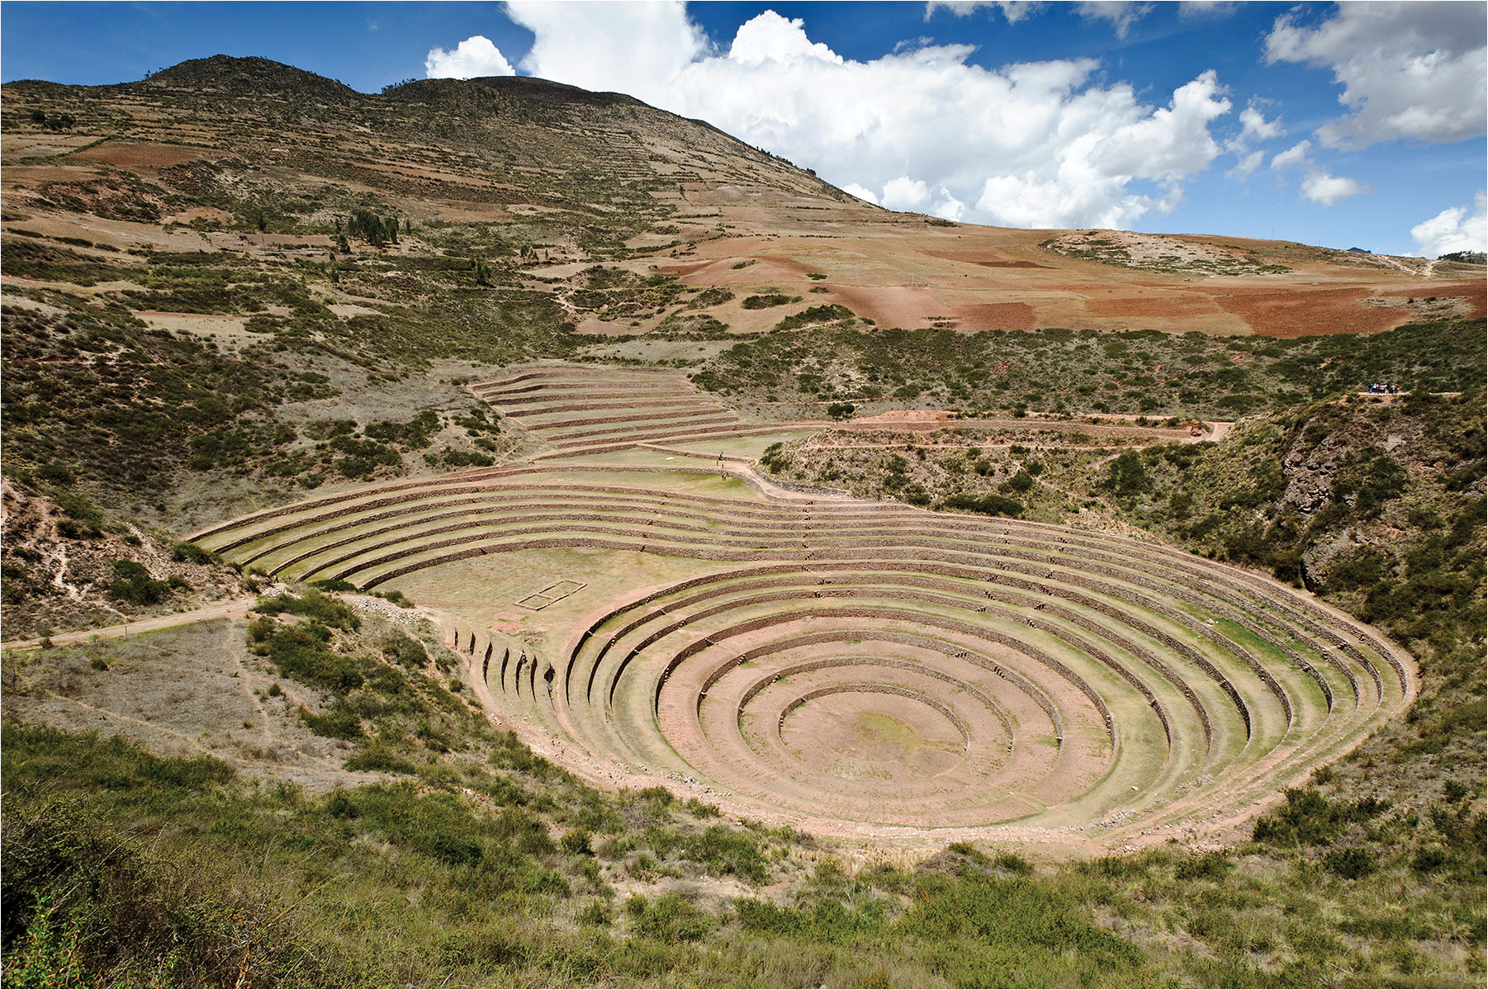
3
Notes:
Incan Agricultural Terraces Found all over the Andes Mountains, stepped irrigation systems increased the amount of arable land and allowed different crops to be grown because the mountain sides got more intense sunlight for longer than the valley floors. The terraced steps also facilitated irrigation by conserving scarce water resources and resisting erosion. In parts of the region, the systems are still in use after more than 500 years.

Slide 3
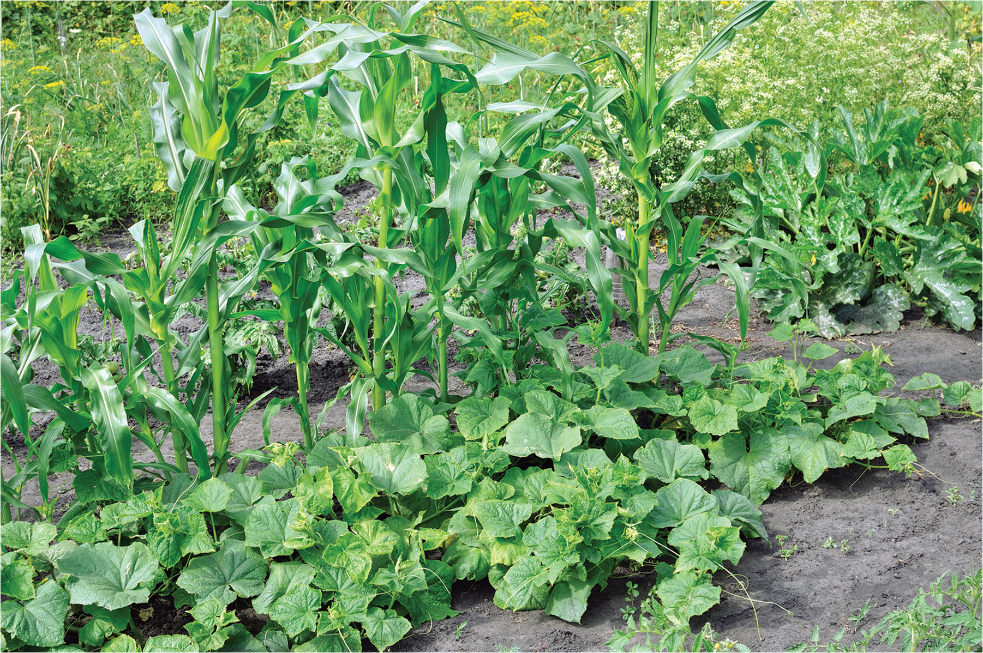
The “Three Sisters”: Maize, Squash, and Beans
Notes:
The “Three Sisters”: Maize, Squash, and Beans Planted together across most of the western hemisphere, these three crops are complementary. The corn acts as a trellis for the beans to climb while the beans pull nitrogen from the air that helps the other two grow. The squash provides ground cover and acts as mulch to limit weeds; its prickly leaves help to repel small animals. This agricultural system could easily be adapted to different environmental conditions.

Slide 4
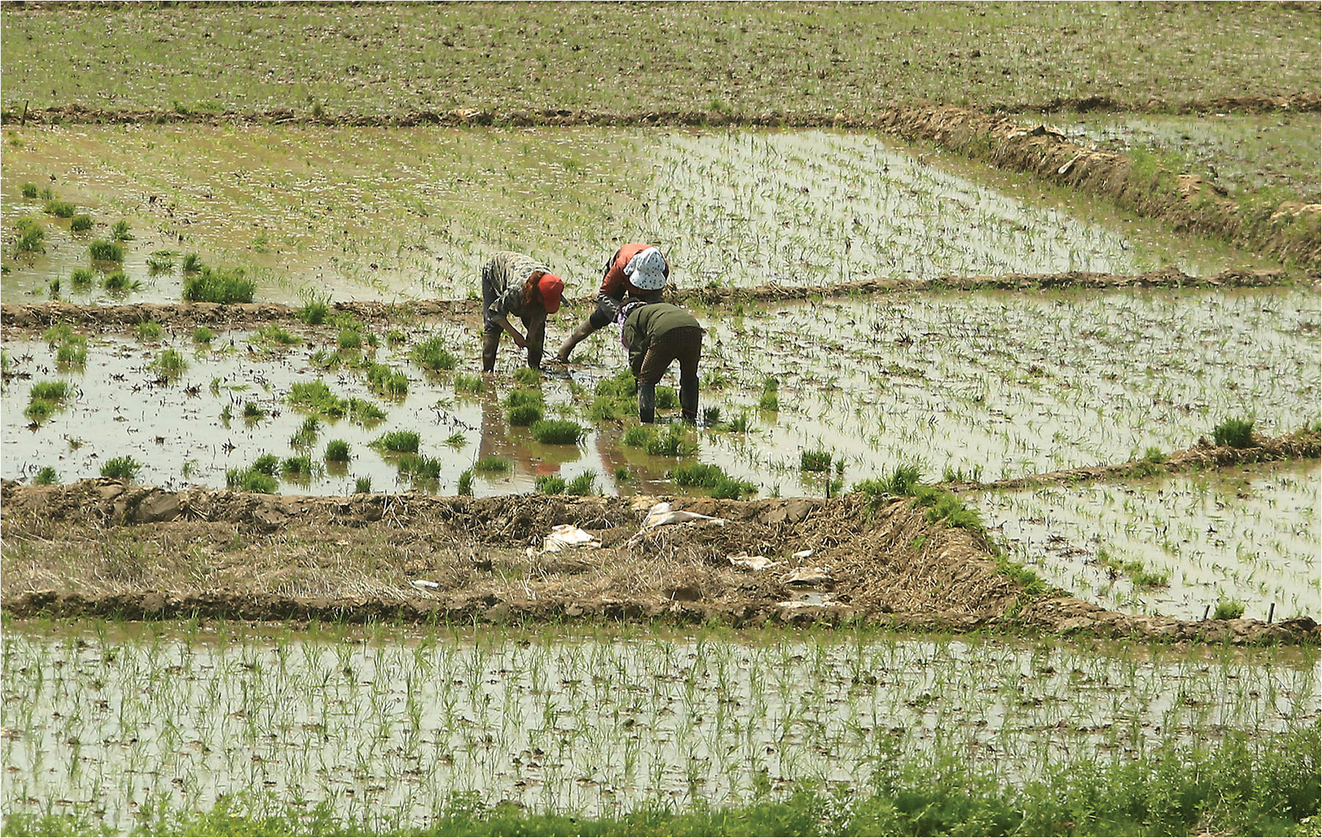
Rice Paddies
Notes:
Rice Paddies This 2015 photo by Stephen Shaver/UPI is from a rice paddy north of Beijing, China. Hunched over, these women tend the delicate shoots while ankle-deep in muddy water. Rice requires backbreaking labor to plant, weed, and harvest along with large-scale cooperative work to upkeep the irrigation system.

Slide 5
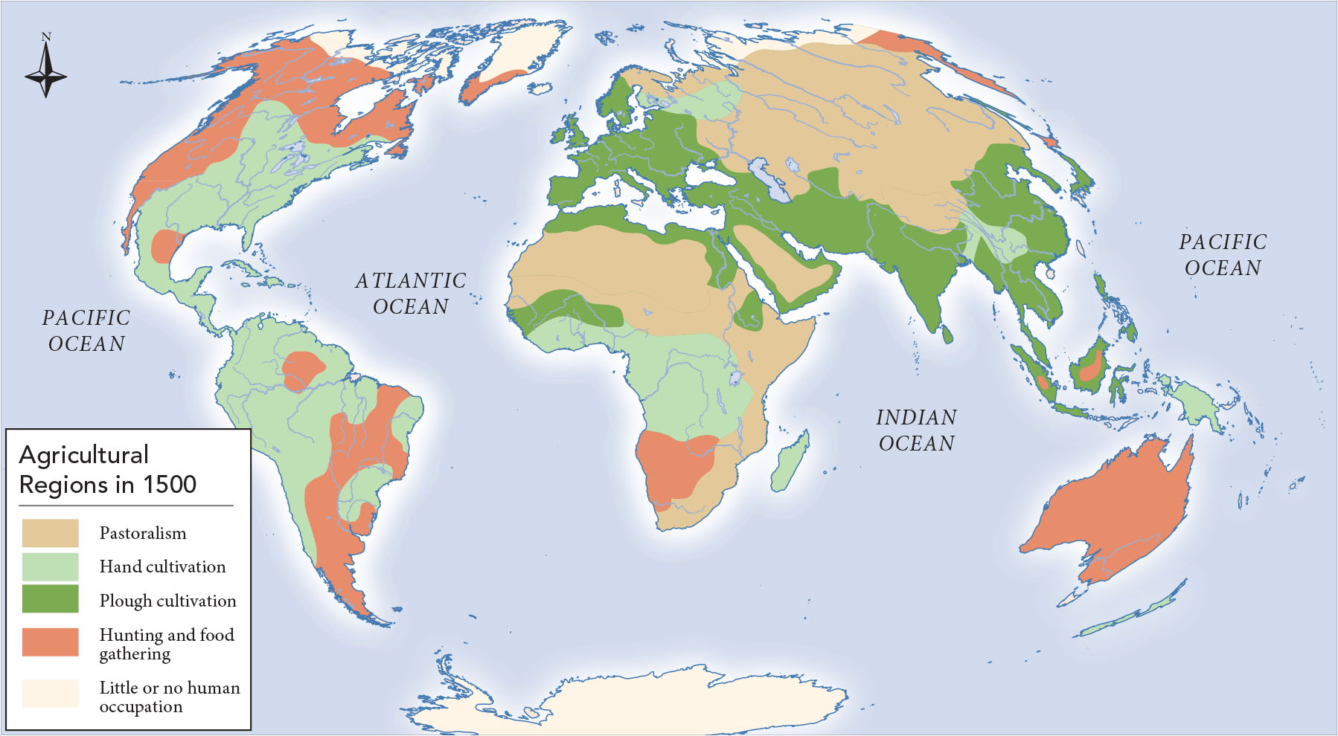
Map 10.1 This map demonstrates the variety of agricultural systems and how rare developed agricultural practice was.
Notes:
Map 10.1 This map demonstrates the variety of agricultural systems and how rare developed agricultural practice was. A startling percentage of land was devoted to livestock raising or herding which provided a relatively small amount of the calories consumed by humanity.

Slide 6
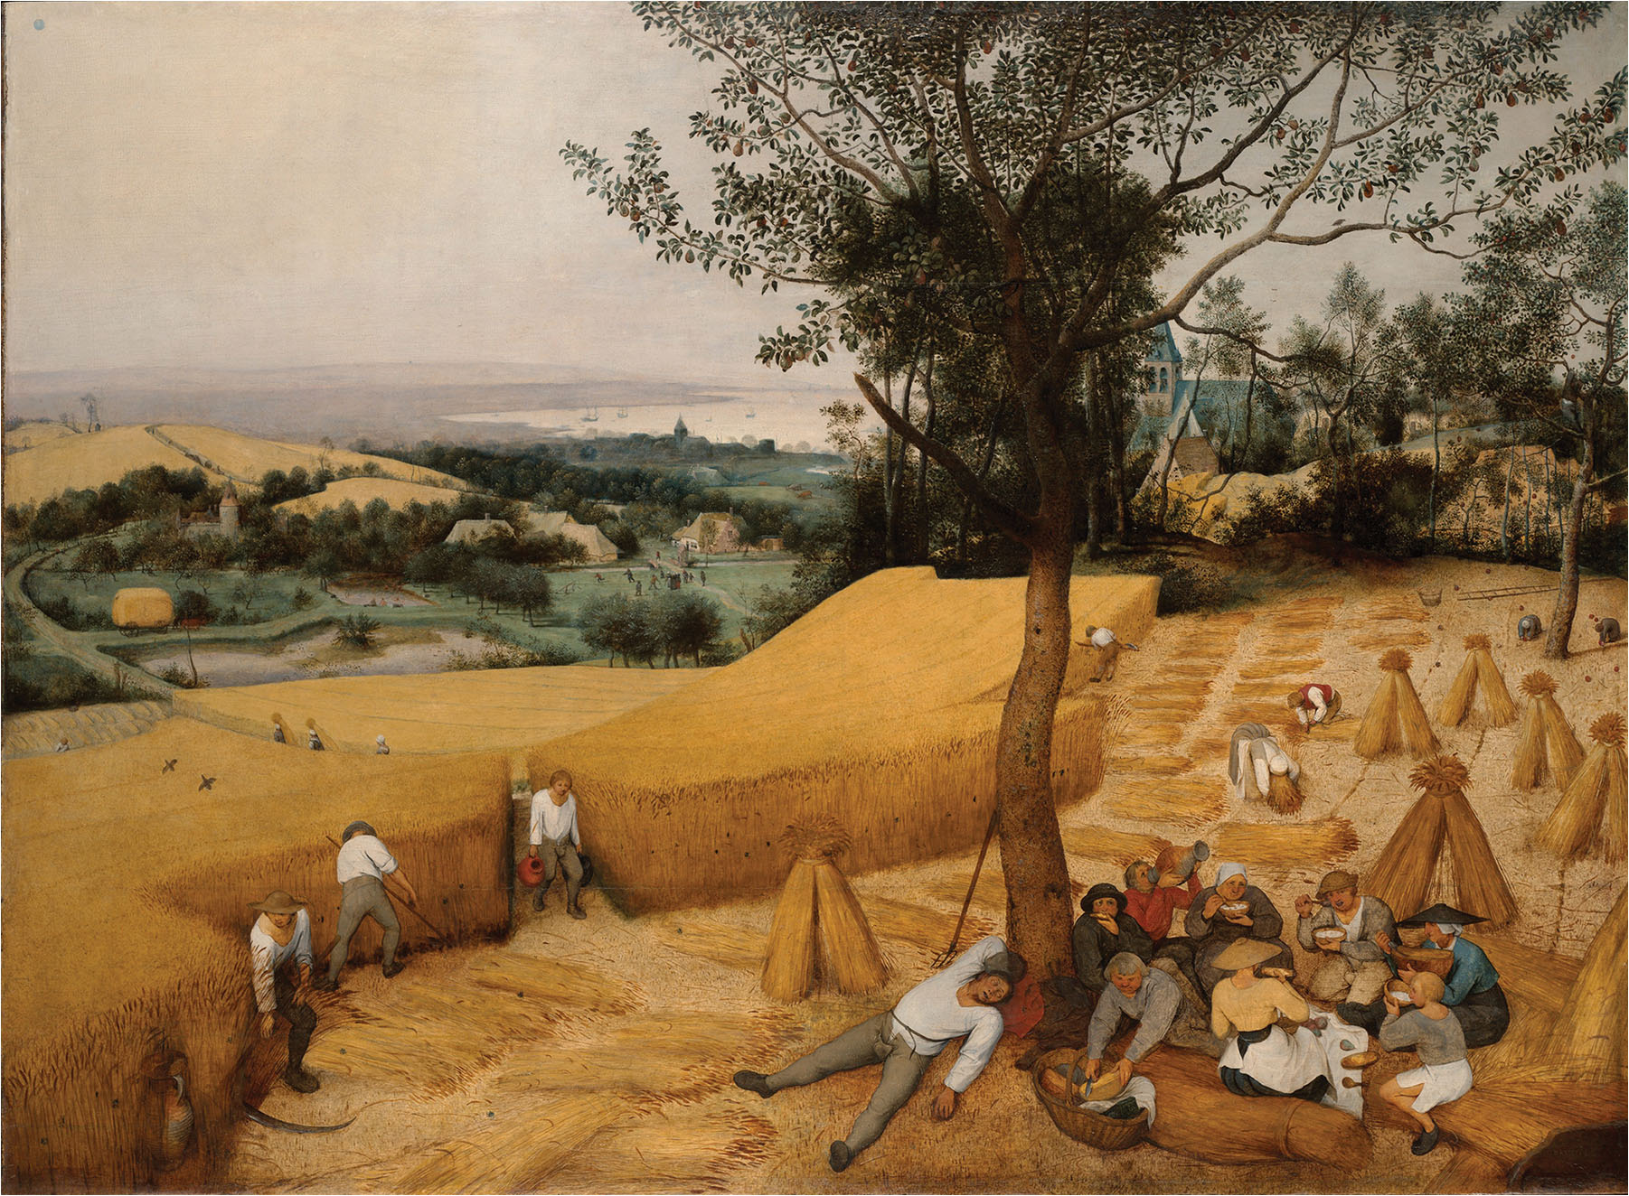
Bruegel’s The Harvesters (1565)
Notes:
Bruegel’s The Harvesters (1565) In this painting commissioned by a merchant for his home, Pieter Bruegel (c. 1525–1569) the elder depicts the July–August grain harvest in his native Netherlands. It shows the gendered division of the various tasks, iron tools as well as a well-earned break from this time-sensitive hard labor.

Slide 7
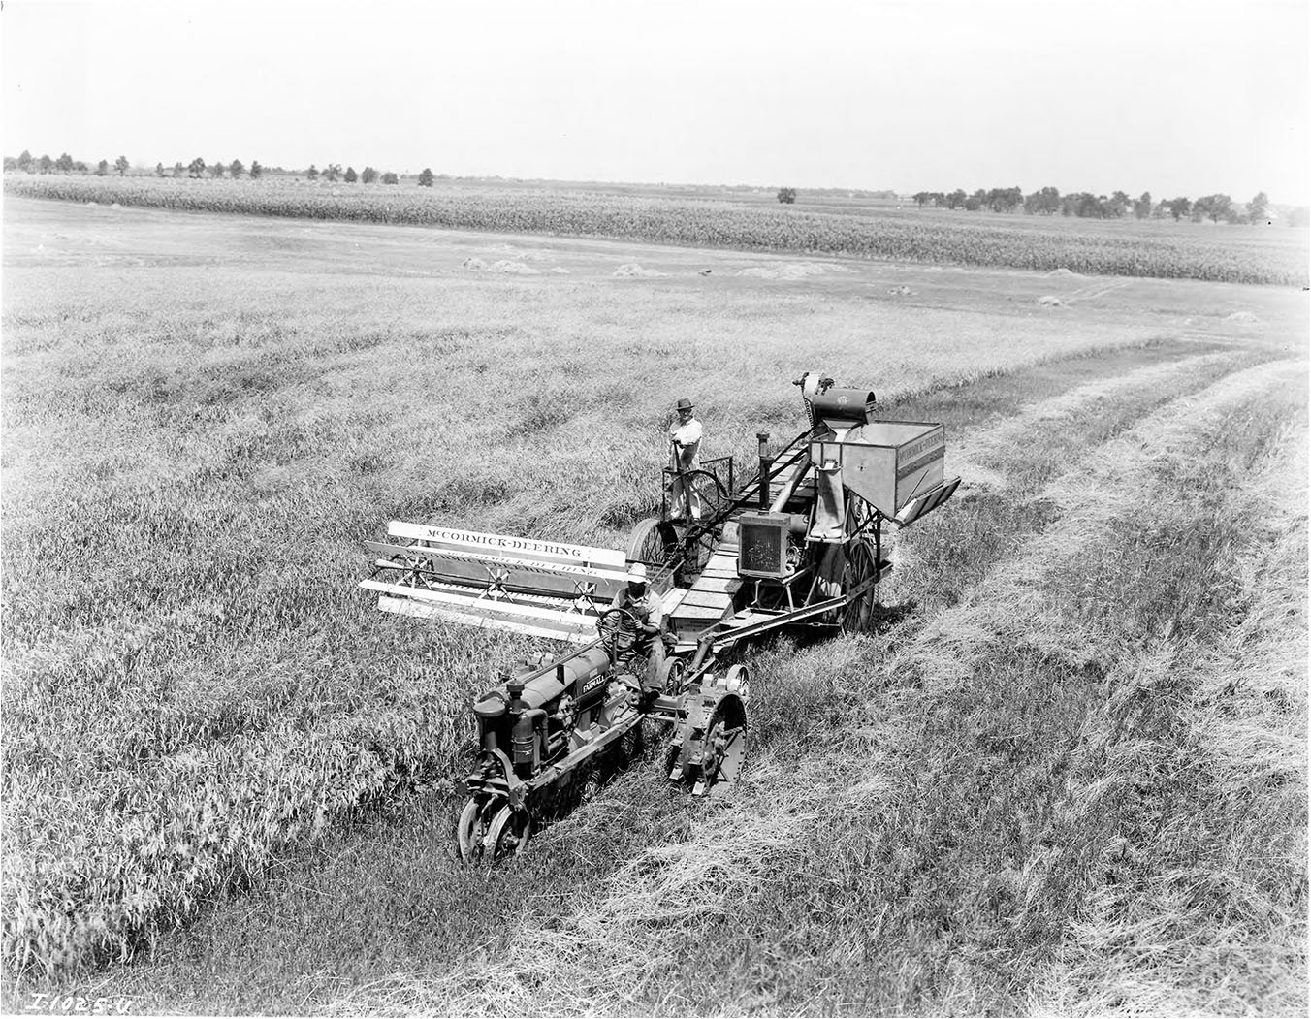
Tractor Pulling a McCormick-Deering Combine
Notes:
Tractor Pulling a McCormick-Deering Combine American Cyrus Hall McCormick (1809–1884) among others patented a mechanical reaper pulled by teams of horses in the early 1830s. Without the need to have as much labor for harvest, individual farms could grow larger. This reaper became ever more efficient and additional tasks were added to make it a combine. The McCormick- Deering engine would soon become the flagship model for a new amalgamated firm: International Harvester. This model from the early twentieth century drew motive and operational power from a gasoline Farmall tractor hitched in front.

Slide 8
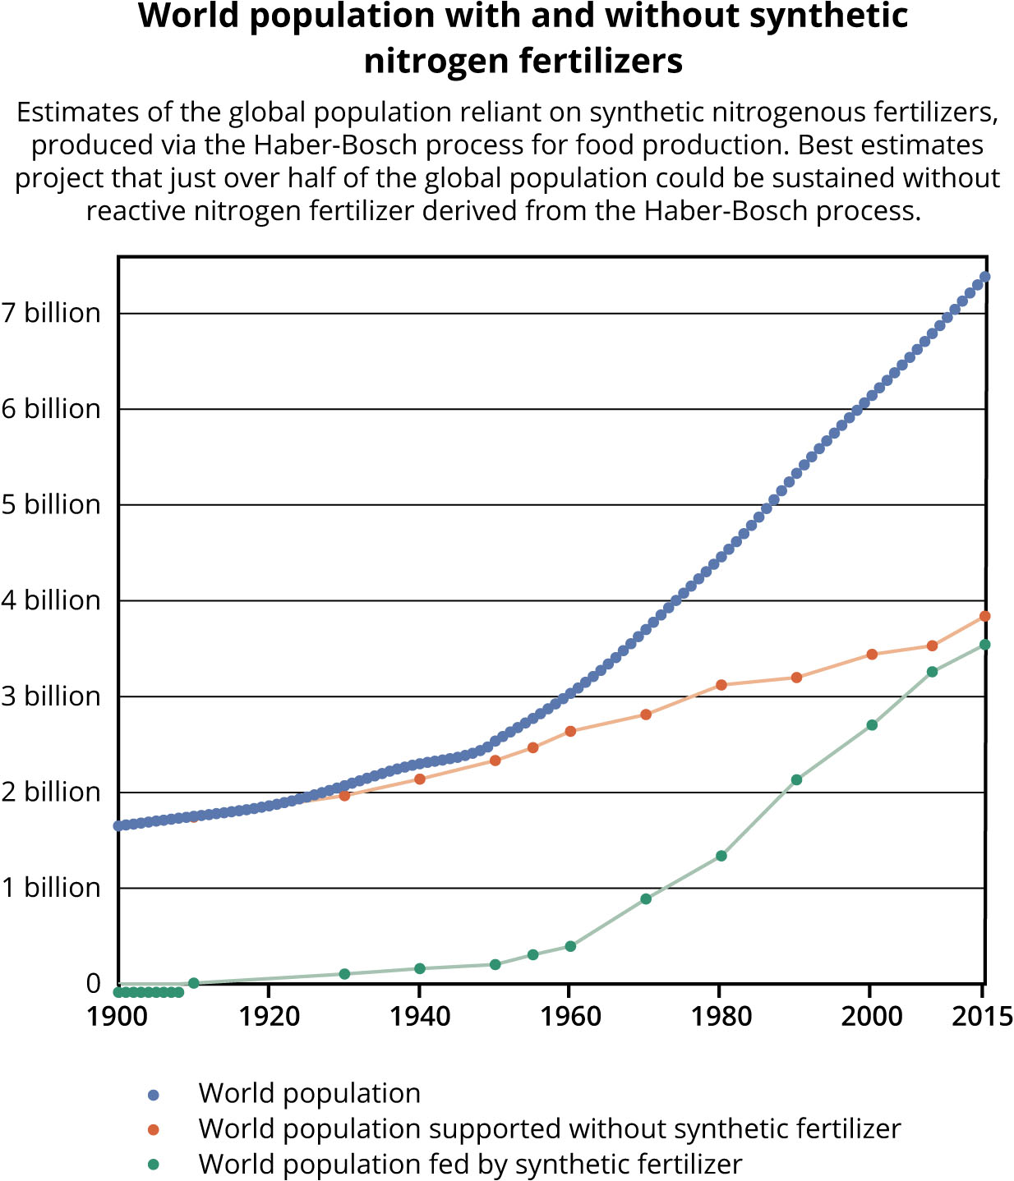
Figure 10.1 The information in this chart compiled by Our World in Data
Notes:
Figure 10.1 The information in this chart compiled by Our World in Data (https:// ourworldindata.org/) illustrates humanity’s dependence on synthetic chemical fertilizers to support population growth. In 2015, just over half of global population could be supported without them.

Slide 9
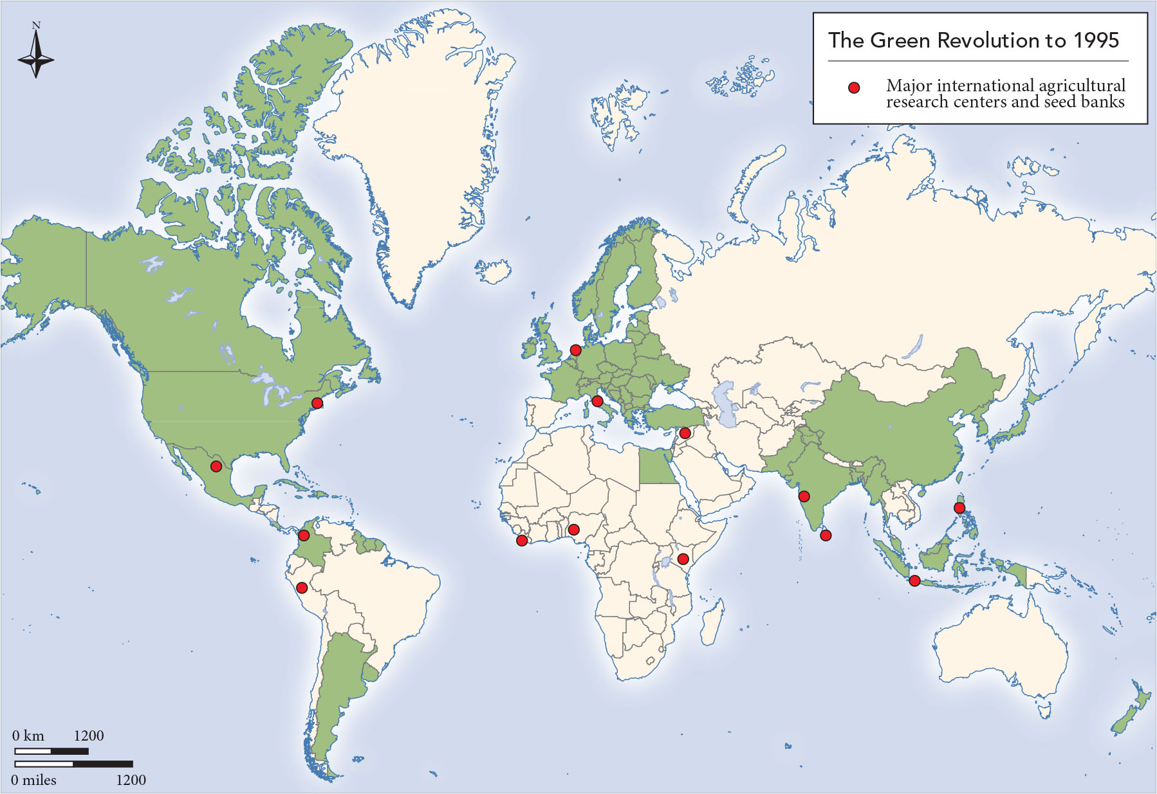
Map 10.2 The Green Revolution has had a global impact, but its benefits are highly concentrated in North America, Europe and East and Southeast Asia.
Notes:
Map 10.2 The Green Revolution has had a global impact, but its benefits are highly concentrated in North America, Europe and East and Southeast Asia. Research into other crops is ongoing in many other parts of the world, but the results have not been as impressive perhaps because of the lack of ability to purchase the new seeds and fertilizers or to set up irrigation. Since 1995, other areas have joined these pioneers.

Slide 10
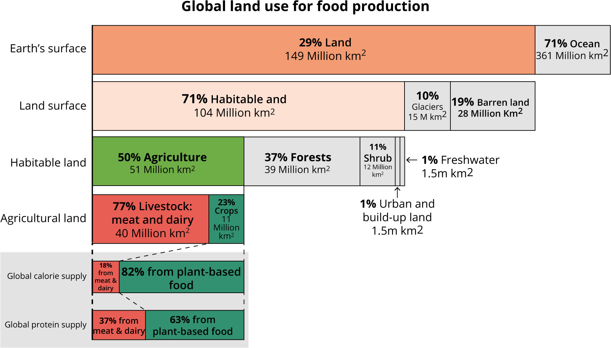
Figure 10.2 This chart was developed by Hannah Ritchie and Max Roser based on data from the United Nations’ Food and Agriculture Organization and made available to Our World in Data
Notes:
Figure 10.2 This chart was developed by Hannah Ritchie and Max Roser based on data from the United Nations’ Food and Agriculture Organization and made available to Our World in Data (https://ourworldindata.org/). It depicts the massive increase in agricultural land and the predominance or resources devoted to producing livestock for meat and dairy.

Slide 11
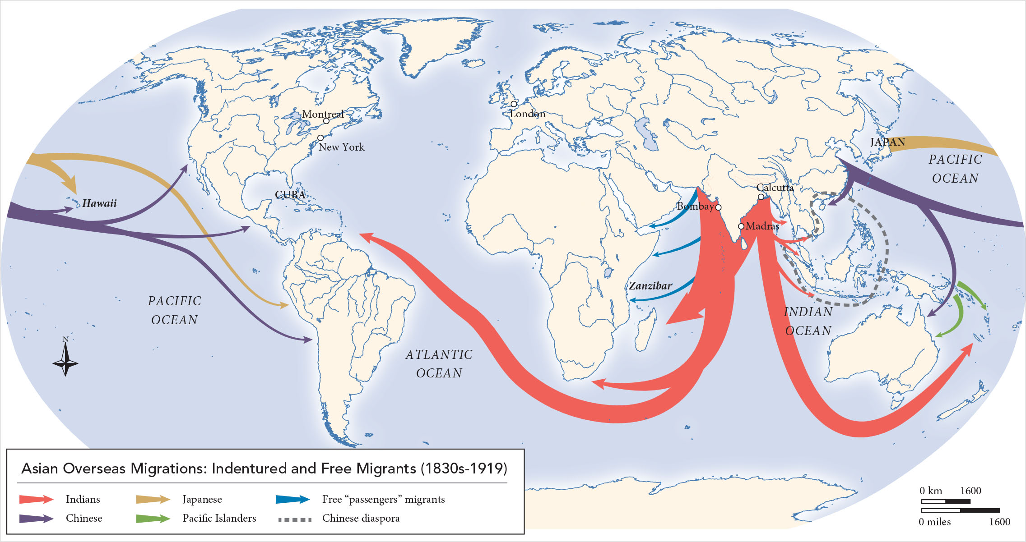
Map 10.3 This map makes clear the global flows of migrant labor during the ongoing abolition of slavery and the importance of South India and China in those movements of primarily agricultural labor.
Notes:
Map 10.3 This map makes clear the global flows of migrant labor during the ongoing abolition of slavery and the importance of South India and China in those movements of primarily agricultural labor.

Slide 12
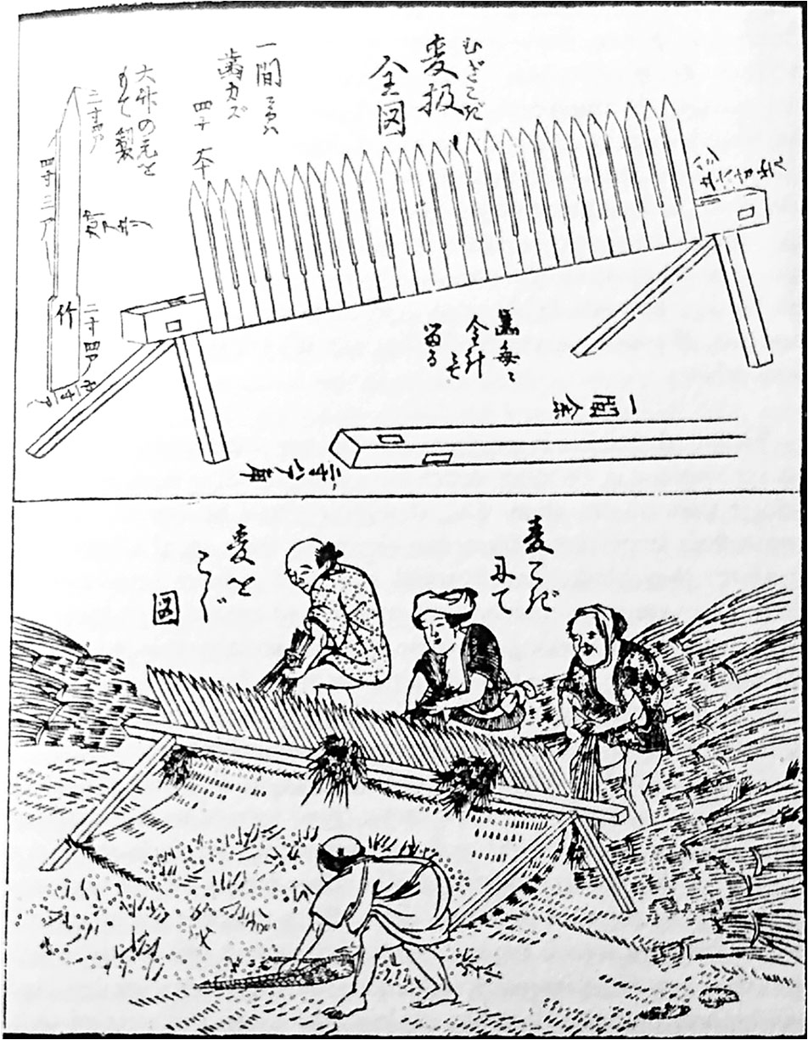
Japanese Peasants Threshing Wheat with the Semba-koki
Notes:
Japanese Peasants Threshing Wheat with the Semba-koki The top illustration provides the specification for making this device which became used at the end of the seventeenth century. It stripped wheat from the stalk far more efficiently and could be used by weaker family members. Particularly in the southern islands, this thresher saved enough labor during harvest that land could be plowed in time for a second crop. Japanese landlords learned about innovations from specialized publications and showed their tenants what to do.

Slide 13
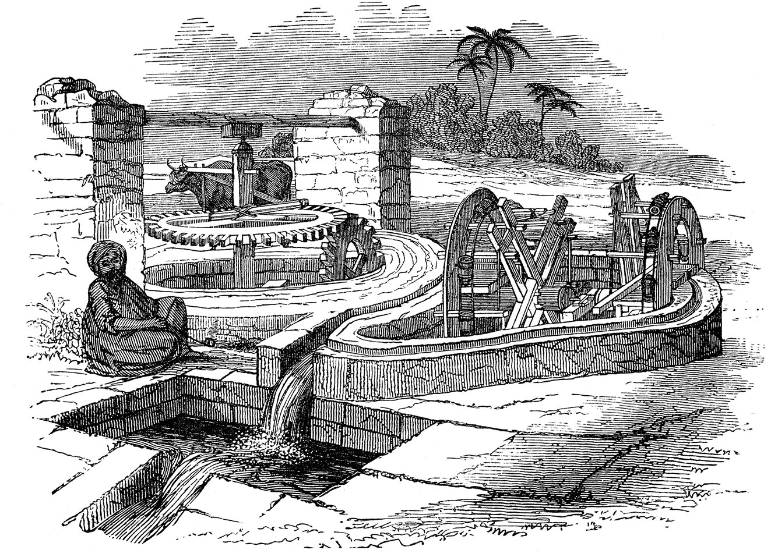
Irrigation in Nineteenth-Century Egypt
Notes:
Irrigation in Nineteenth-Century Egypt This illustration appeared in a French publication on hydrology by Paul Bory that appeared in 1888. It shows how water from the Nile River was pumped to sustain agriculture in the arid surrounding farmland. Once in place, the Egyptian has only to oversee the complex gearing and system of sluices powered by an ox.

Slide 14
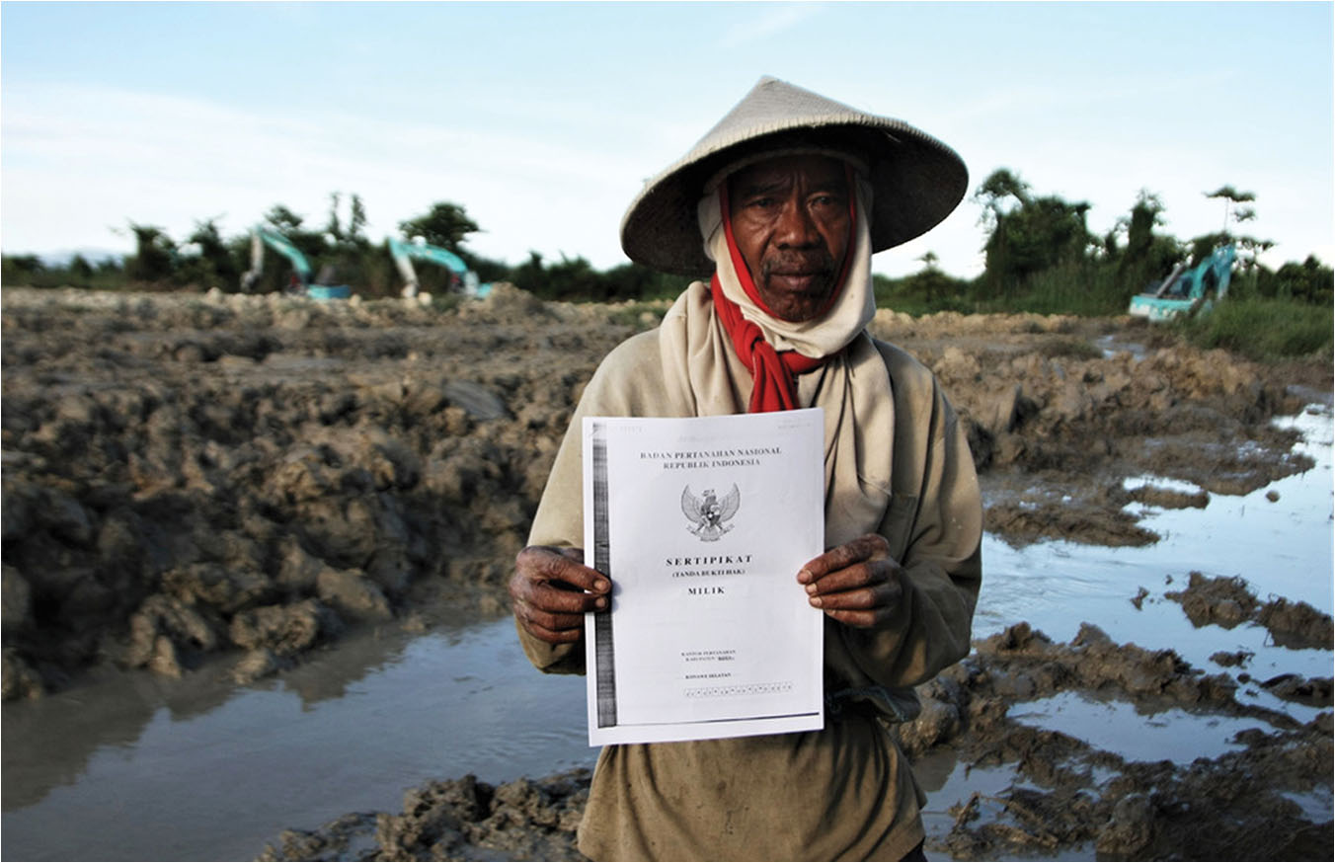
Limits of Land Reform in Indonesia (2018)
Notes:
Limits of Land Reform in Indonesia (2018) In 2013, the Indonesian government promised to provide ownership certificates to state forest lands. However, by refusing to give licenses to farm cleared land like the one pictured here in Sulawesi if there is any dispute over ownership, Indonesia has distributed less than ten percent of the promised 12.7 million hectares.

Slide 15
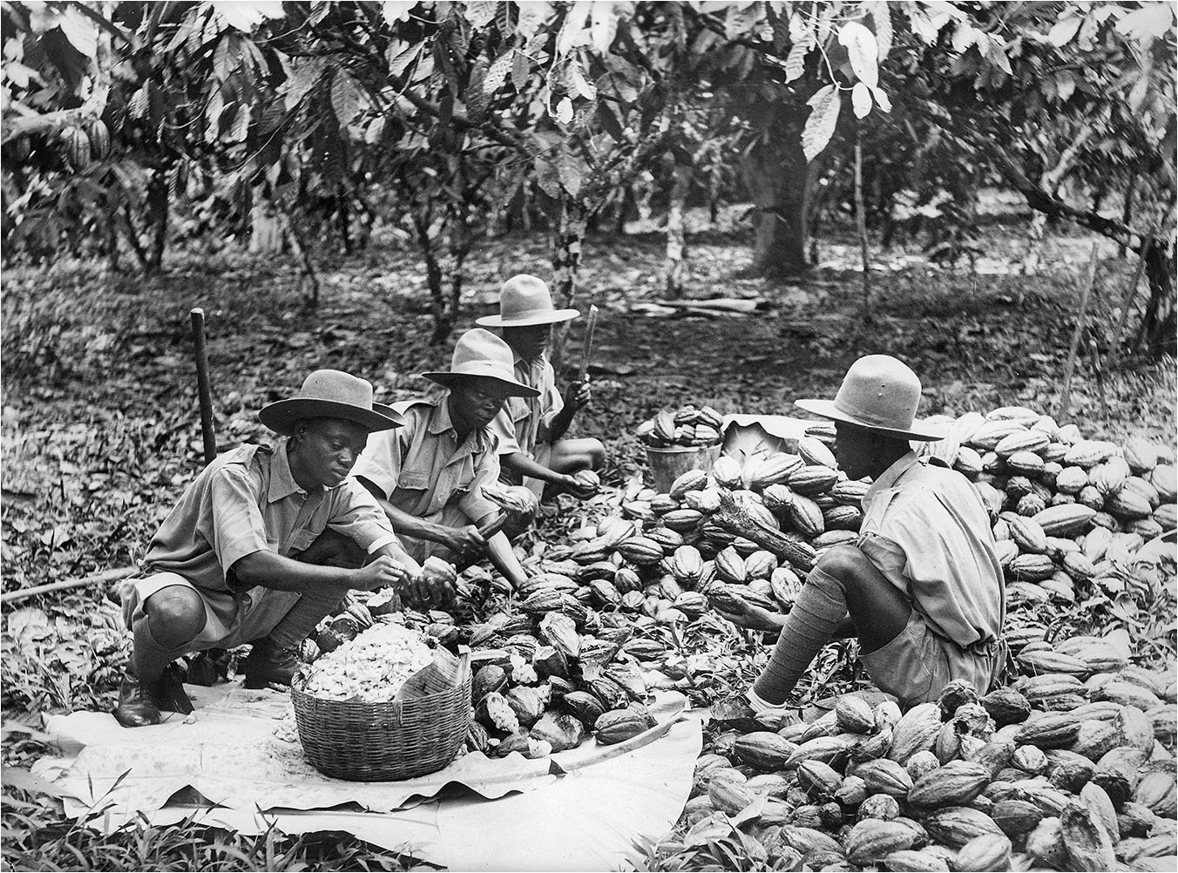
Drying Cocoa Beans in Gold Coast
Notes:
Drying Cocoa Beans in Gold Coast This photo dates from the colonial era when Gold Coast was the world’s largest producer of cocoa. Cocoa beans are picked from the tree by hand to avoid crushing the beans. They are then covered in plantain leaves and left to ferment for 3–9 days as is shown here. The beans are then sundried usually on a raised bamboo platform for 7–10 days; they must be stirred hourly, by hand. The high volume of manual labor and the availability of land has enabled small farmers to remain in control of the cocoa crop.

Slide 16
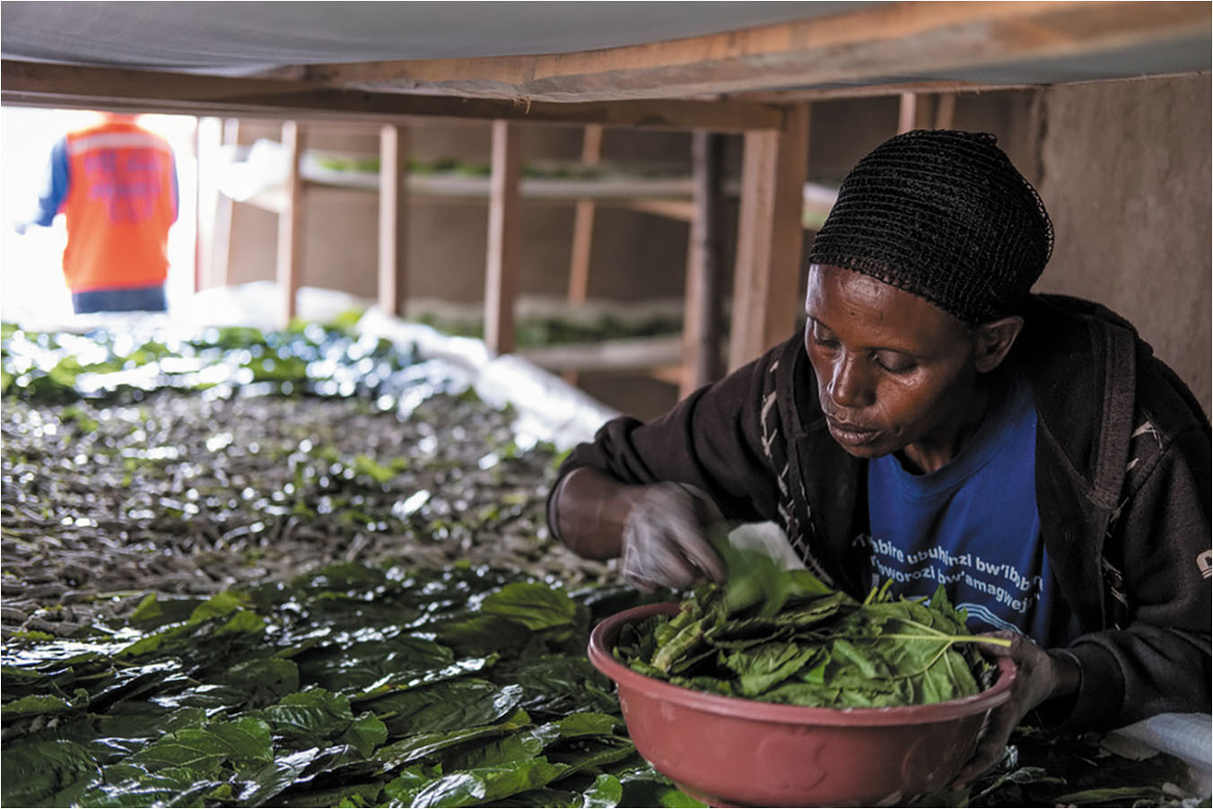
Rwandan Silk Rearing (2020)
Notes:
Rwandan Silk Rearing (2020) This photograph of Rwandan Pierre Kanjarwanda (b. 1973) feeding mulberry leaves to silkworms comes thanks to an investment in sericulture by a partnership of the United Nations’ International Fund for Agricultural Development (IFAD) and the government of Rwanda. Five-thousand farmers are now linked to manufacturers in South Korea to provide a cash crop to former subsistence farmers.

Slide 17
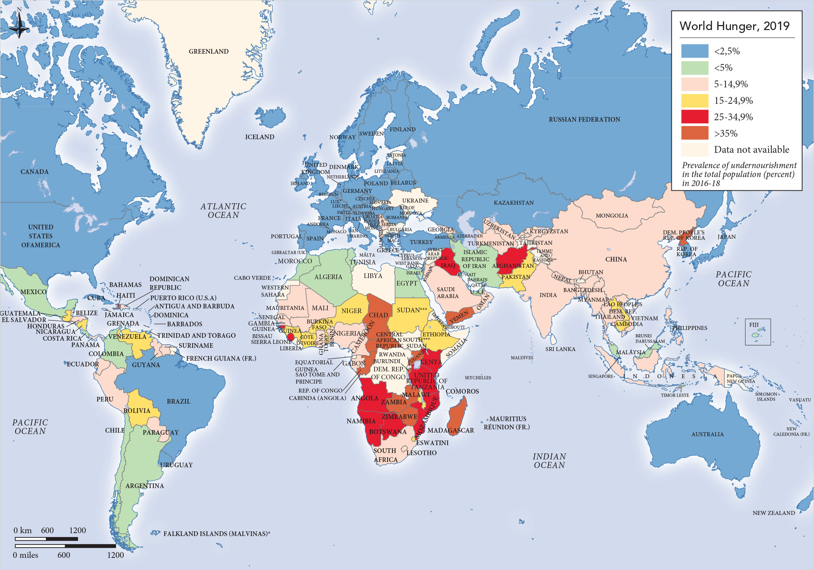
Map 10.4 This provocative map produced by the World Food Program
Notes:
Map 10.4 This provocative map produced by the World Food Program (https://www.wfp.org/) that operates under the aegis of the United Nations illustrates the geography of hunger and the lingering gap between rich and poor nations. It points to where the most vulnerable people are concentrated.

