Slide 1
Lecture slides
Connecting with Law
Fifth Edition
Michelle Sanson and Thalia Anthony
Teaching and Learning Resource material prepared by Michelle Sanson and Thalia Anthony, based on content from Connecting with Law, Fifth edition
USER AGREEMENT
These slides include resources from Connecting with Law, fifth edition, and are made available for teaching use only to those using the book as a text in their courses. Users are free to copy and modify the material as needed for teaching purposes (e.g. incorporating them into lecture notes/slides or student handouts), provided that the authors are acknowledged. The slides can be placed on university-controlled unit or subject-related websites (that are password protected), as long as these are restricted to student use and not accessible to the public at large. Permission from the publisher should be sought to use the slides in any other manner.
© Oxford University Press 2022

Slide 2
CHAPTER 1
LEARNING LAW: HOW CAN I DEVELOP A LEGAL MIND?

Slide 3
CHAPTER 1
LEARNING LAW: HOW CAN I DEVELOP A LEGAL MIND?
Covered in this chapter:
How learning law is different from other disciplines
Inductive, deductive and analogical reasoning
Threshold Learning Outcomes (TLOs) in law
How to succeed in law school
Being an ethical student

Slide 4
KEY TERMS
Critical analysis = using powers of observation, reasoning, reflection and questioning to interpret information and make findings or form opinions based on it.
Critical thinking = maintaining an enquiring mind in evaluating information and seeking out hidden assumptions and contradictions.
Deductive reasoning = using a general theory to test specific facts. For example: ‘All dogs bark. Rufus is a dog. Therefore, Rufus barks.’
Diversity = the coexistence of differences such as in culture, gender, sexuality, age, culture, capacity and perspectives.
Ethics = a field of thinking about what is morally right, appropriate and acceptable.
Graduate attributes = generic skills, attitudes and values, plus specific content knowledge, expected of students who have completed a tertiary course of study.

Slide 5
Independent learning = students taking the primary responsibility and initiative for their own learning, including being able to recognise gaps in their learning and where to find the information to fill them.
Inductive reasoning = using specific examples to create generalisations. For example: ‘Apples rot. Pears rot. Bananas rot. Therefore, all fruit rots.’
Information literacy = knowing what information is available, when it is needed, and how to find it and use it effectively; and recognising its inherent strengths and limitations.
Lifelong learning = a perspective which holds that continuous learning is a fundamental part of one’s personal and professional life.
Self-management = strategies and processes by which a person manages their time, thoughts, feelings, goals and actions.
Threshold learning outcome = the minimum discipline-based learning outcome of a course of tertiary studies. For law there are six – knowledge, ethics and professional responsibility, thinking skills, research skills, communication and collaboration, and self-management.

Slide 6
LAW AS A DISCIPLINE
How law is different from other disciplines
Narrower focus (on the law) than on people’s lives and society, like sociologists
Less likely to have a clear single right answer like mathematics and science
Communications are less rich and expressive than arts and humanities
Growing recognition of need for interdisciplinary approaches

Slide 7
2 LEGAL REASONING
Thinking like a lawyer
Non-assumptive thinking
Facts over emotions
Tolerance of ambiguity
Seeing connections between facts, documents and laws
Verbal mapping and ordering
Automatic devil’s advocacy

Slide 8
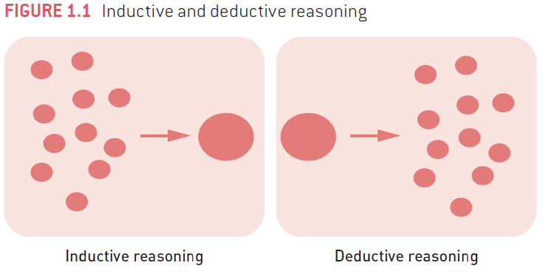
2 LEGAL REASONING
Beyond legal reasoning
→ Is legal reasoning enough? Or is contextual reasoning equally important, towards holistic lawyering?

Slide 9
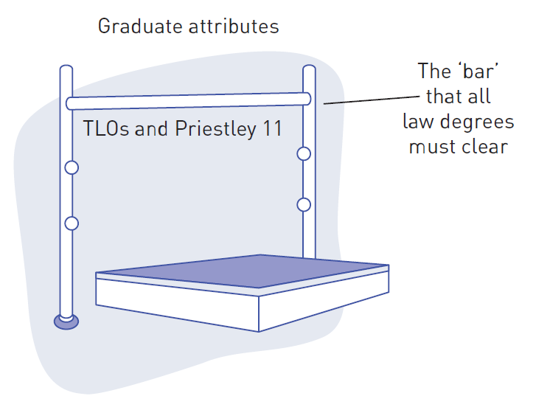
3 OUTCOMES OF YOUR LEGAL EDUCATION
Priestley 11
Threshold Learning Outcomes (TLOs)
Graduate attributes

Slide 10
3 OUTCOMES OF YOUR LEGAL EDUCATION
Threshold Learning Outcomes (TLOs)
TLO 1: Knowledge
Graduates of the Bachelor of Laws will demonstrate an understanding of a coherent body of knowledge that includes:
a The fundamental area of legal knowledge, the Australian legal system, and underlying principles and concepts, including international and comparative contexts;
b The broader contexts within which legal issues arise; and
c The principles and values of justice and of ethical practice in lawyers’ roles.

Slide 11
3 OUTCOMES OF YOUR LEGAL EDUCATION
Threshold Learning Outcomes (TLOs)
TLO 2: Ethics and Professional Responsibility
Graduates of the Bachelor of Laws will demonstrate:
a An understanding of approaches to ethical decision-making;
b An ability to recognize and reflect upon, and a developing ability to respond to legal issues;
c An ability to recognize and reflect upon the professional responsibility of lawyers in promoting justice and in service to the community; and
d A developing ability to exercise professional judgement.

Slide 12
3 OUTCOMES OF YOUR LEGAL EDUCATION
Threshold Learning Outcomes (TLOs)
TLO 3: Thinking Skills
Graduates of the Bachelor of Laws will be able to:
a Identify and articulate legal issues;
b Apply legal reasoning and research to generate appropriate responses to legal issues;
c Engage in critical analysis and make a reasoned choice amongst alternatives; and
d Think creatively in approaching legal issues and generating appropriate responses.

Slide 13
3 OUTCOMES OF YOUR LEGAL EDUCATION
Threshold Learning Outcomes (TLOs)
TLO 4: Research Skills
Graduates of the Bachelor of Laws will demonstrate the intellectual and practical skills needed to identify, research, evaluate and synthesise relevant factual, legal and policy issues.
TLO 5: Communication and Collaboration
Graduates of the Bachelor of Laws will be able to:
a Communicate in ways that are effective, appropriate and persuasive for legal and non-legal audiences; and
b Collaborate effectively.

Slide 14
3 OUTCOMES OF YOUR LEGAL EDUCATION
Threshold Learning Outcomes (TLOs)
TLO 6: Self-Management
Graduates of the Bachelor of Laws will be able to:
a Learn and work independently; and
b Reflect on and assess their own capabilities and performance, and make use of feedback as appropriate to support personal and professional development.

Slide 15
3 OUTCOMES OF YOUR LEGAL EDUCATION
Priestley 11
  Federal and State Constitutional Law
  Criminal Law and Procedure
  Contracts
  Torts
  Administrative Law
  Company Law
  Property
  Equity and Trusts
  Evidence
  Civil Dispute Resolution
  Ethics and Professional Responsibility
Graduate attributes
Identify the applicable graduate attributes for your courses, including for introductory law subjects

Slide 16
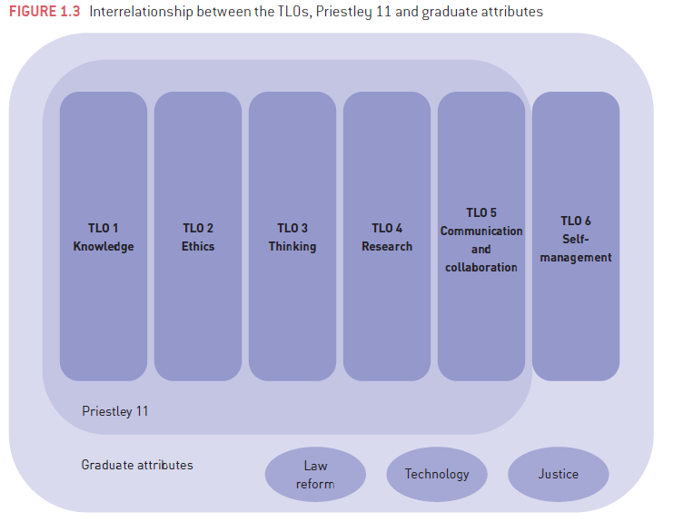
3 OUTCOMES OF YOUR LEGAL EDUCATION

Slide 17
Get organised
Plan and prioritise
Speed-read
Find synergies
Block out time
Snippets
Study groups
Best time
Self-negotiation
Back-up
SUCCESS IN LAW SCHOOL
Being productive

Slide 18
SUCCESS IN LAW SCHOOL
Tackling assessments
Types of exams: open book, restricted open book, closed book, and take home
Types of exam questions: essay questions, problem questions, short- answer questions, and multiple- choice questions
Problem solving: IRAC method
  I Identify the Issues
  R Identify the applicable legal Rules
  A Apply the law to the facts
  C Reach a Conclusion
Being an ethical student
Academic integrity
Academic misconduct
Consequences

Slide 19
DISCUSSION QUESTIONS
1. There can often be an imbalance of power between parties to litigation. Do you think lawyers have greater ethical obligations where their client is more powerful than the opposing lawyers’ client? Why, or why not?
2. The Constitution of Malaysia allows for a combination of secular law (civil and criminal law) and Islamic law, which applies only to Muslims. There is a Syariah Court (sharia) which has civil jurisdiction over matters such as marriage, and criminal jurisdiction with power to impose fines and prison sentences. What are some advantages and disadvantages of this approach?
3. Why is lifelong learning important? Do you think it is becoming more, or less important? Why?
4. Think back to the exams and essays you have done in previous studies. What aspects have you found easy and difficult? Have you had trouble with running out of time in exams, or leaving too much of the work on an essay until the last minute? You can learn from these and avoid making the same mistakes in law school.

