Slide 1
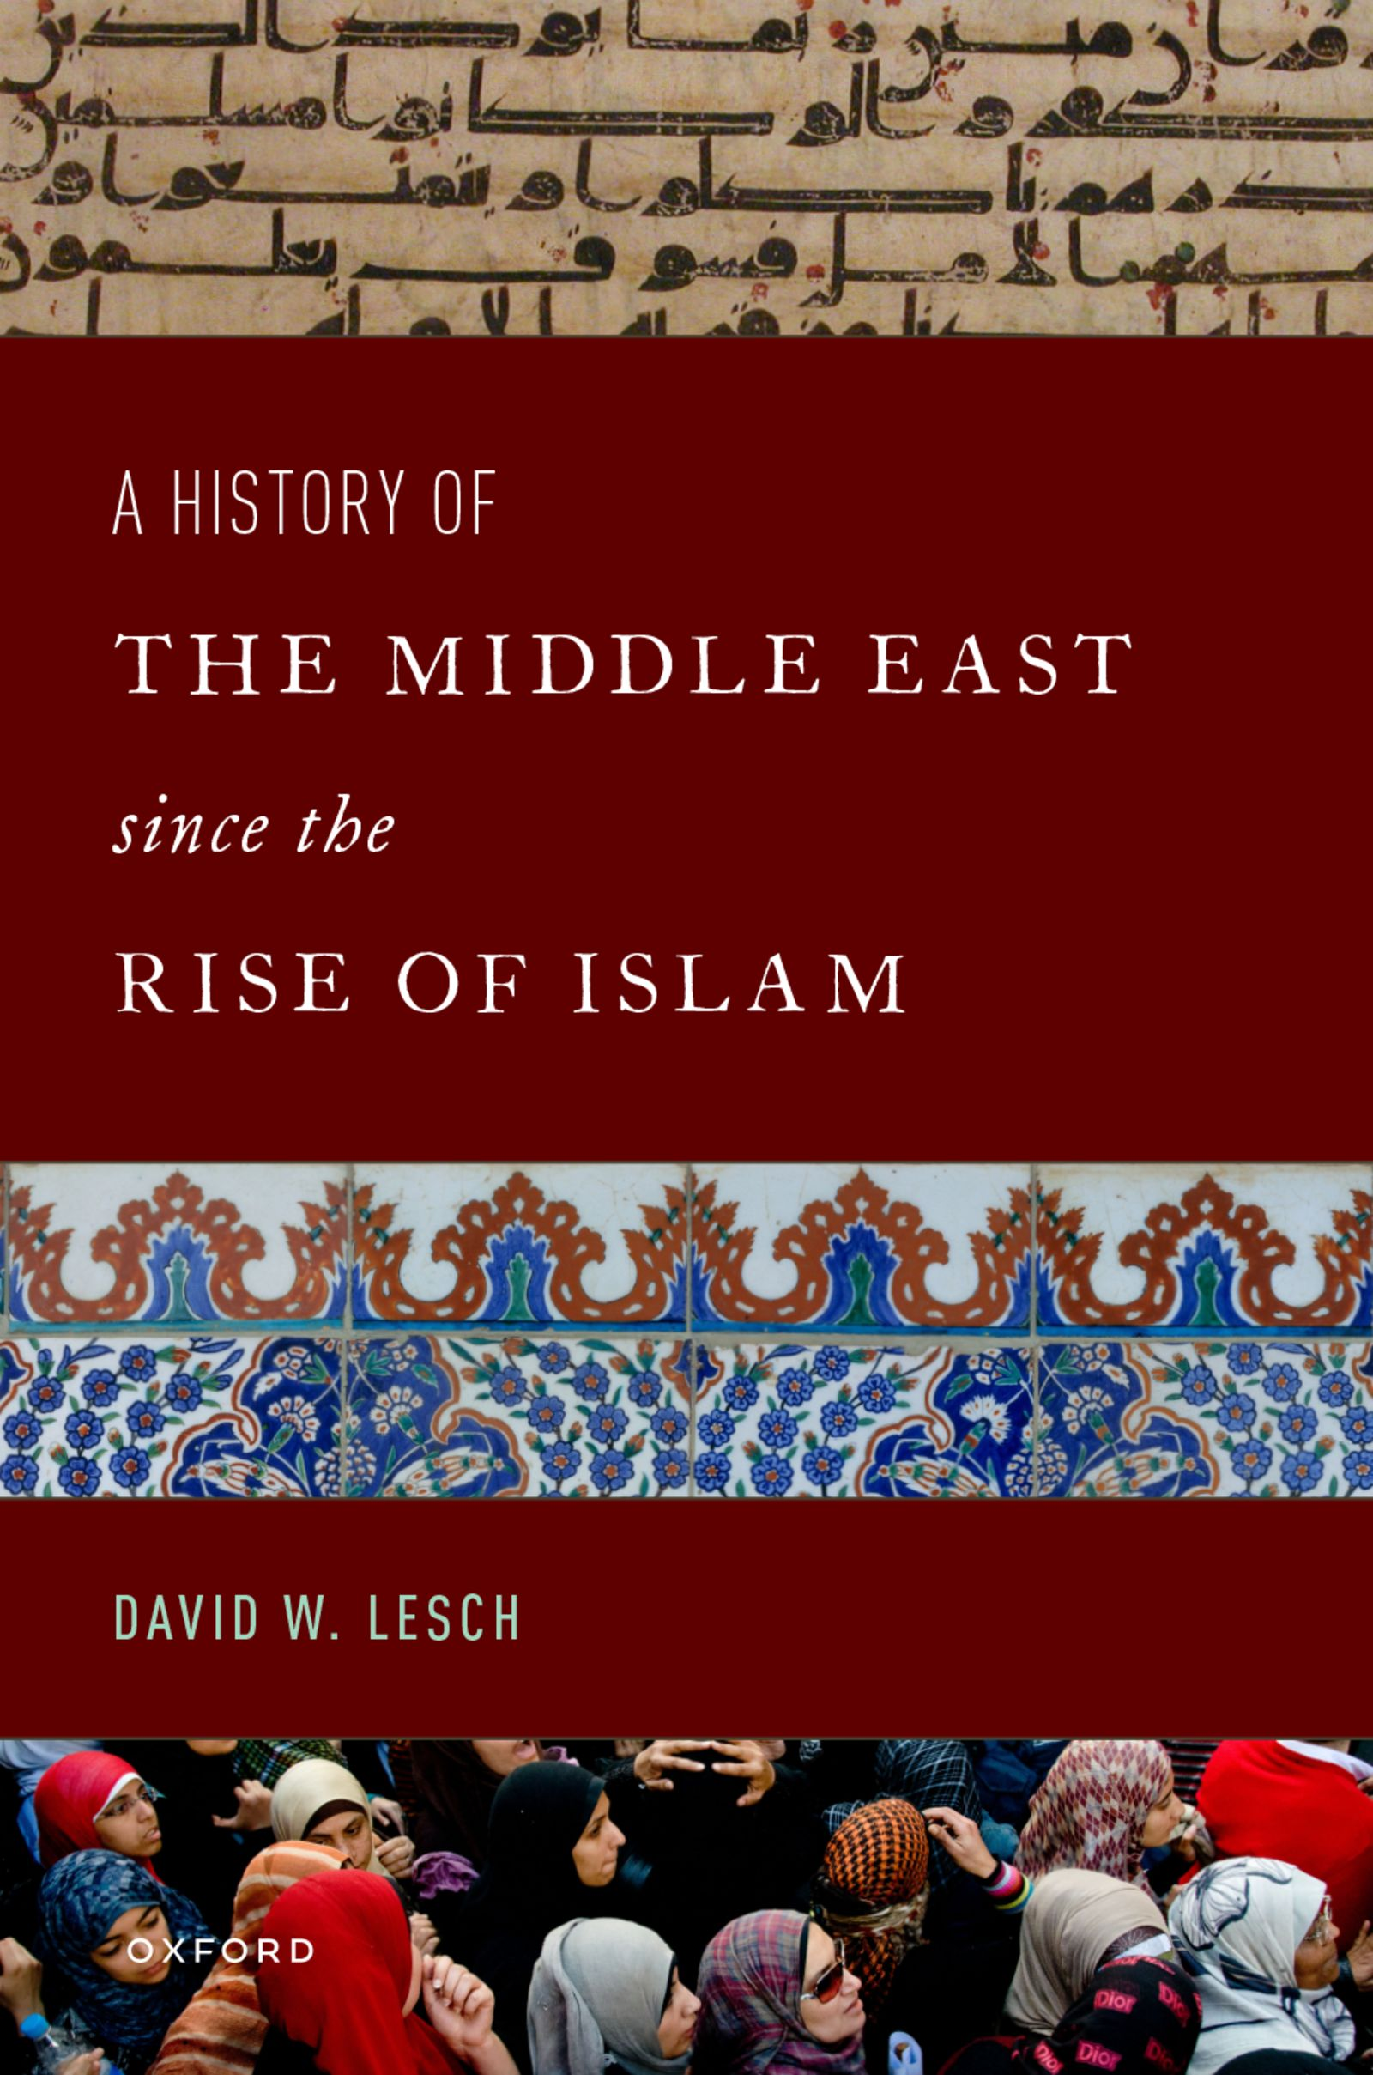
A History of the Middle East Since the Rise of Islam
by David W. Lesch

Slide 2
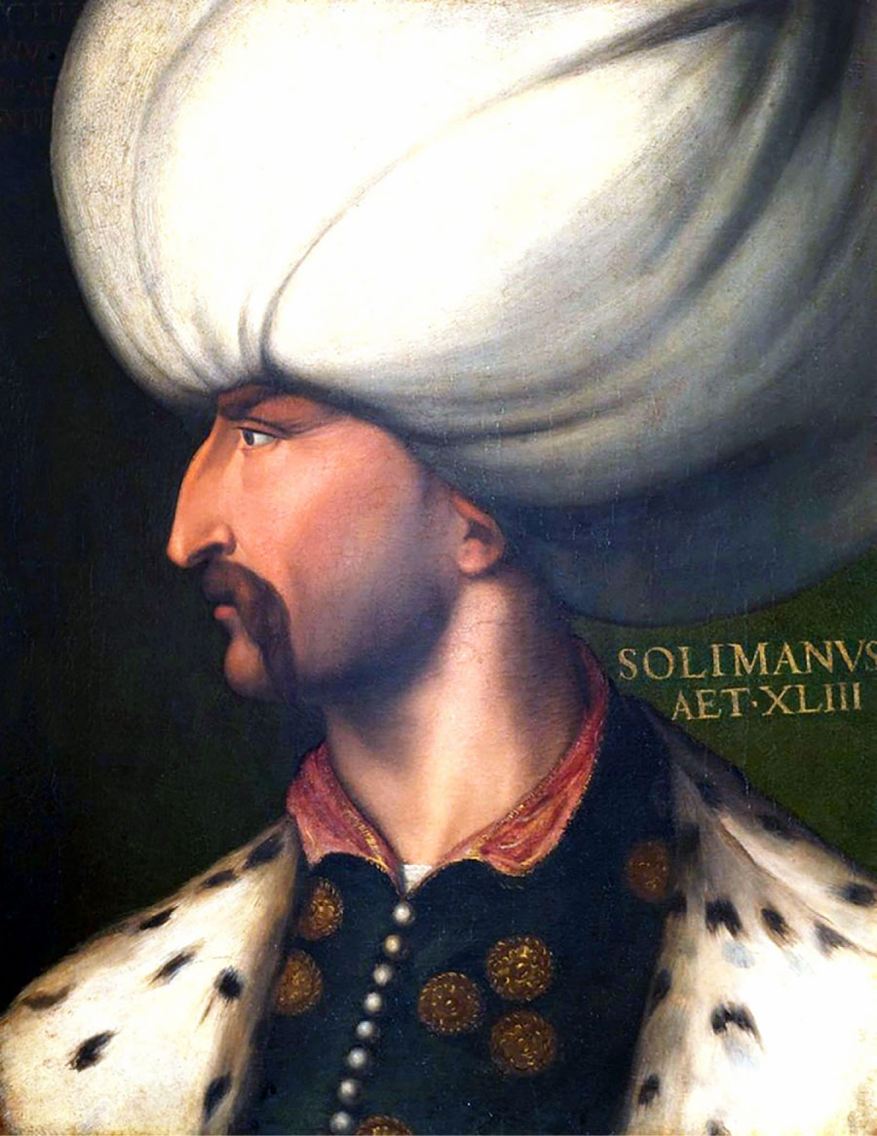
Sultan Suleyman I (1494–1566), also known as “Suleyman the Magnificent” and “Suleyman the Lawmaker,” was the tenth and longest reigning sultan of the Ottoman Empire.
Notes:
Sultan Suleyman I (1494–1566), also known as “Suleyman the Magnificent” and “Suleyman the Lawmaker,” was the tenth and longest reigning sultan of the Ottoman Empire.
CPA Media Pte Ltd/Alamy Stock Photo

Slide 3
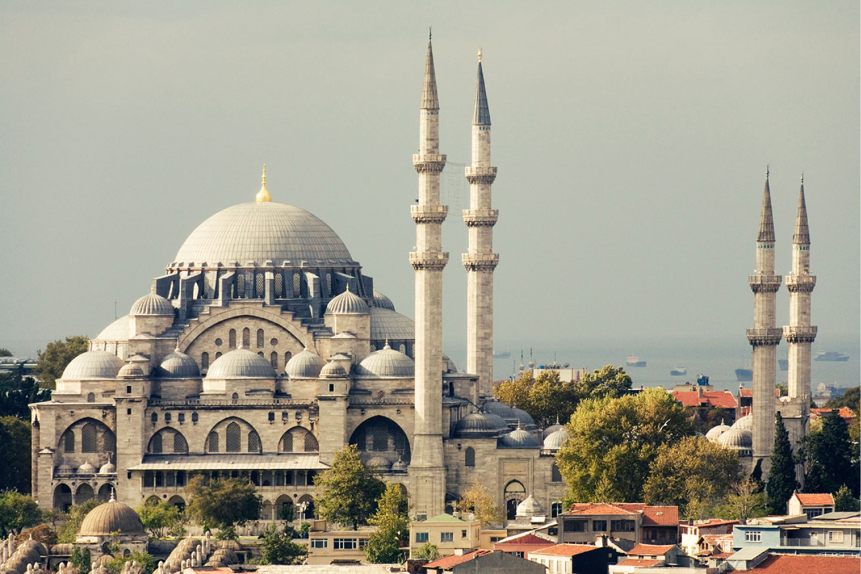
Sulaymaniyyah Mosque in Istanbul, Turkey, built in the 1550s by the famous Ottoman architect, Sinan.
Notes:
Sulaymaniyyah Mosque in Istanbul, Turkey, built in the 1550s by the famous Ottoman architect, Sinan.
mastix/Alamy Stock Photo

Slide 4
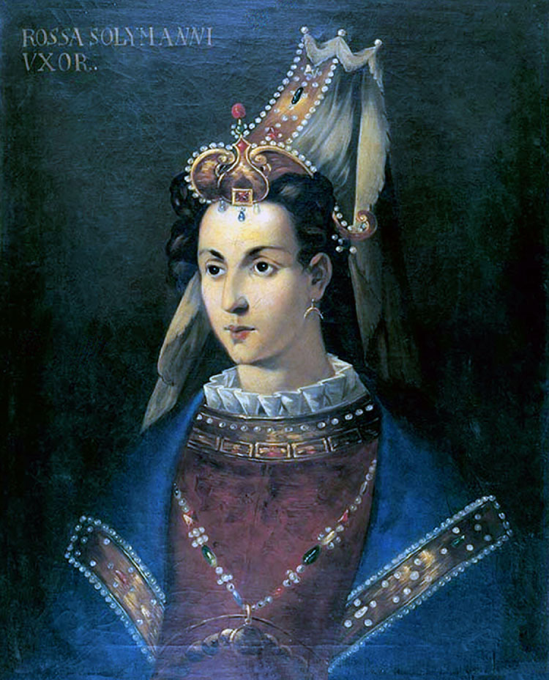
Her Imperial Majesty the Empress consort Hürrem Sultan of the Ottoman Empire, known to Europeans informally as simply Roxelana (c. 1500–1558),
Notes:
Her Imperial Majesty the Empress consort Hürrem Sultan of the Ottoman Empire, known to Europeans informally as simply Roxelana (c. 1500–1558), was the wife of Sülayman the Magnificent of the Ottoman Empire. Anonymous eighteenth-century painting.
CPA Media Pte Ltd/Alamy Stock Photo

Slide 5
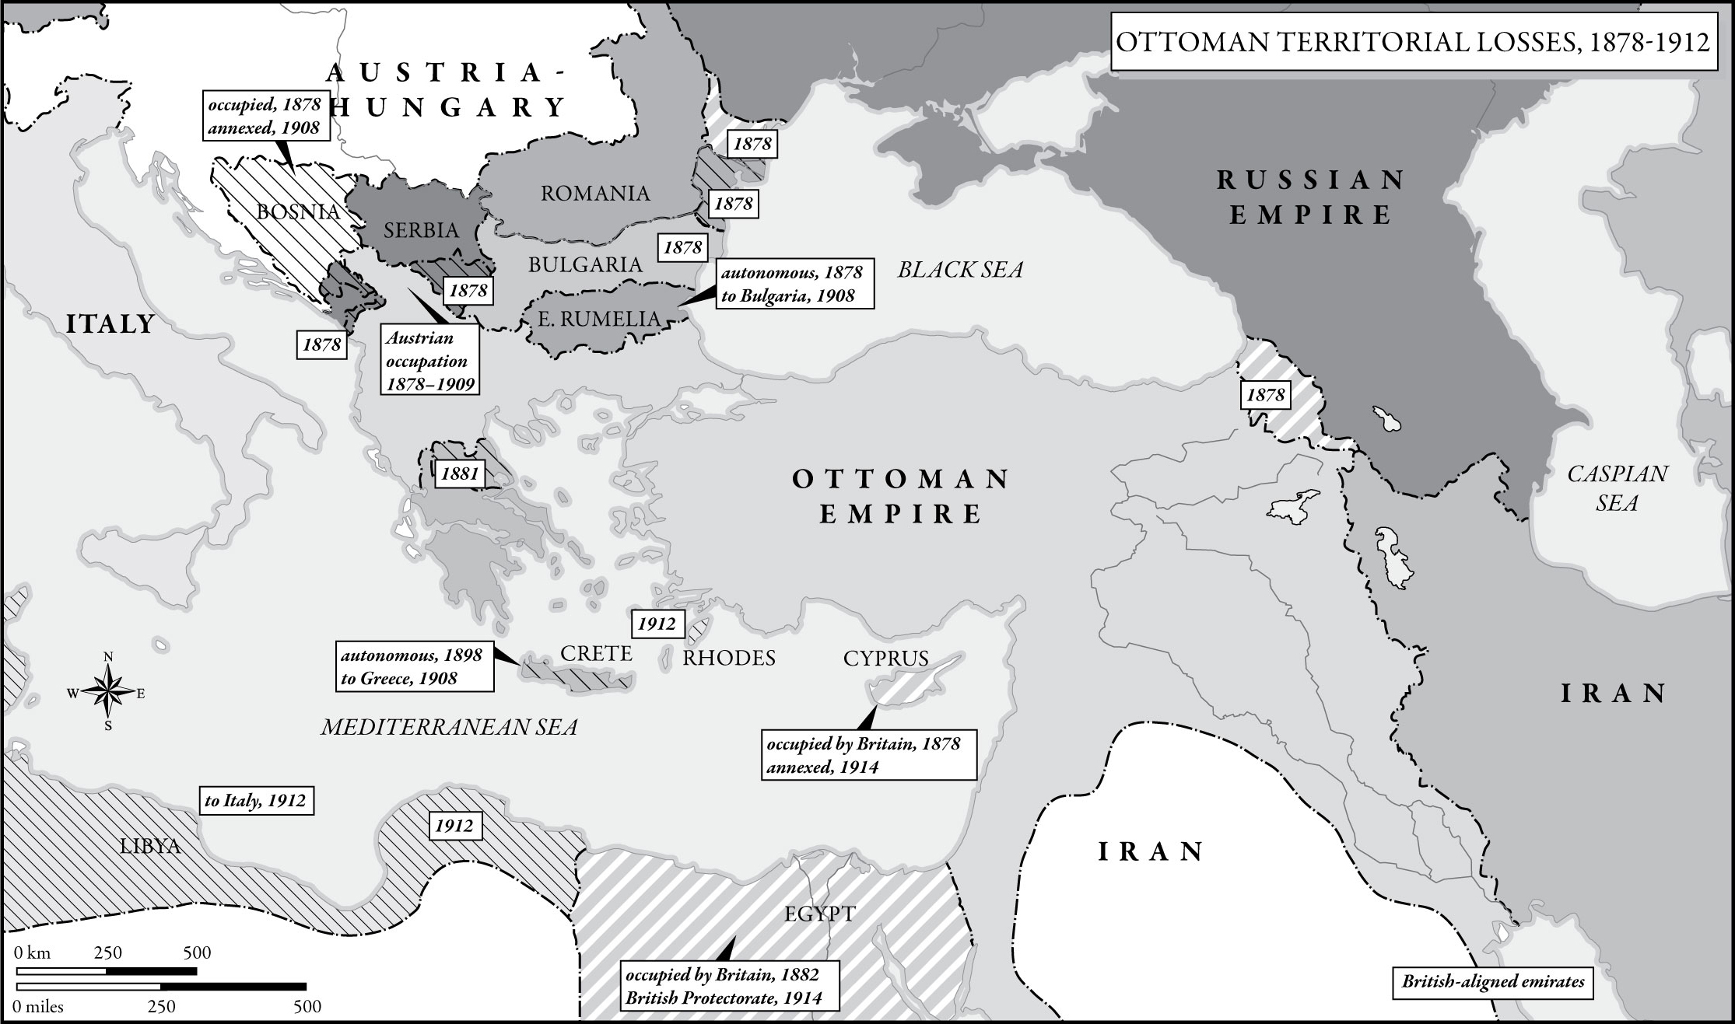
Map 15 Ottoman Territorial Losses, 1878–1912
Notes:
Map 15 Ottoman Territorial Losses, 1878–1912

Slide 6
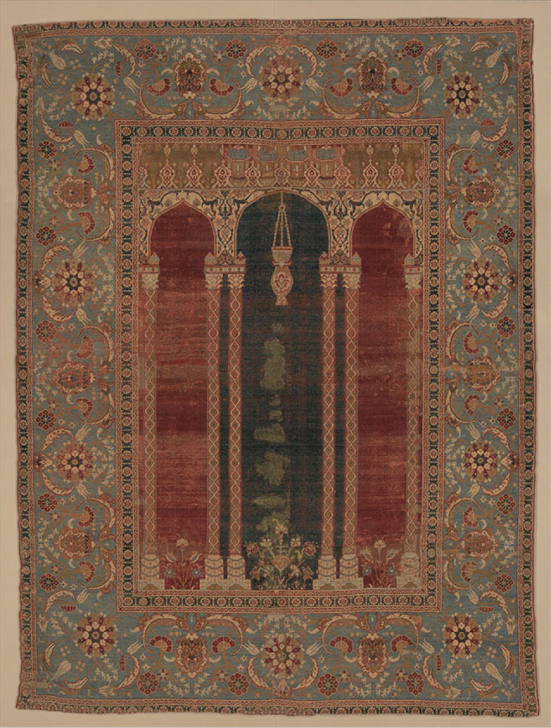
Carpet with Triple-Arch Design c. 1575–1590.
Notes:
Carpet with Triple-Arch Design c. 1575–1590. One of the earliest carpets to include a triple-arched gateway, its design probably originated in the Ottoman imperial workshop. The combination of this carpet’s imagery, high quality, and relatively small size suggest that it was used as a prayer rug by a member of the Ottoman courtly elite.
The Metropolitan Museum of Art

Slide 7
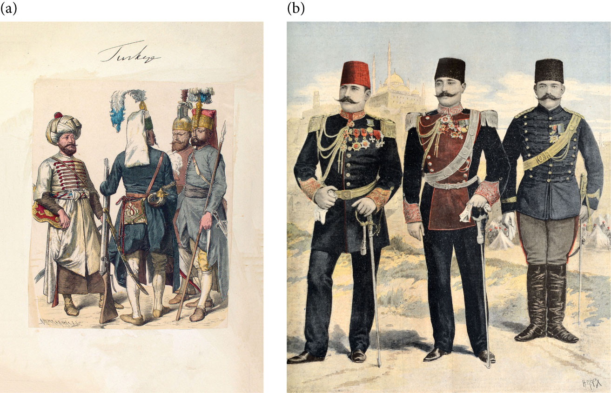
Lithograph showing Ottoman soldiers, 1600–1805. Ottoman Army officers in 1895. Vintage illustration by Henri Meyer.
Notes:
Lithograph showing Ottoman soldiers, 1600–1805.
mccool/Alamy Stock Photo
Ottoman Army officers in 1895. Vintage illustration by Henri Meyer.
Chris Hellier/Alamy Stock Photo

