Slide 1
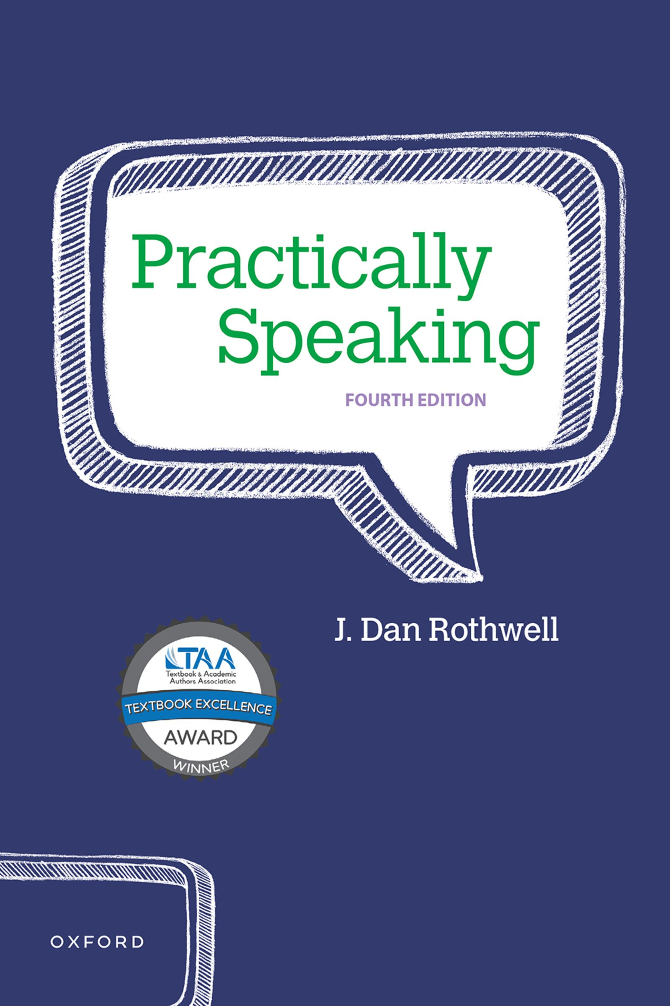
Practically Speaking
by J. Dan Rothwell

Slide 2
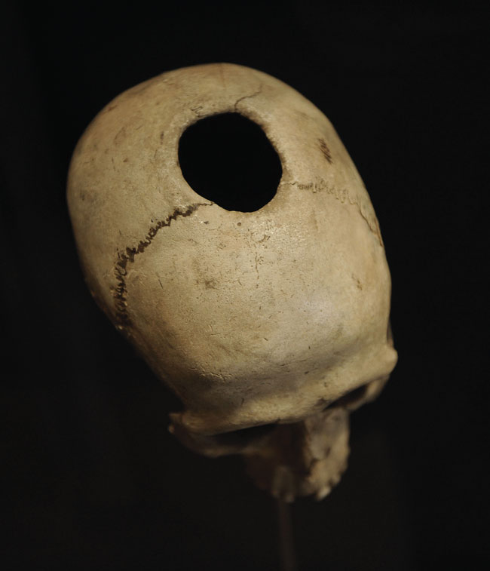
PHOTO 12.1: Trephining was a primitive procedure that involved drilling a hole in a person’s skull while alive to release evil spirits or “mad thoughts.”
Notes:
PHOTO 12.1: Trephining was a primitive procedure that involved drilling a hole in a person’s skull while alive to release evil spirits or “mad thoughts.” Clearly, not all ideas are equal. We like to think that credible reasoning and evidence have advanced significantly since those dark days of ignorance. Recent “truth decay,” however, raises concerns.

Slide 3
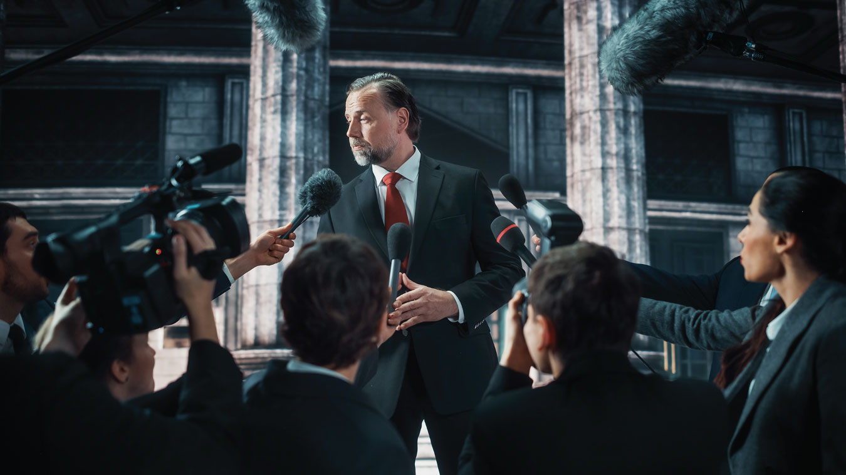
PHOTO 12.2: Confirmation bias can leave you unprepared for strong counterarguments and research that might be used against you in a debate or an exchange with class members, business colleagues, conference attendees, or even in some cases the press after your speech.
Notes:
PHOTO 12.2: Confirmation bias can leave you unprepared for strong counterarguments and research that might be used against you in a debate or an exchange with class members, business colleagues, conference attendees, or even in some cases the press after your speech.

Slide 4
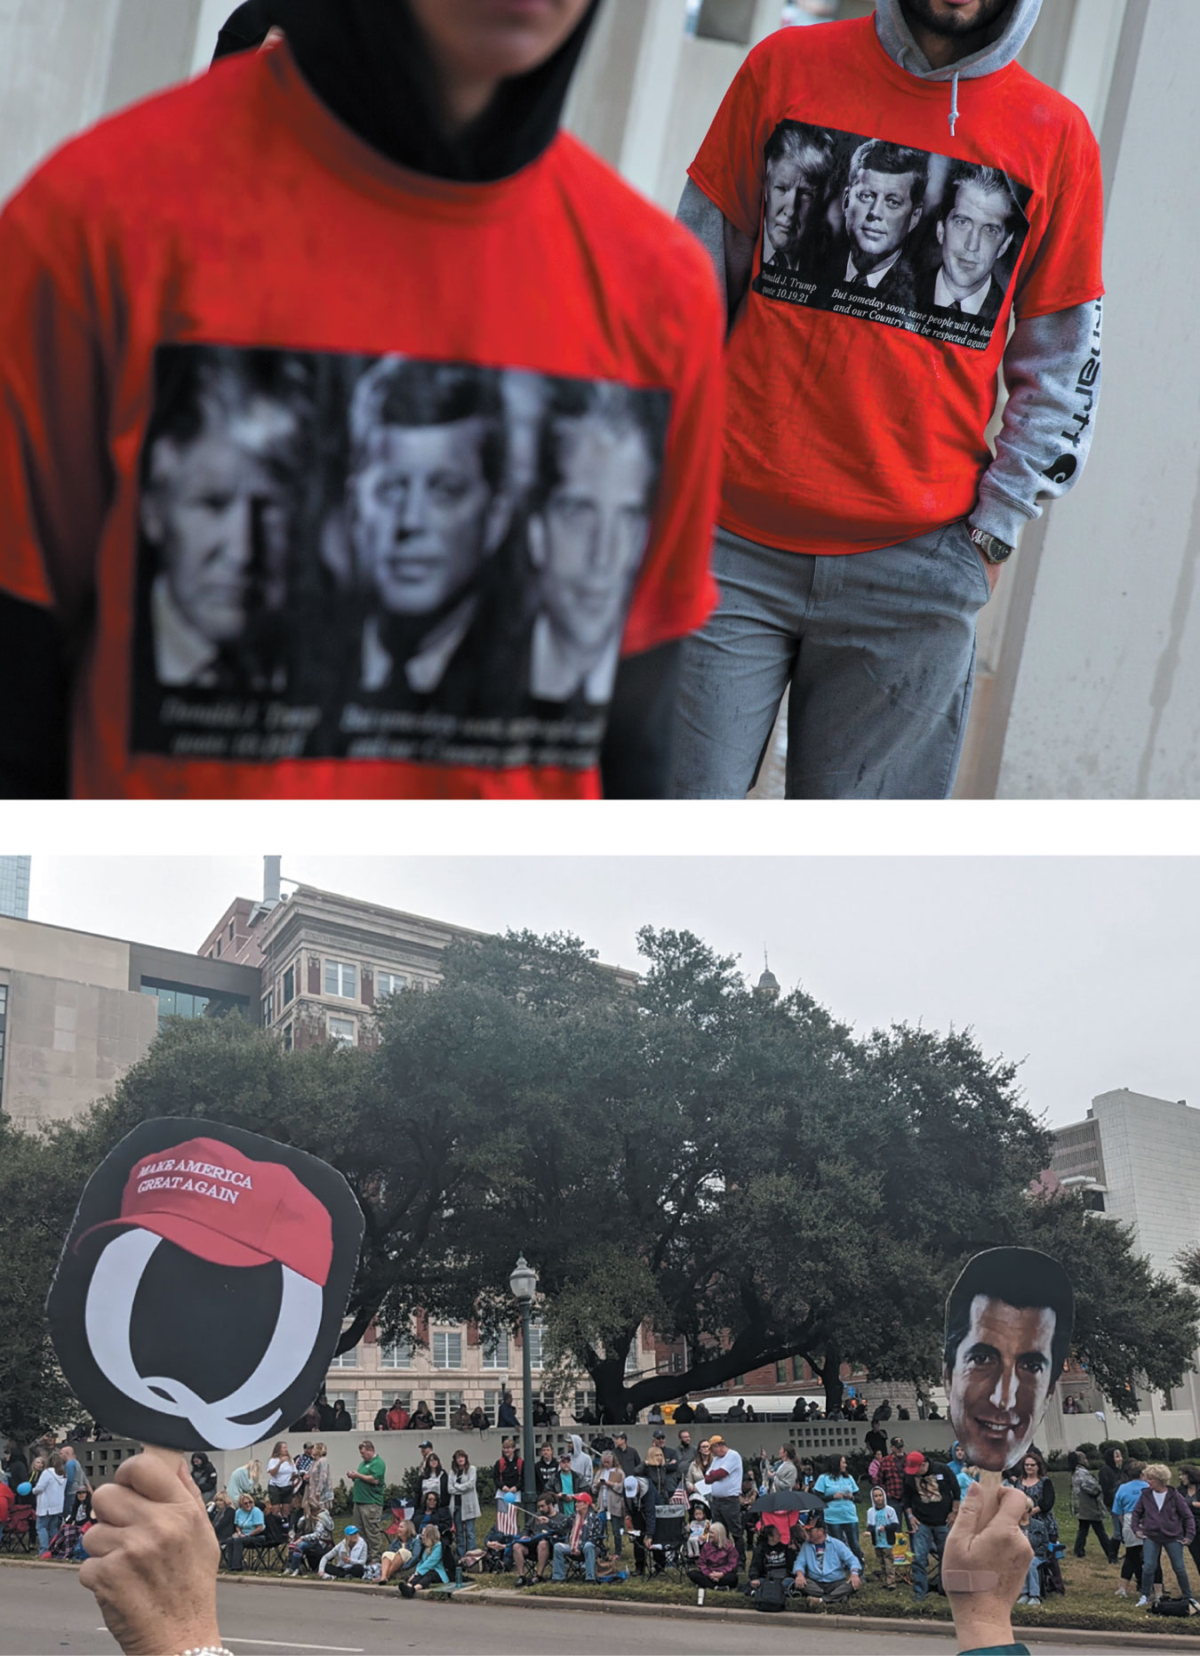
PHOTOS 12.3 & 12.4: QAnon acolytes gather on Dealey Plaza in Dallas, sight of the JFK assassination, awaiting JFK’s return (resurrection?) along with his son John Jr., who was killed in a plane crash in 1999.
Notes:
PHOTOS 12.3 & 12.4: QAnon acolytes gather on Dealey Plaza in Dallas, sight of the JFK assassination, awaiting JFK’s return (resurrection?) along with his son John Jr., who was killed in a plane crash in 1999. Speakers proselytized at these rallies until they became “hoarse before throngs of followers” (Stieb, 2021). True belief can reach staggering heights of irrationality. Is this a serious problem or merely a few hundred deluded individuals? QAnon claims a million followers, but one study found that about a fifth of respondents will not change any of their strong beliefs regardless of the evidence (Pennycock et al., 2020). True belief is not inconsequential.

Slide 5
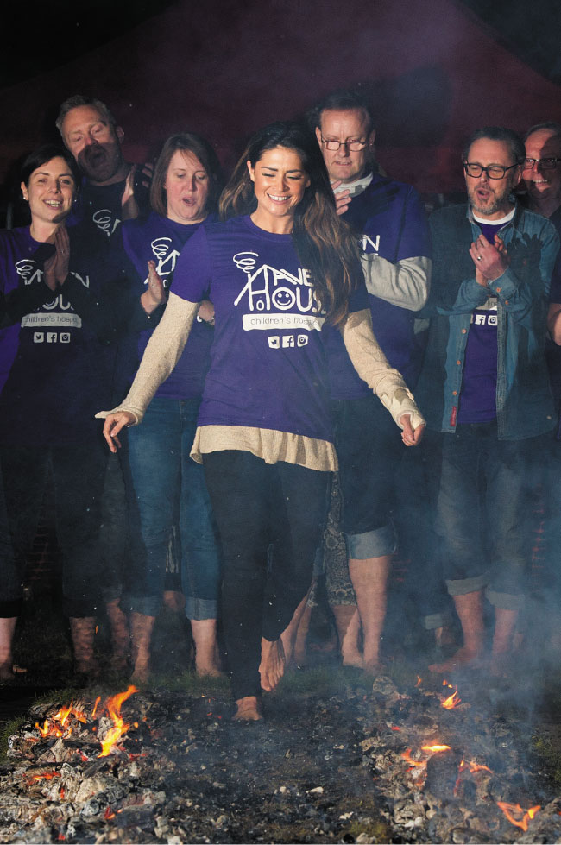
PHOTO 12.5: This activity is called firewalking, not firestanding, for a reason. Firestanding would result in horrible burns; firewalking is simple physics—keep moving and you won’t likely be burned.
Notes:
PHOTO 12.5: This activity is called firewalking, not firestanding, for a reason. Firestanding would result in horrible burns; firewalking is simple physics—keep moving and you won’t likely be burned. The extraordinary claim of “mind over matter” exhibited by firewalking enthusiasts requires extraordinary proof far beyond this simple demonstration.

Slide 6
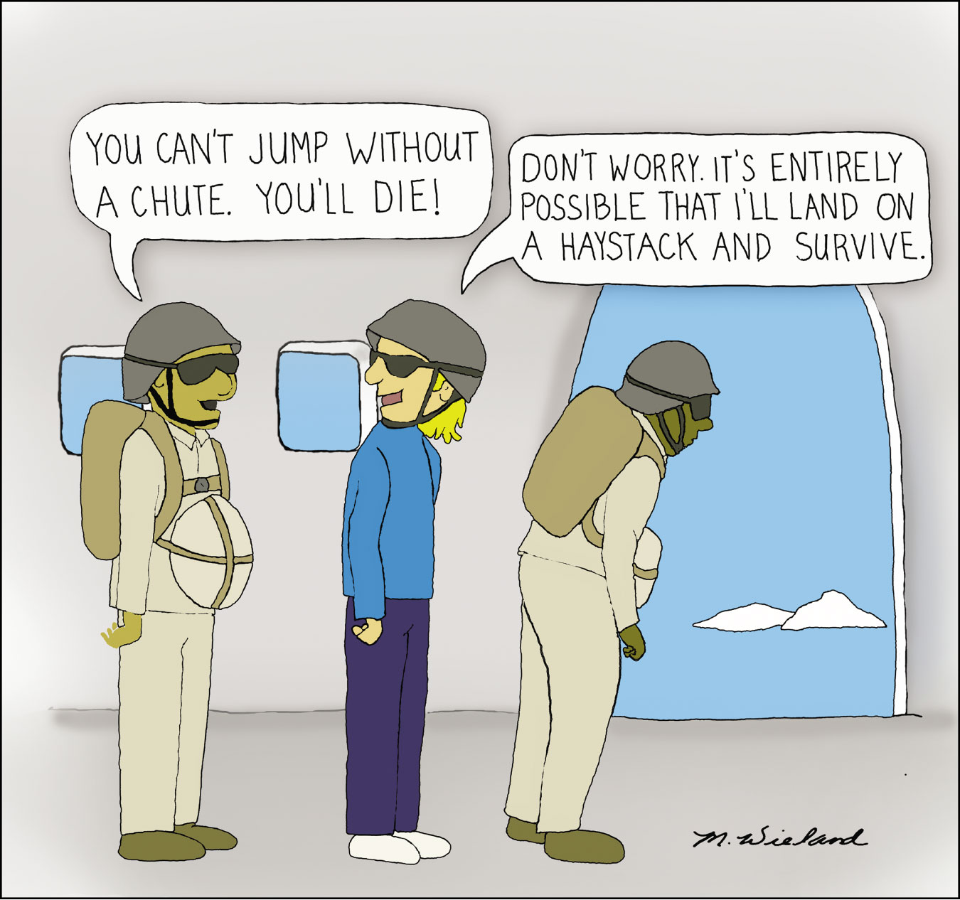
CARTOON 12.1: Basing your decisions on only a possibility is silly in the extreme. It makes the weakest “possible” argument for a speech.
Notes:
CARTOON 12.1: Basing your decisions on only a possibility is silly in the extreme. It makes the weakest “possible” argument for a speech.

Slide 7
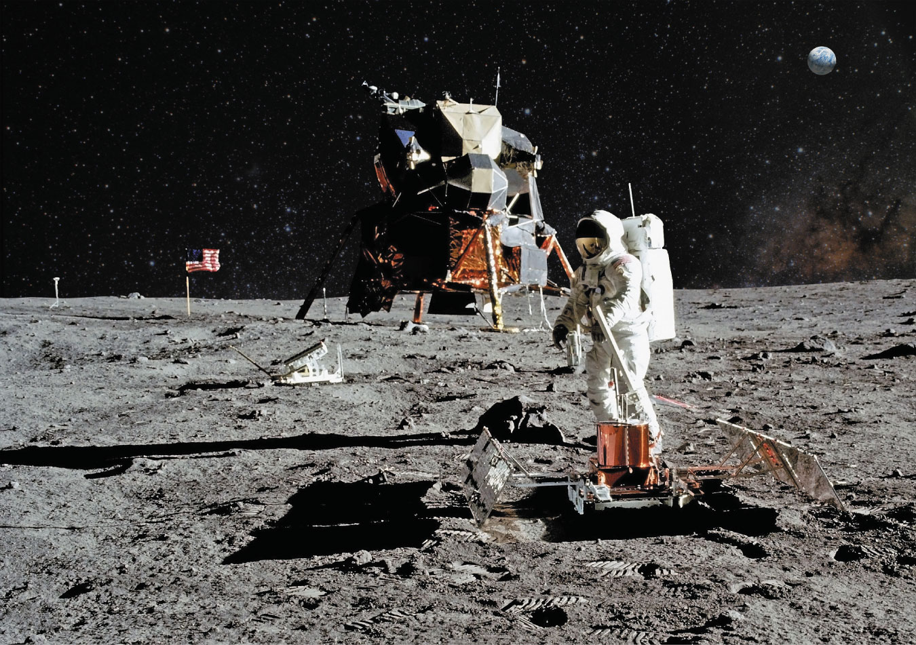
PHOTO 12.6: The “Moon landing hoax” is one of those persistent conspiracy theories that defies logic and is contradicted by massive mountains of evidence. True believers, however, are impervious to such overwhelming support. The hoax claim is implausible.
Notes:
PHOTO 12.6: The “Moon landing hoax” is one of those persistent conspiracy theories that defies logic and is contradicted by massive mountains of evidence. True believers, however, are impervious to such overwhelming support. The hoax claim is implausible.

Slide 8

PHOTO 12.7: Open-mindedness does not mean that you have to listen to hateful bigotry spouted, for example, by Westboro Baptist Church members.
Notes:
PHOTO 12.7: Open-mindedness does not mean that you have to listen to hateful bigotry spouted, for example, by Westboro Baptist Church members.

