Slide 1
A People’s History of the World
Jeff Horn

Slide 2
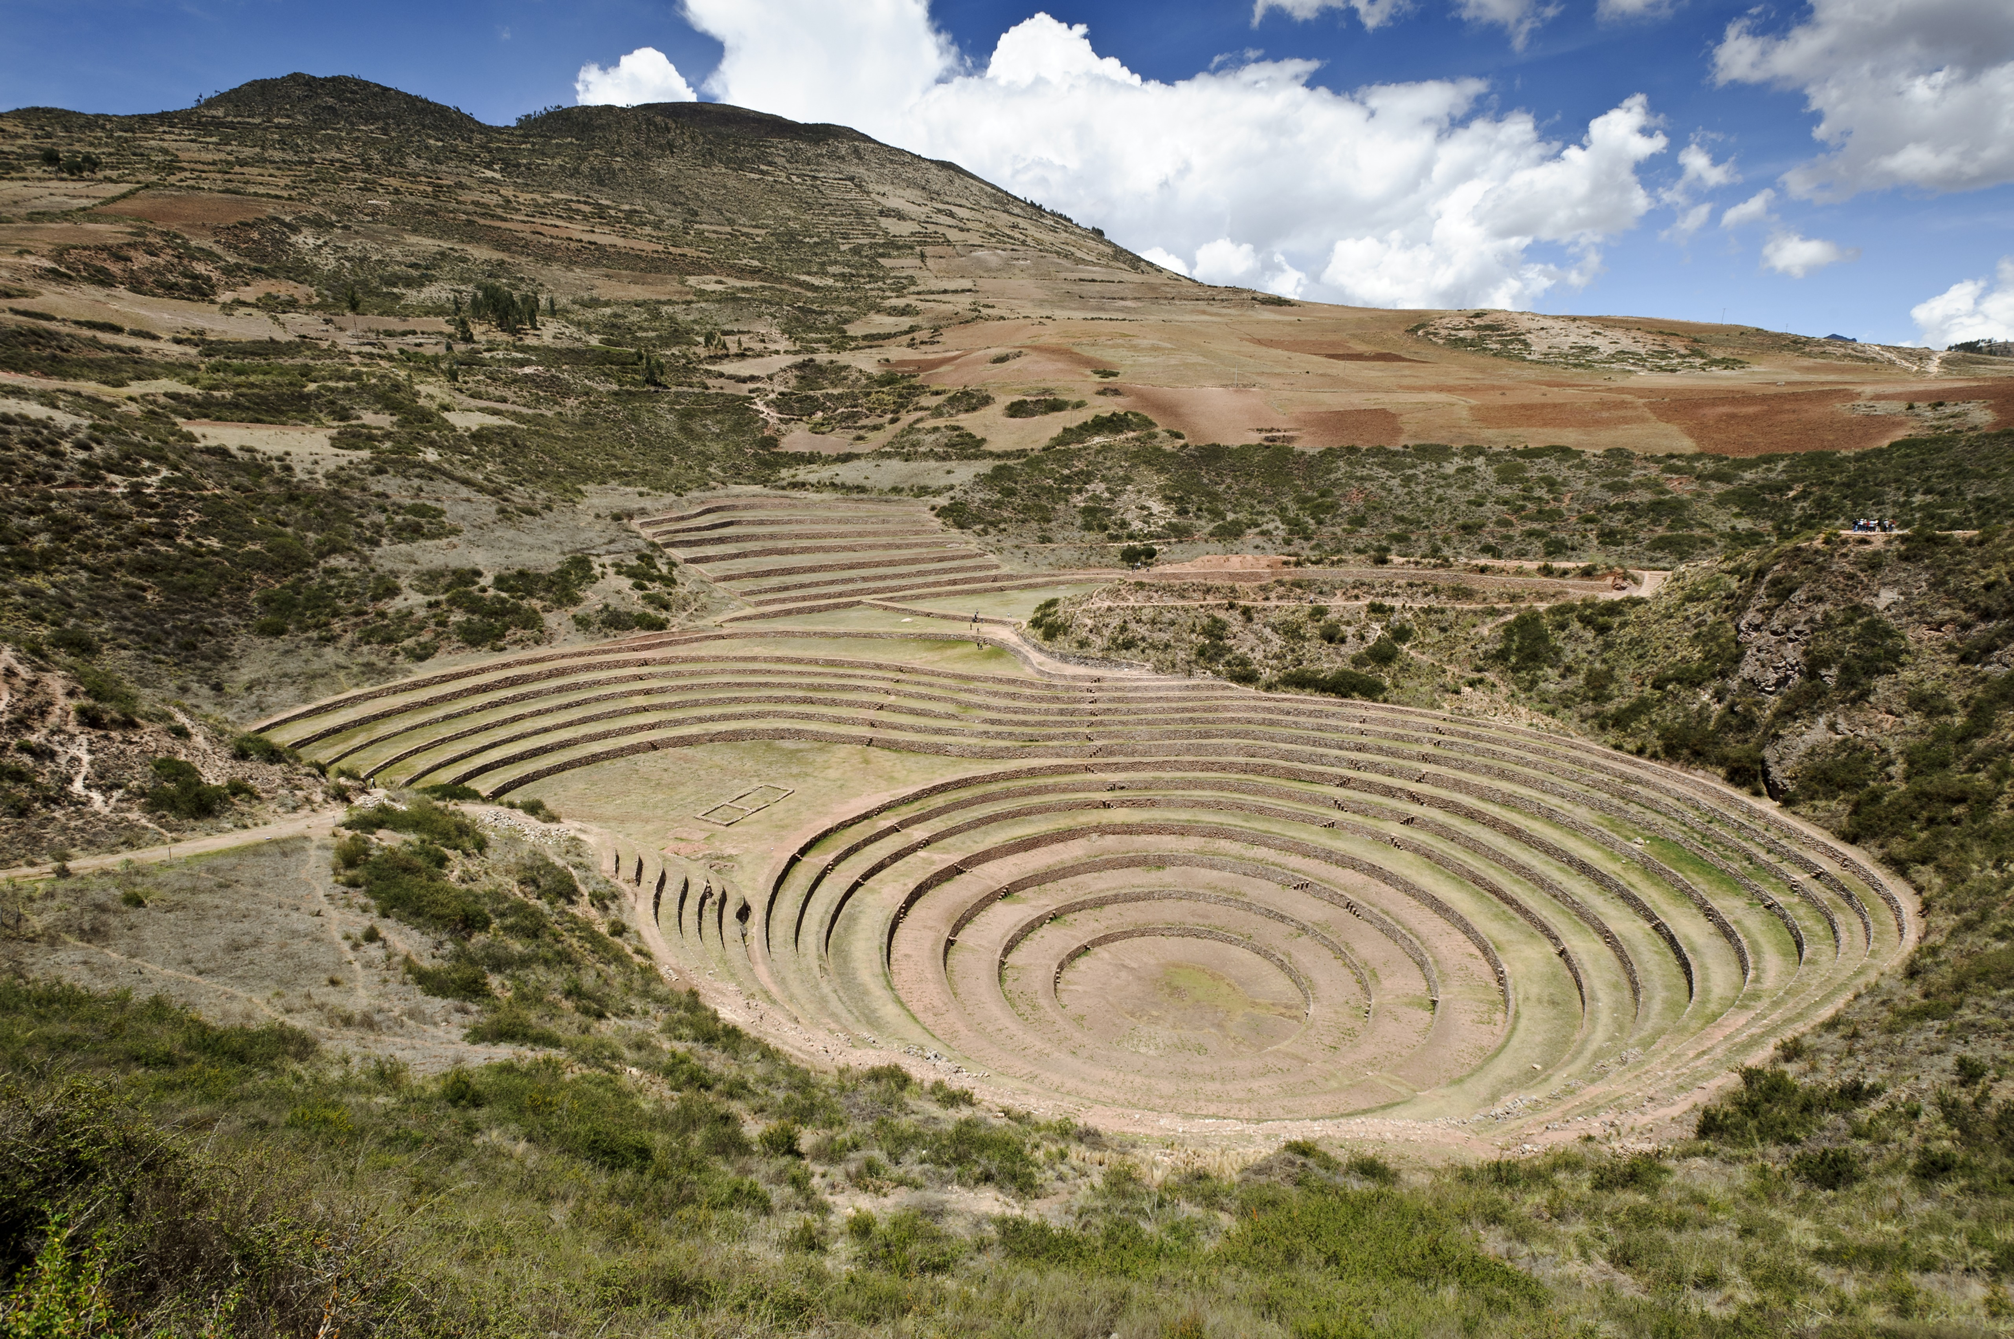
Chapter 10
From Scarcity to Surplus: Modern Agriculture
Systems, Traditions, and Innovation
Technique, Technology, the Emergence of Industrial Agriculture, and Beyond
Labor and Land Tenure
Entrepreneurship and State Action
The New Constraints

Slide 3
Chapter 10 Learning Objectives
What innovative agriculture techniques emerged as a result of globalization after 1400?
What effects did industrialization have on world agriculture? How did agricultural production change as a result of industrialization after 1750?
How did the rising productivity of agricultural lands impact land use and agricultural labor after 1750?

Slide 4
Chapter 10 Learning Objectives
How did state intervention influence agricultural development and innovation? How did various states benefit from such changes?
What present-day conditions are the most significant and pressing factors influencing further agricultural development and productivity? Why?

Slide 5
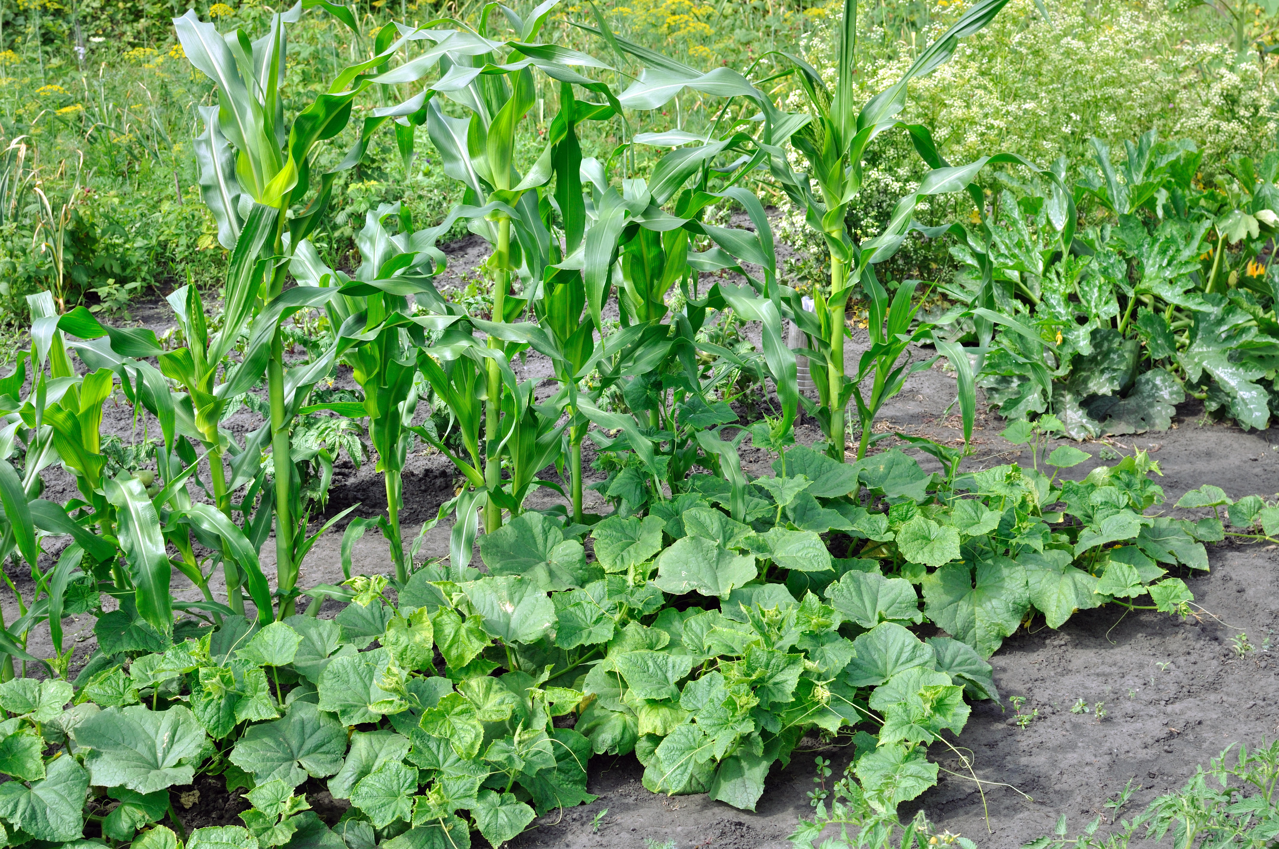
Systems, Traditions, and Innovation
Agricultural improvements accelerated because of globalization
Three sisters
Organized infrastructure

Slide 6
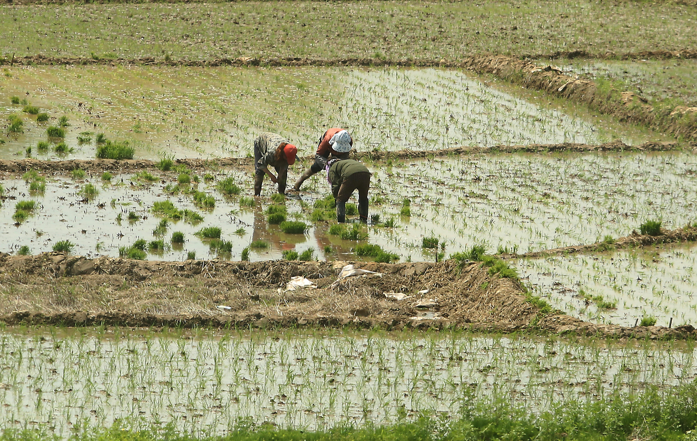
China’s Good Production
Wet-field rice
New tools, fertilizers, new seed strains
Improved irrigation, greater specialization, new transportation and commercial networks
Grand Canal
Population increased by 50%
Improvement in Europe, Western Asia was slower

Slide 7
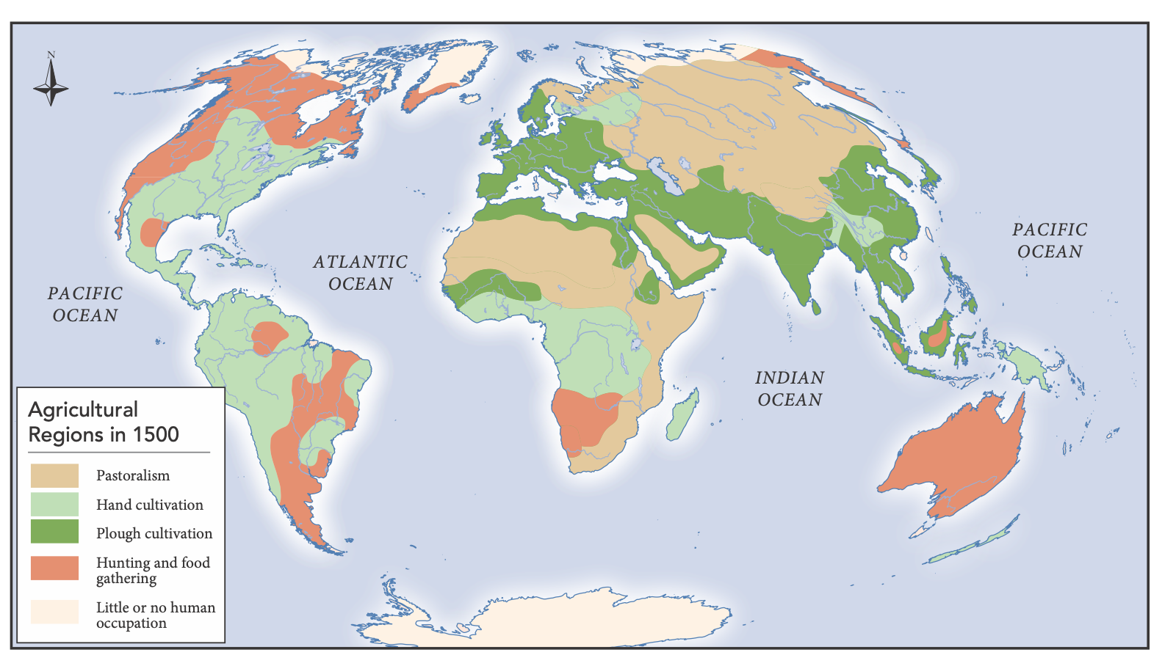
Agricultural Regions in 1500

Slide 8
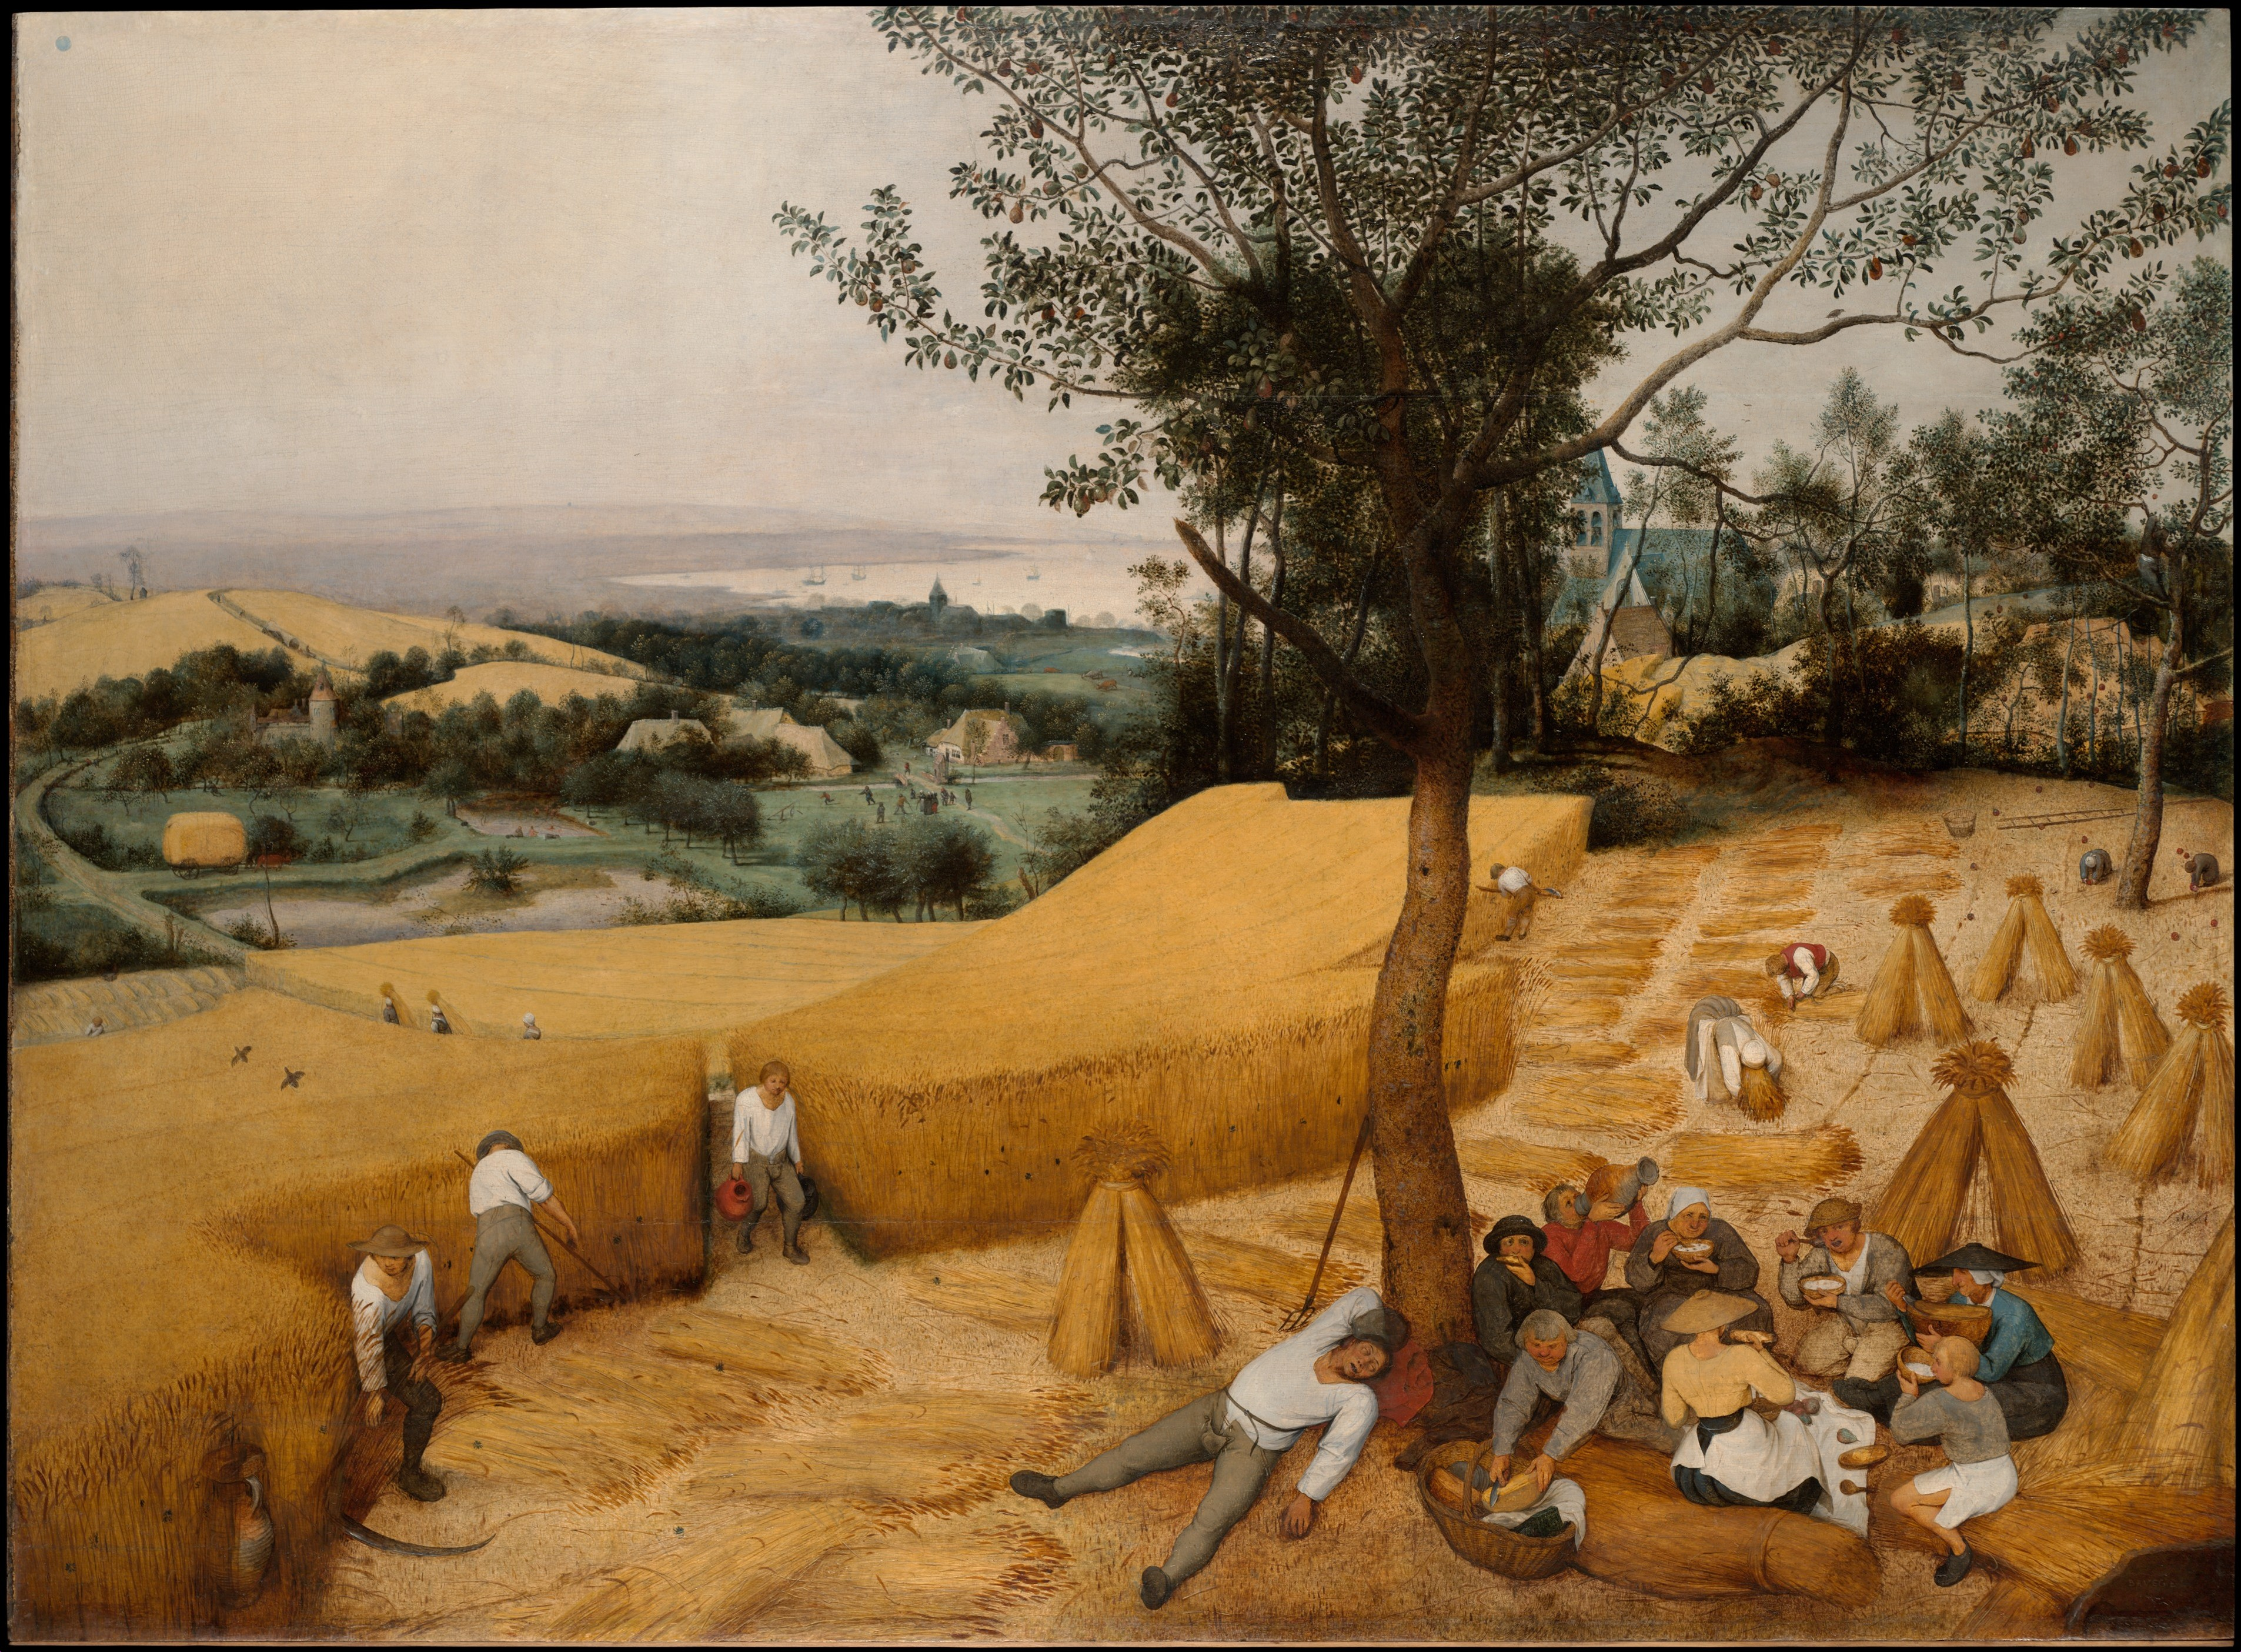
The Agricultural Revolution
Europe adapted farming, animal husbandry techniques from the Muslim world
Improvements after 1750 facilitated the Industrial Revolution
Intensification in Great Britain
Elimination of the Corn Laws in Britain in 1846

Slide 9
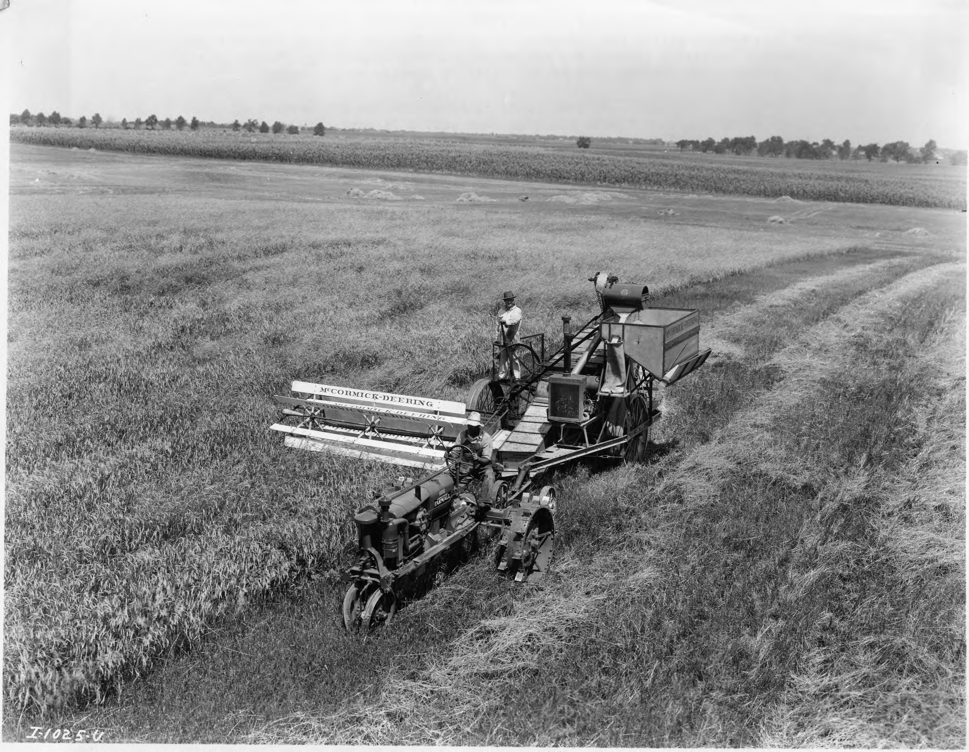
Technique, Technology, the Emergence of Industrial Agriculture, and Beyond
Impact of the plantation economy
Technologies transformed industry, agriculture
Reapers, tractors
Mechanization was resisted by some
Captain Swing riots

Slide 10
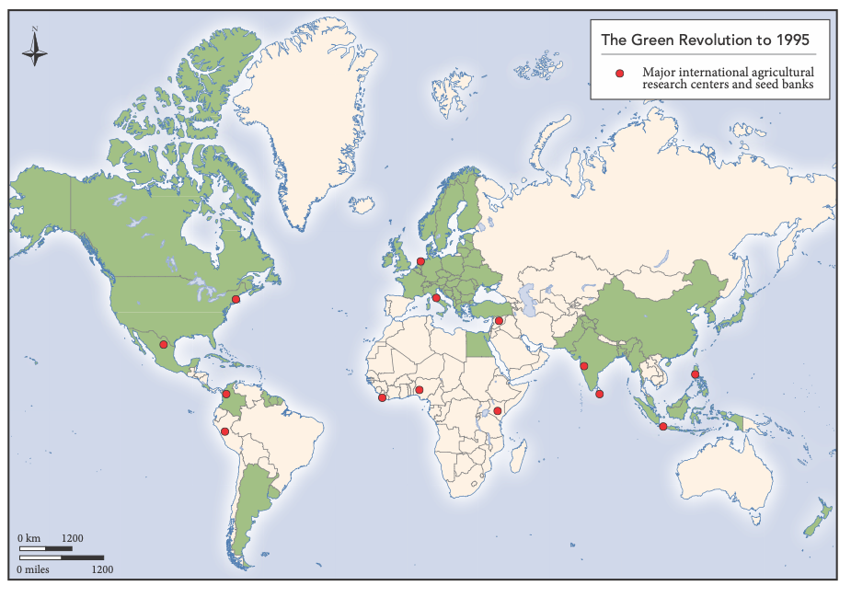
The Green Revolution
Development of agriculture to address food shortages in less developed parts of the world
High-yield wheat and rice
Antibiotics and vaccines limited the spread of disease in herd animals
Chemical pesticides, insecticides
DDT
Improved technology is expensive

Slide 11
Labor and Land Tenure
Transformation in the agricultural use of land and labor
Gains in productivity, consumption
Contributions to global warming
Changes in the nature of the landholding system

Slide 12
Unfree Labor and Migration
Large landowners used unfree labor to create surpluses
Globalization
Labor migration
Enslaved labor, indentured servants
Migrant farm workers keep food prices low, agricultural profits high

Slide 13
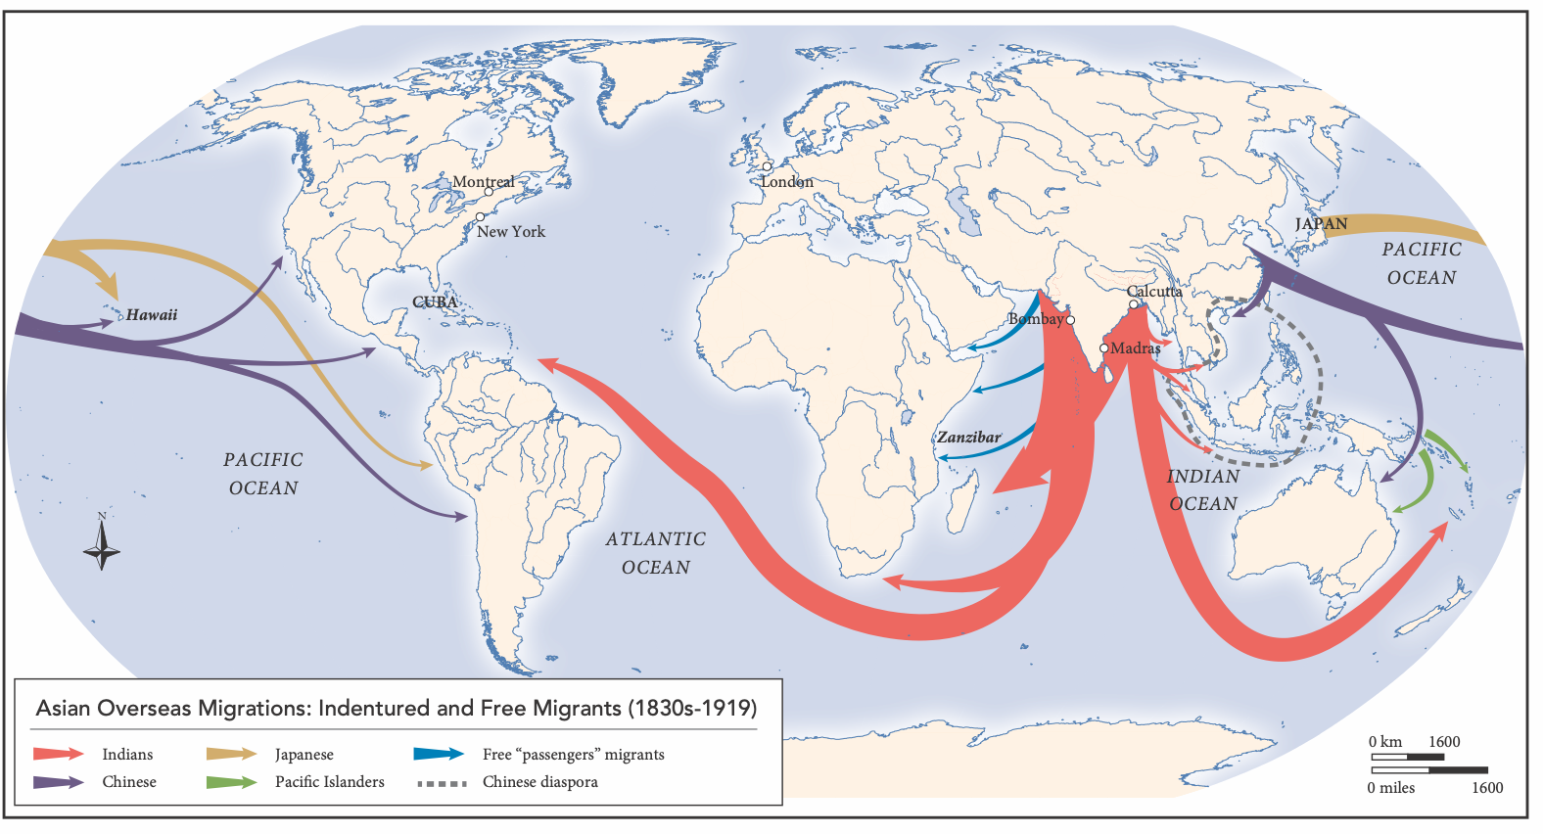
Asian Overseas Migrations

Slide 14
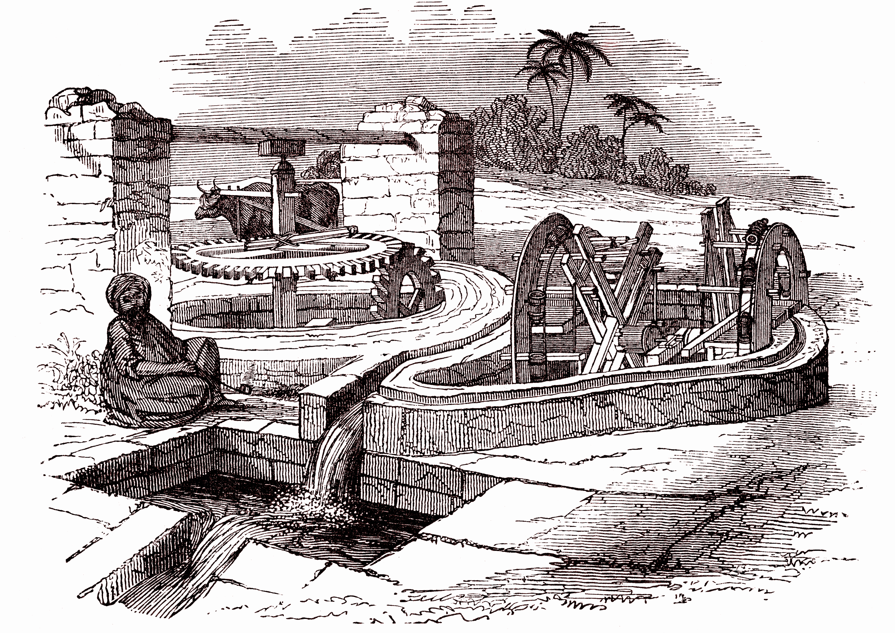
Agriculture in the Islamic World
Land is private property, viewed as a trust
State appropriated land in the Ottoman Empire
European imperial intervention led to cultivation of commodities
Serfdom in Eastern Europe
US Homestead Act

Slide 15
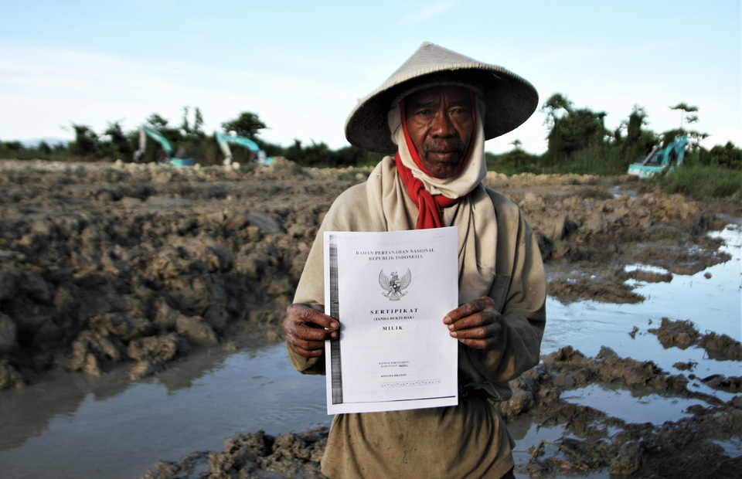
Land Reform
Concentration of agricultural landholdings is often unpopular
Socialism, populism promote agrarian reform
Latin America
Provide people with opportunities to own land, credit, education
Former colonies succeeded at land reform at the expense of foreign interests

Slide 16
Entrepreneurship and State Action
Governments play important roles in developing agricultural methods
Tax incentives, subsidies of seeds, machinery, credit promoted the Columbian Exchange, the agricultural revolution, the Green Revolution
States ensured the dominance of landlords
Agricultural education
In Africa, palm oil replaced enslaved people as a commodity

Slide 17
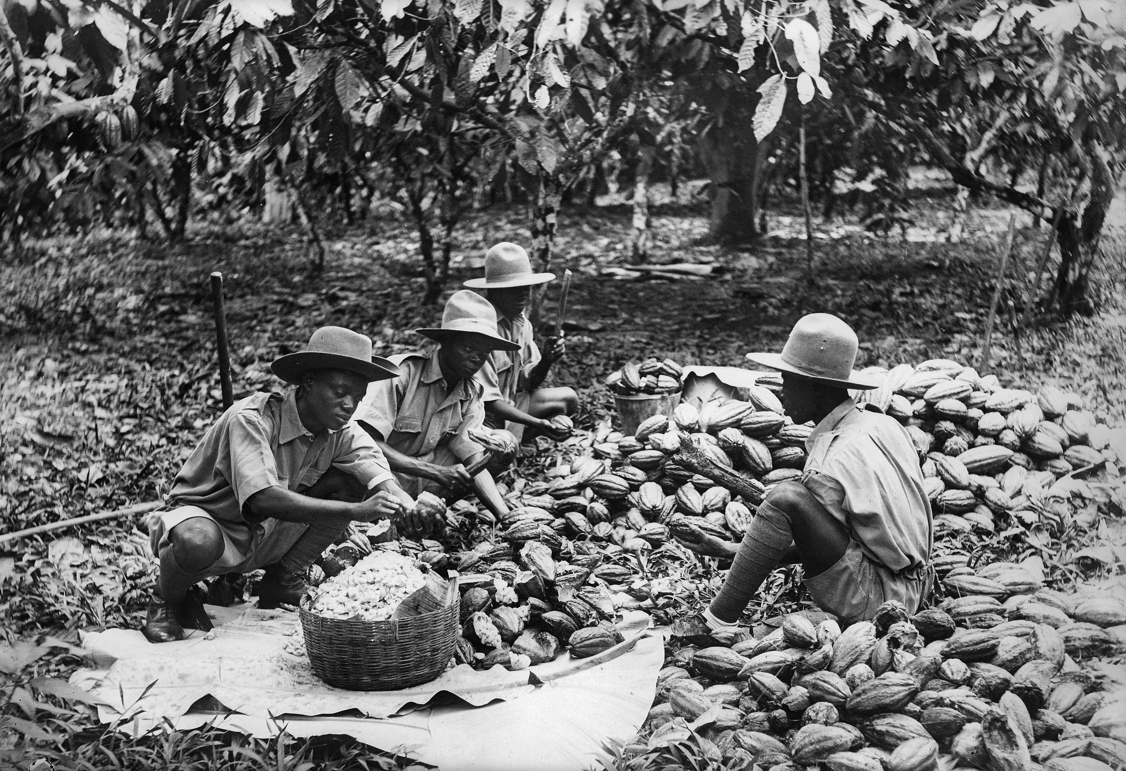
African Agricultural Entrepreneurialism
Growth of cocoa as a commodity in West Africa
Gold Coast
Grown by small farmers, migrant laborers
British wars with the Ashanti led to control of cocoa fields
Cooperatives pooled credit, tools, maintained prices

Slide 18
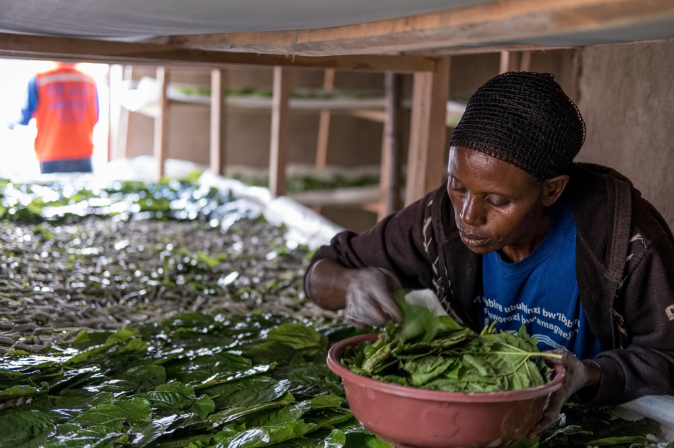
The New Constraints
Global population increases would have been impossible without high-level agricultural transformation
Substitution of capital for labor
Chemicals, mechanization
Will improvements stay ahead of population growth?
Availability of water is a critical limitation

