Slide 1

Comparative Politics
by J. Tyler Dickovick, Jonathan Eastwood, Robin M. LeBlanc and Zoila Ponce de Leon

Slide 2

3
Notes:
Egyptian police and soldiers outside a voting center in 2011. The military and police shape the development and functioning of the state in critical ways.

Slide 3
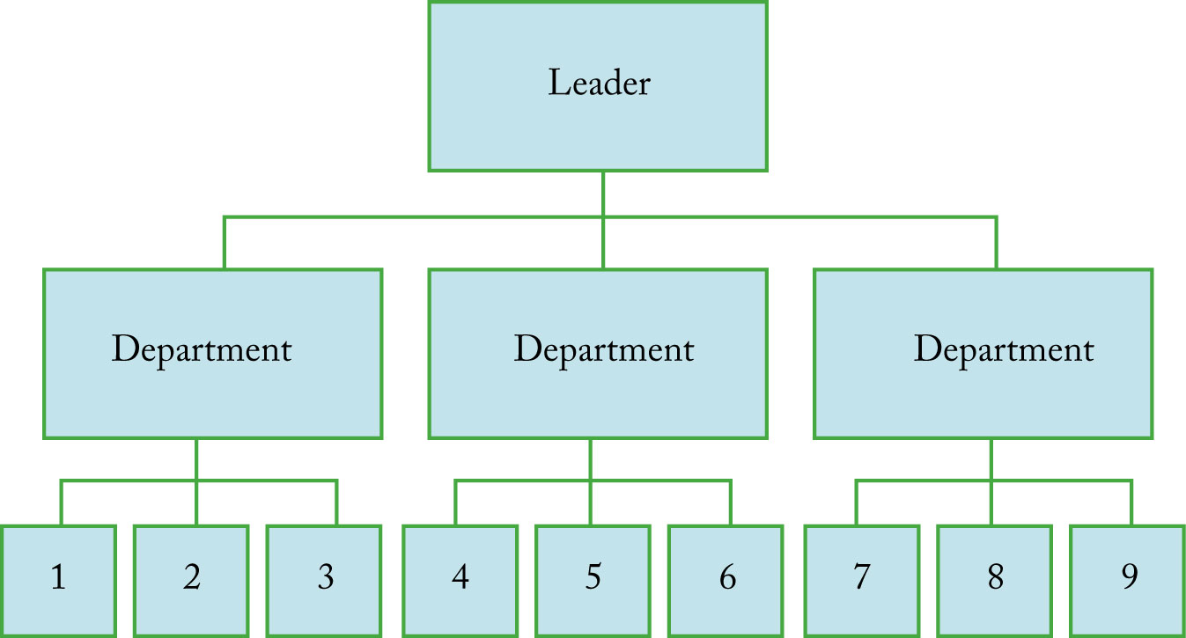
Figure 3.1 This is a simplified model of how a bureaucratic structure can achieve the coordination of complex tasks carried out by individual officeholders.
Notes:
Figure 3.1 This is a simplified model of how a bureaucratic structure can achieve the coordination of complex tasks carried out by individual officeholders. Imagine that this organization’s mission requires the coordinated performance of nine complex tasks. How
difficult might it be to accomplish these tasks in the absence of bureaucratic organization?

Slide 4
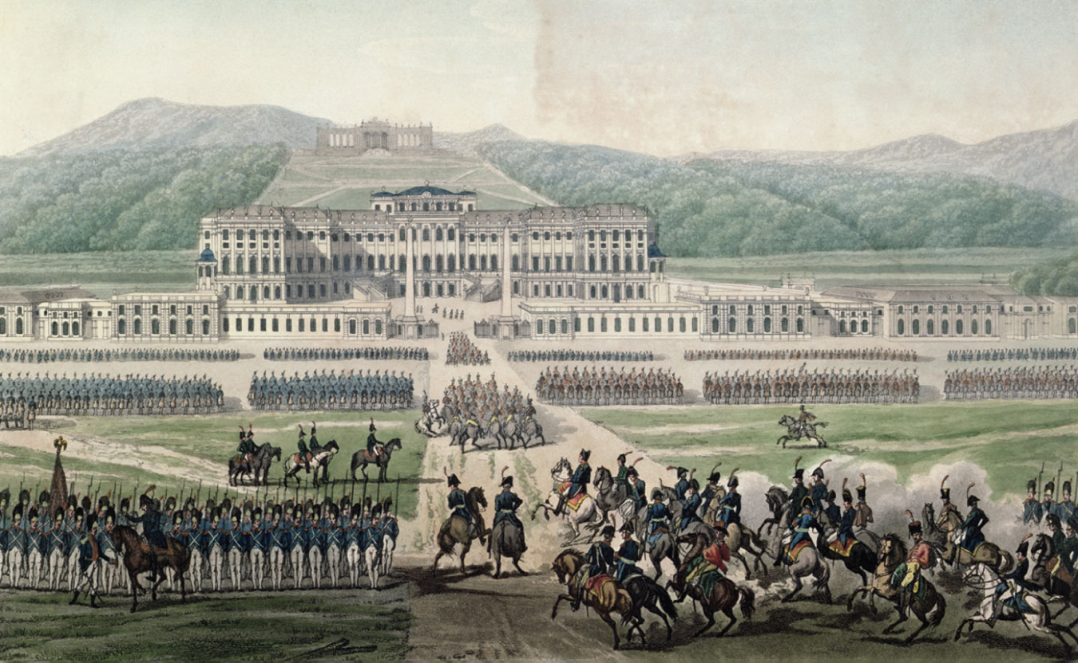
4
Notes:
The Arrival of Napoleon Bonaparte at Schloss Schönbrunn, engraved by Aubertin, c. 1820. According to conflict theories of the state, under certain conditions war can help states grow stronger. It encourages the state’s ability to extract revenue, its ability to mobilize the population, and its capacity to exert the Weberian monopoly on legitimate force.

Slide 5
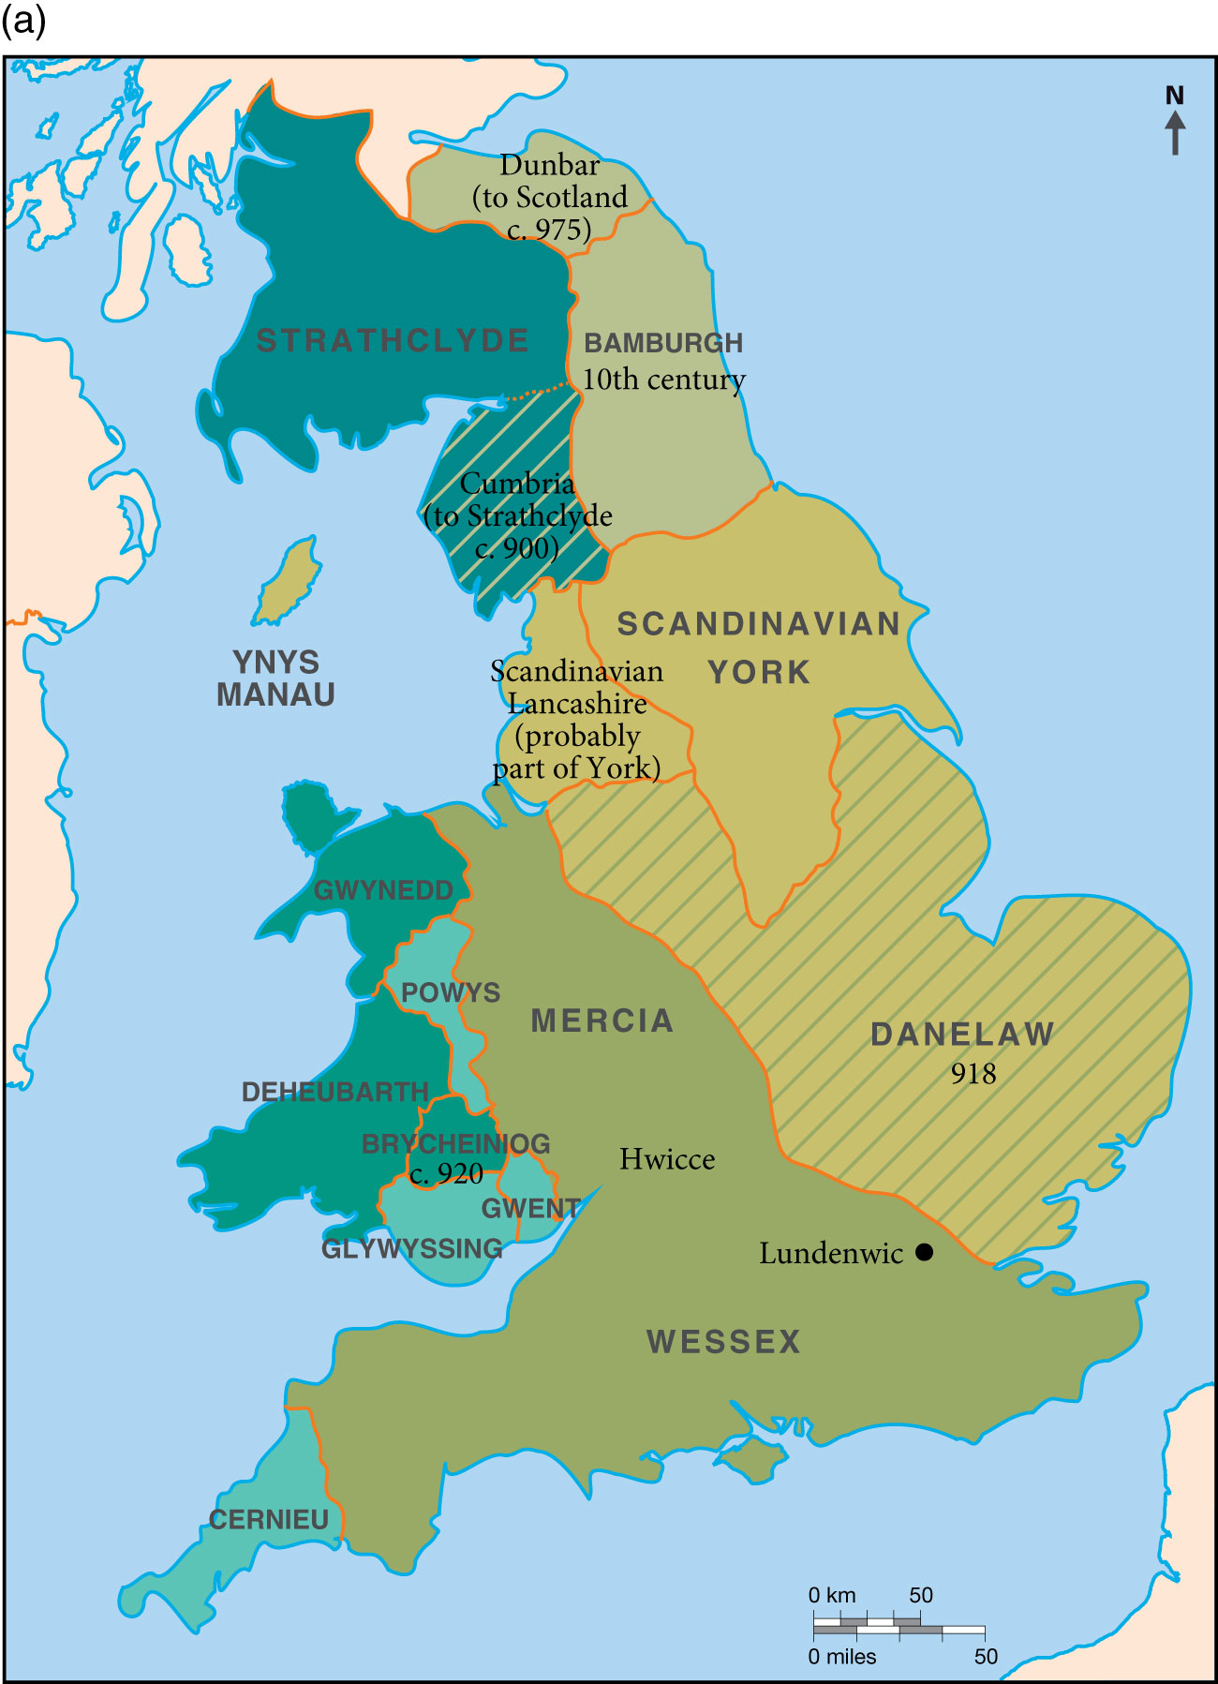
Map 3.1 (a) The land that became the United Kingdom, c. 900.
Notes:
Map 3.1 (a) The land that became the United Kingdom, c. 900.

Slide 6
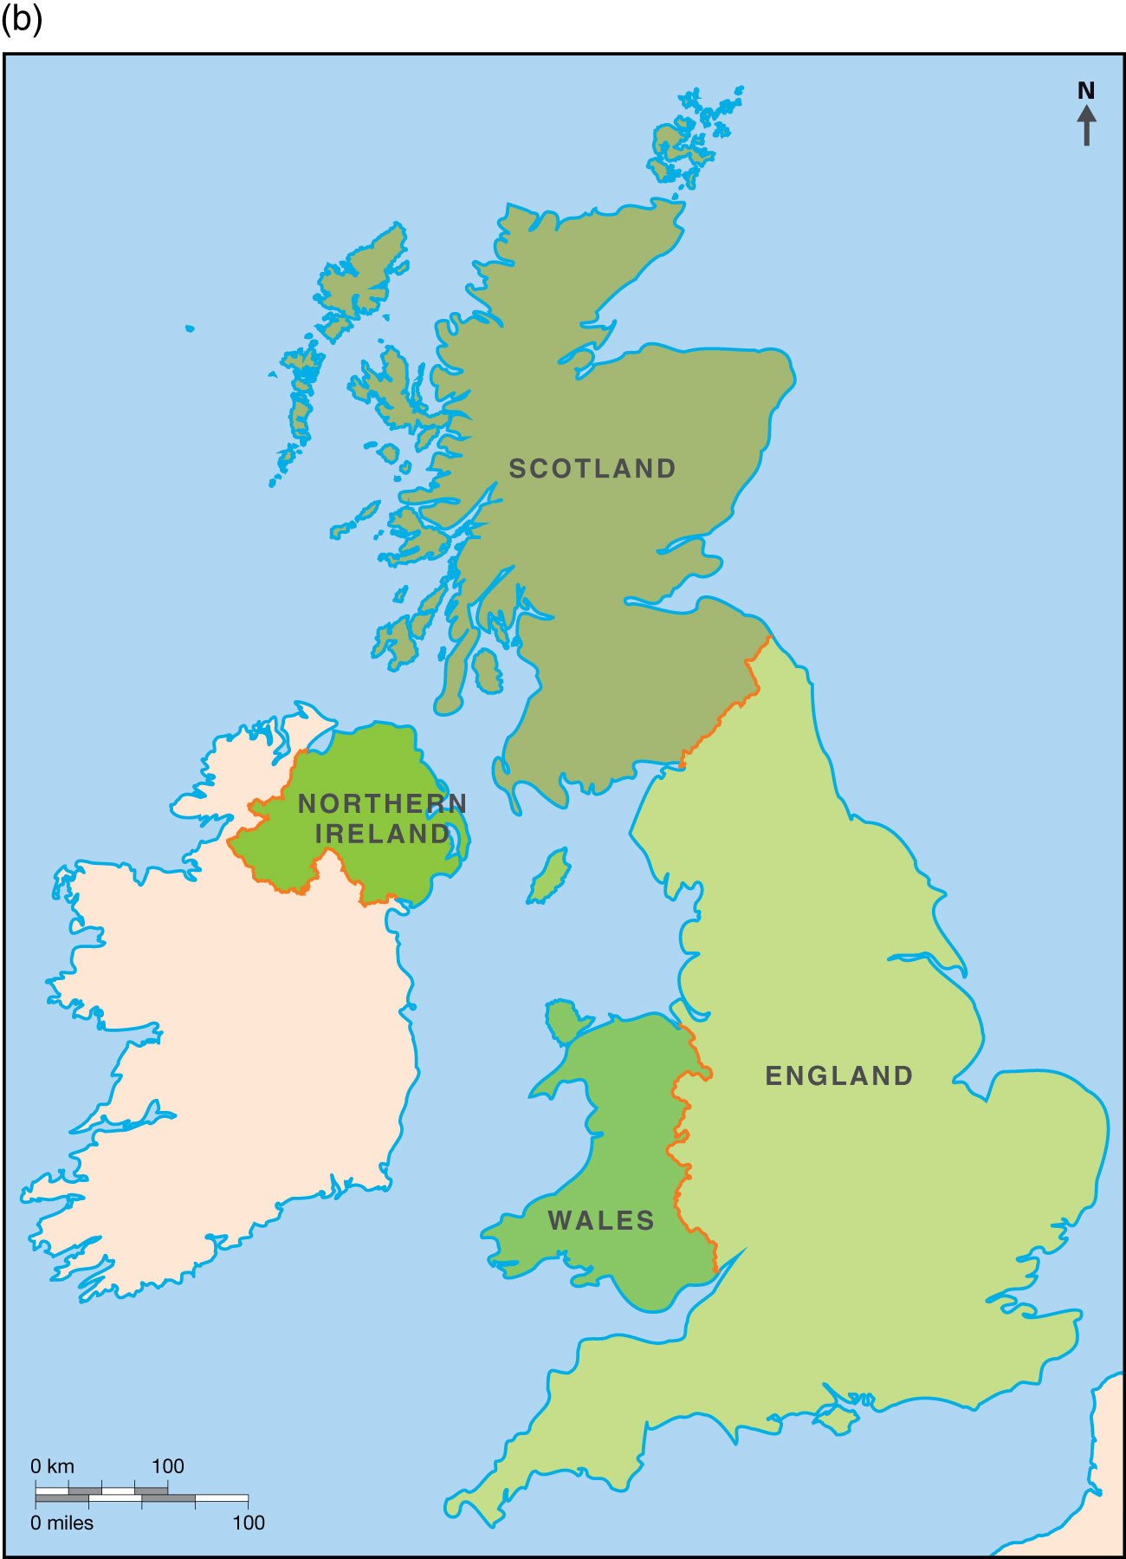
Map 3.1 (b) The United Kingdom today.
Notes:
Map 3.1 (b) The United Kingdom today.

