Slide 1
Chapter 3: Elements from 2D and 3D Art and Design

Slide 2
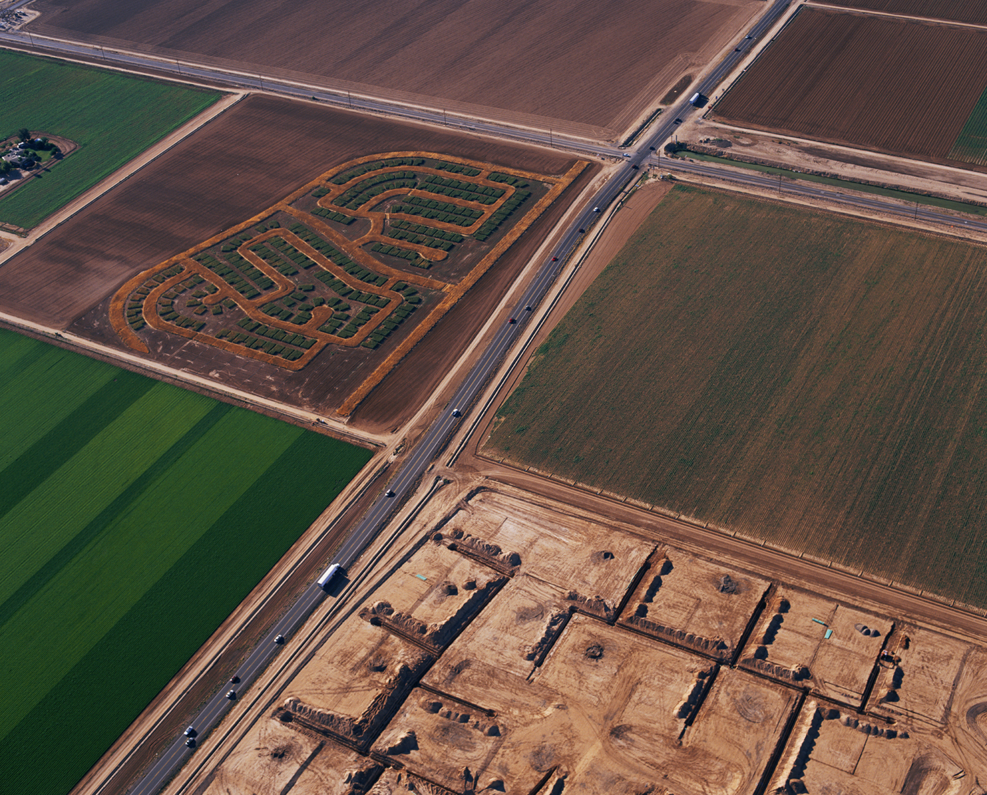
Fig. 3-2. Matthew Moore, Rotations: Moore Estates (2005–2006), sorghum and wheat on 35 acres of family farm, Phoenix, Arizona. Courtesy of the artist.

Slide 3
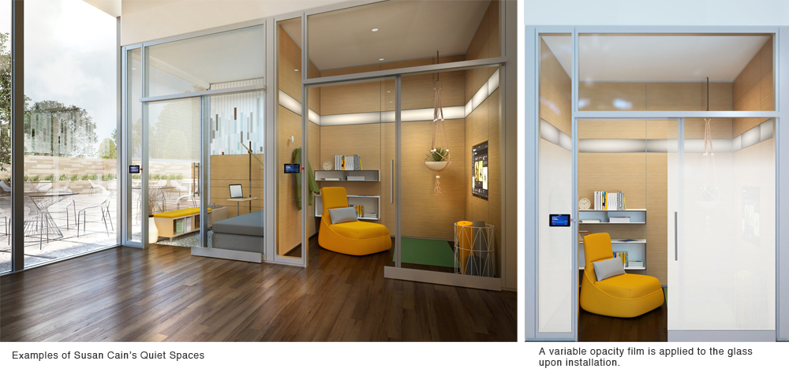
Fig. 3-8. Examples of Susan Cain’s Quiet Spaces, including an illustration of the variable opacity film applied to the glass upon installation. Courtesy of Steelcase.

Slide 4
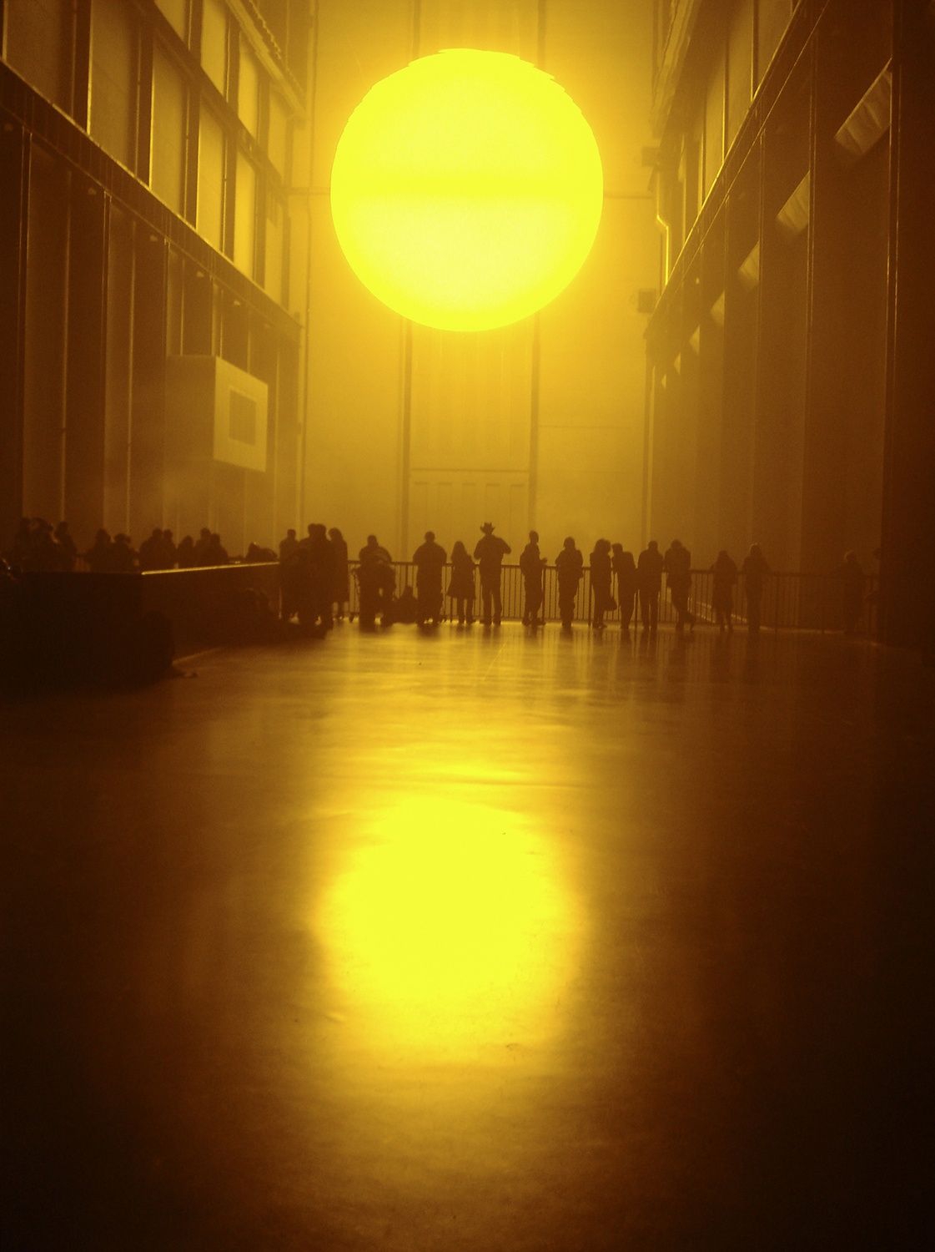
Plate 6. Olafur Eliasson, The Weather Project (2003), monofreqency lights, projection foil, haze machines, mirror foil, aluminum, and scaffolding, 26.7 m × 22.3 m × 155.4 m, installation in Turbine Hall, Tate Modern, London. Photo: Studio Olafur Eliasson, Courtesy the artist; neugerriemschneider, Berlin; and Tanya Bonakdar Gallery, New York, © Olafur Eliasson 2003.

Slide 5
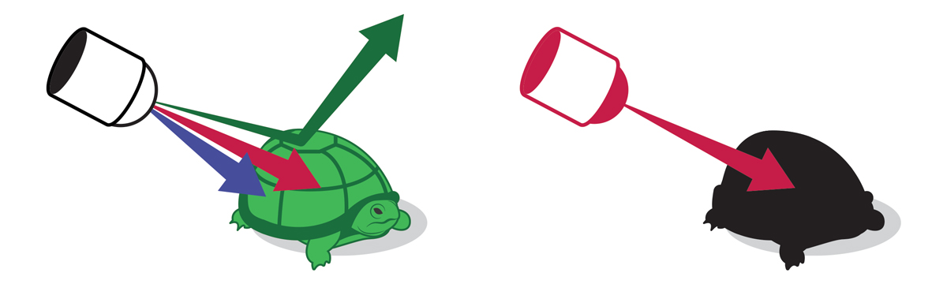
Plate 10. When you shine white light at a green turtle, all the light is absorbed by the turtle except the green light, which is reflected back into your eye. If you shine a red light at a turtle, the turtle will look black because there is no green light to reflect back into your eye. © Phil McCollam.

Slide 6
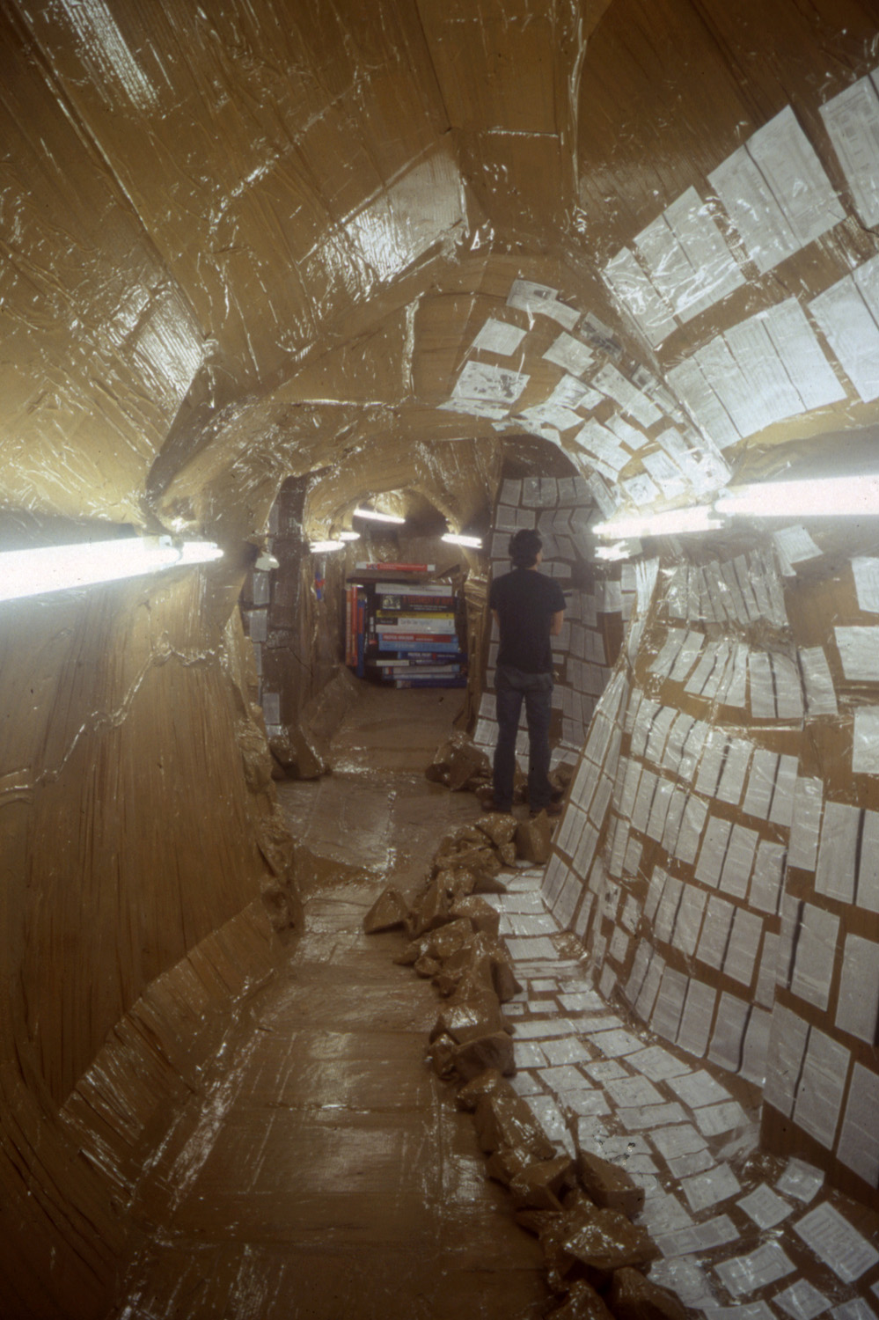
Thomas Hirschhorn « Cavemanman », 2002
Gladstone Gallery, New York, 2002
Courtesy D.Daskalopoulos Collection

Slide 7
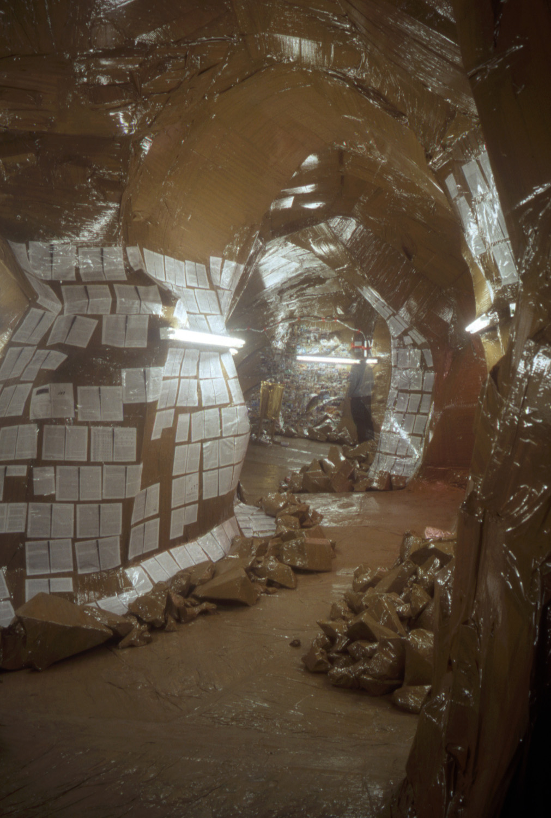
Thomas Hirschhorn « Cavemanman », 2002
Gladstone Gallery, New York, 2002
Courtesy D.Daskalopoulos Collection

Slide 8
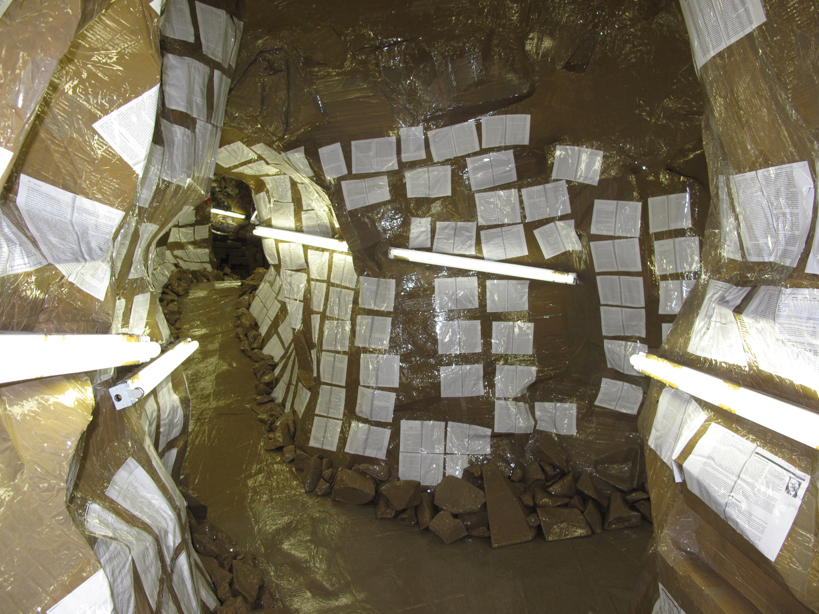
Thomas Hirschhorn « Cavemanman », 2002 Exhibition ‘Walking in my mind’, Hayward Gallery, Londres, 2009 Courtesy D.Daskalopoulos Collection

