Slide 1

Essential Communication 3e
by Adler, Rodman, and du Pré

Slide 2
Chapter 3: Communication and Culture
Culture
Culture Defined
Cultural Values and Norms
Communication and Cocultures
Age and Generation
Talking About Race
Overcoming Prejudice
Coping with Culture Shock

Slide 3
Chapter 3 Learning Objectives (1)
3.1 Define culture and coculture, and differentiate between in-groups and out-groups.
3.2 Analyze how values and norms affect communication between members of different cultures.
3.3 Apply the concept of intersectionality to communication, and identify communication factors that help shape cocultural identity.
3.4 Explain communication patterns within and between different age groups.

Slide 4
Chapter 3 Learning Objectives (2)
3.5 Adopt communication practices that promote understanding between people of different races.
3.6 Practice thinking mindfully to overcome prejudiced assumptions that influence communication.
3.7 Analyze the stages involved with adapting to communication in a new culture.

Slide 5

Culture Defined
Culture
Coculture
Salience
In-group
Out-group
Notes:
Estimated Time: 5 mins
Key Concepts
Culture Defined
Culture
Coculture
Salience
In-group
Out-group
Key Points
Culture is “the language, values, beliefs, traditions, and customs people share and learn.”
A coculture is a group that is part of an overarching, encompassing culture.
Cultural differences are salient in some situations but not in others.
People with whom we identify are considered in-group and others are out-group.

Slide 6
Learning About Others Activity
Notes:
Estimated Time: 15 mins
Activity: Learning About Others
Introductions for Students
Pair up with a student in the class whom you don’t know well. Identify three things the two of you have in common and three things about you that are different.
Follow-Up Discussion
What did you learn about each other?
Was it hard to find things you had in common? Things that were different?
Do you think the same activity would be successful with a random stranger? Why or why not?
The book cites evidence that people tend to overestimate how much they have in common with their friends, but underestimate how much they have in common with strangers. Is this true, in your experience?

Slide 7
In- and Out-Group
What cultures and co-cultures are you part of?
In what situations do you feel like an in-group member? What role does communication play in creating that sense of belonging?
Are there situations in which you feel like an out-group member? If so, what gives you that feeling?
Notes:
Estimated Time: 5 mins
Journal Prompts: In- and Out-Group
What cultures and co-cultures are you part of?
In what situations do you feel like an in-group member? What role does communication play in creating that sense of belonging?
Are there situations in which you feel like an out-group member? If so, what gives you that feeling?

Slide 8
“Weird or Just Different?”
Notes:
Estimated Time: 15 mins
Video Connection: Cultural Differences
Introduction to the Video
In “Weird or Just Different?” Derek Sivers describes cultural differences that can make it difficult to read a map or follow music in another culture.
“Weird or Just Different?”
https://learninglink.oup.com/ebook/access/content/adler-rodman-dupre3e-supplemental-resources/adler-rodman-dupre3e-instructor-resources-derek-sivers-weird-or-just-different
(3 mins)
Follow-Up Discussion About the Video
Have you ever felt like a stranger or a minority? If so, how did that feel?
Have you ever experienced a culture significantly different from your own? If so, did people communicate in ways that surprised or puzzled you? How?
Teaching Tip
This is a good time to ask who has lived in or visited a different country or culture. Ask students what differences stood out between the new culture and their own. How did they manage communication challenges that arose?

Slide 9
“All That We Share”
Notes:
Estimated Time: 15 mins
Video Connection (in Oxford Insight): “Us” and “Them”
Introduction to the Video
Let’s see what happens when people of many backgrounds are challenged to find common ground.
“All That We Share”
https://learninglink.oup.com/ebook/access/content/adler-rodman-dupre3e-supplemental-resources/adler-rodman-dupre3e-instructor-resources-all-that-we-share
(3 mins)
Follow-Up Discussion About the Video
How do people initially organize themselves in the room?
What is the response when the speaker asks the “class clowns” to step forward?
How do things change as people began to realize that they have more in common than it appears on the surface?
How does the group respond when one person stands alone?
How are the interactions between people different at the end than they were at the beginning? Why do you think their treatment of one another has changed?

Slide 10
Your Cultural Identity
What are some of the cultural groups with which you identify?
Which of them has played the greatest role in shaping your communication style and expectations? How?
Notes:
Estimated Time: 20 to 60 mins
Public Speaking Topic: Your Cultural Identity
What are some of the cultural groups with which you identify?
Which of them has played the greatest role in shaping your communication style and expectations? How?

Slide 11

Cultural Norms and Values
Individualism and Collectivism
Low and High Context
Uncertainty Avoidance
Power Distance
Talk and Silence
Notes:
Estimated Time: 5 mins
Key Concepts
Cultural Values and Norms
Individualism and collectivism
Low and high context
Uncertainty avoidance
Power distance
Talk and silence
Key Points
Cultures tend to emphasize either individual or collective identity.
Members of low-context cultures use language primarily to express thoughts, feelings, and ideas as directly as possible. But members of high-context cultures rely more on subtle, often nonverbal cues.
Uncertainty avoidance reflects the degree to which members of a culture feel threatened by ambiguous situations.
Cultures that observe a high power distance demonstrate a high regard for people of higher status.
People in some cultures are comfortable with silence, whereas in others, they may find it awkward.

Slide 12
“What Not to Do in Japan”
Notes:
Estimated Time: 15 mins
Video Connection: “What Not to Do in Japan”
Introduction to the Video
An American in Japan provides cultural tips for people who plan to visit the country.
“What Not to Do in Japan”
https://learninglink.oup.com/ebook/access/content/adler-rodman-dupre3e-supplemental-resources/adler-rodman-dupre3e-instructor-resources-what-not-to-do-in-japan
(5 mins)
Discussion About the Video
How do the speaker’s tips reflect collectivistic attitudes in Japan?
How might Japanese visitors to the United States be surprised or offended by people’s behavior?

Slide 13
Experimenting with Silence Activity
Notes:
Estimated Time: 15 mins
Activity: Experimenting with Silence
Instructions for Students
Pair up with someone in class or choose a person with whom you regularly interact. Ask that person to tell you about their day. Use nonverbal cues to show that you are interested and are actively listening, but remain silent. Don’t interrupt or ask questions.
Follow-Up Discussion
Did the other person seem encouraged by your silence or uncomfortable with it? Why do you think they reacted that way?
Was it easy for you to be silent or difficult? Why?
In what situations do you appreciate silence? When does it make you uncomfortable?

Slide 14

What Norms Influence You?
Notes:
Estimated Time: 15 mins
Introspection and Discussion: What Norms Influence You?
(handout provided)
Instructions for Students
Answer questions on the handout and prepare to share your ideas with others.
Follow-Up Discussion
Which cultures are you most knowledgeable about?
What might you do to increase your knowledge of other cultures?
In what ways is your identity shaped by who you are as an individual?
In what ways is it shaped by the groups to which you belong (e.g., your family, hometown, college, clubs, religion, and so on)?
Do you identify more with the cultural value of individualism or collectivism? How?
Do you mostly observe a high power distance around authority figures or a belief that all people are equal, regardless of their rank or status? How does this affect the way you communicate with people?
Do you tend to appreciate silence or find it uncomfortable? Does this vary by relationship? If so, how?

Slide 15

Social Identity
Intersectionality Theory
Race
Ethnicity
Notes:
Estimated Time: 5 mins
Key Concepts
Social Identity
Intersectionality theory
Race
Ethnicity
Key Points
Intersectionality theory describes the complex interplay of people’s multiple identities.
The notion of race was created to reflect superficial differences between people whose ancestors originated in different regions of the world—Africa, Asia, Europe, and so on.
Ethnicity is a social construct that refers to the degree to which a person identifies with a particular group, usually on the basis of nationality, culture, religion, or some other perspective.

Slide 16
“Mixed Identity”
Notes:
Estimated Time: 20 mins
Video Connection: Mixed Identity
Introduction to the Video
This clip from the documentary “Other” features the perspectives of people with multiple racial identities.
“Other: Mixed Identity”
https://learninglink.oup.com/ebook/access/content/adler-rodman-dupre3e-supplemental-resources/adler-rodman-dupre3e-instructor-resources-other-mixed-identity
(13 mins)
Discussion About the Video
What do you think of the perspectives of people in this video who identify with multiple races and ethnic groups?
How do you think it feels to be asked to choose one race or ethnicity if you identify with more than one?
In your opinion, what are the advantages of identifying with multiple social groups? What are the challenges?

Slide 17
“12 Pairs of Legs”
Notes:
Estimated Time: 20 to 40 mins
Video Connection: Reframing “Disability”
Introduction to Video 1
In “12 Pairs of Legs,” Aimee Mullins challenges stereotypes about people whose physical features are different than others’.
“12 Pairs of Legs”
https://learninglink.oup.com/ebook/access/content/adler-rodman-dupre3e-supplemental-resources/adler-rodman-dupre3e-instructor-resources-aimee-mullins-its-not-fair-having-12-pairs-of-legs
(10 mins)
Discussion About the Video
What do you think about Mullins' assertion that, rather than being disabled, she is the architect of her own identity?
What pivotal communication episodes does she describe? Why are they important to her?
Do think differently about people with disabilities after hearing her talk? If so, how?
Teaching Tip
Ask students to share an experience related to this topic. People tend to learn more when topics feel relevant to them.

Slide 18

Your Cultural Tree
Create a diagram resembling a family tree that shows your various cultural and cocultural identities.
Then describe how your communication with others is shaped by different dimensions of your identity.
Notes:
Estimated Time: 20 mins
Activity: Your Cultural Tree
Instructions for Students
Create a diagram resembling a family tree that shows your various cultural and cocultural identities.
Then describe how your communication with others is shaped by different dimensions of your identity.

Slide 19
Your Intersecting Identities Activity
Notes:
Estimated Time: 20 mins
Activity: Your Intersecting Identities
Instructions for Students
List 5 to 10 of your social identities (e.g., your gender, race, occupation, sexual orientation, family, and so on). From the perspective of intersectionality theory, explain how the interface of these identities (e.g., white female engineer in the south) gives rise to issues that are different than if you considered each of these roles separately (e.g., how being be a female engineer is different than the sum total of being a female and an engineer).
Follow-Up Questions
How does living at the intersection of multiple identities make your life experience different than that of a person who shares some of your identities, but not all of them?
Do you ever feel that people form opinions of you based on only one or two of your qualities? If so, how does this shape the way they communicate with you?
Teaching Tip
If you feel that students may be wary of posting or sharing personal information with classmates, consider having them share it with only you on the condition that you keep the information confidential.

Slide 20
Discussing Politics on Social Media Activity
Notes:
Estimated Time: 15 mins
Activity: Discussing Politics on Social Media
(handout provided)
Teaching Tip
This activity works well in groups. It can also be used as the basis for a brief paper or journal entry.
Instructions for Students
Follow the instructions on the handout to evaluate an instance in which people discuss politics online. Then consider the questions about it on your handout.
Follow-Up Discussion
Overall, do you feel the participants were engaged in responsible and respectful discussion of diverse viewpoints? Why or why not?
Were particular participants more or less respectful than others? If so, how?
What might people do to keep trolls from disrupting responsible discourse?
Have you ever posted something you wished you hadn’t? If so, what tips do you have for others?

Slide 21

Age and Generation
Personal fable
Imaginary audience
Technology Use
Notes:
Estimated Time: 5 mins
Key Concepts
Age and Generation
Personal fable
Imaginary audience
Technology Use
Key Points
Adolescents typically experience a personal fable, the belief that they are different from everybody else, and imaginary audience, a heightened self-consciousness that makes it seem as if people are always observing and judging them.
Older adults are more likely than youngers ones to value privacy over sharing personal information online.

Slide 22
“Generation Gap”
Notes:
Estimated Time: 10 mins
Video Connection: Generation Gap
Introduction to the Video
Consider how easy it is to misunderstand and stereotype people based on their age.
Generation Gap
https://learninglink.oup.com/ebook/access/content/adler-rodman-dupre3e-supplemental-resources/adler-rodman-dupre3e-instructor-resources-generation-gap
(4:15 mins)
Discussion About the video
What communication behaviors in the video stood out to you and why?
Do you perceive a difference between the way your generation and others communicate? If so, how?
How might we best bridge generation gaps as communicators?
Teaching Tip
End activities by inviting students to share their take-away lessons. You might ask: Why does this matter? and What can you do with this knowledge?

Slide 23
Generation What?
In what ways does society stereotype people your age?
Are these assumptions mostly true or not?
How do they affect the way people communicate with you?
Notes:
Estimated Time: 10 mins
Discussion Starter: Generation What?
In what ways does society stereotype people your age?
Are these assumptions mostly true or not?
How do they affect the way people communicate with you?

Slide 24
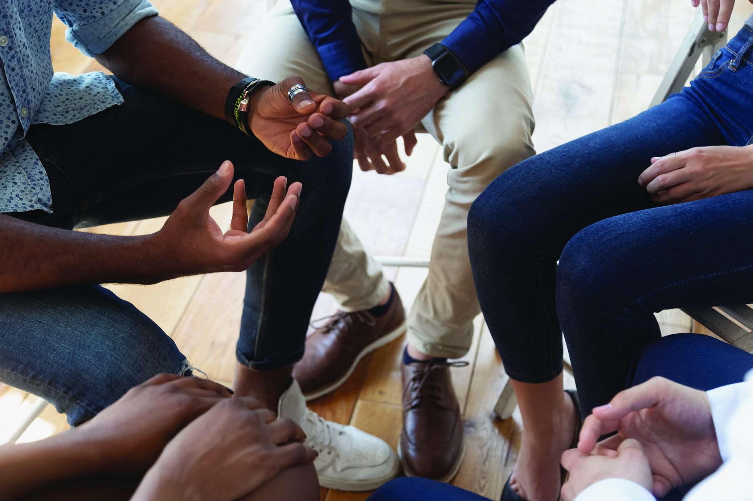
Tips for Talking About Race (1)
Expect strong emotions.
Put yourself in the other person’s shoes.
Don’t debate.
Learn and apologize, if appropriate.
Don’t force the issue.

Slide 25
Racial Literacy
Notes:
Estimated Time: 20 mins
Video Connection (in Oxford Insight): Racial Literacy
Introduction to the Video
What happens when two high school students set out to learn more about racism and end up redefining the notion of racial literacy?
Racial Literacy
https://learninglink.oup.com/ebook/access/content/adler-rodman-dupre3e-supplemental-resources/adler-rodman-dupre3e-instructor-resources-priya-vulchi-and-winona-guo-racial-literacy
(12:26 mins)
Discussion About the video
What might we all do to help co-create a shared American culture that welcomes racial diversity?
How might people increase their racial literacy and understand one another better?
Teaching Tip
End activities by inviting students to share their take-away lessons. You might ask: Why does this matter? and What can you do with this knowledge?

Slide 26

Tips for Talking About Race (2)
What emotions do you experience when the topic of race comes up? How do you react?
What communication approaches might you use to talk about race without turning the conversation into a debate?
Notes:
Estimated Time: 5 mins
Journal Prompts: Talking About Race
What emotions do you experience when the topic of race comes up? How do you react?
What communication approaches might you use to talk about race without turning the conversation into a debate?

Slide 27
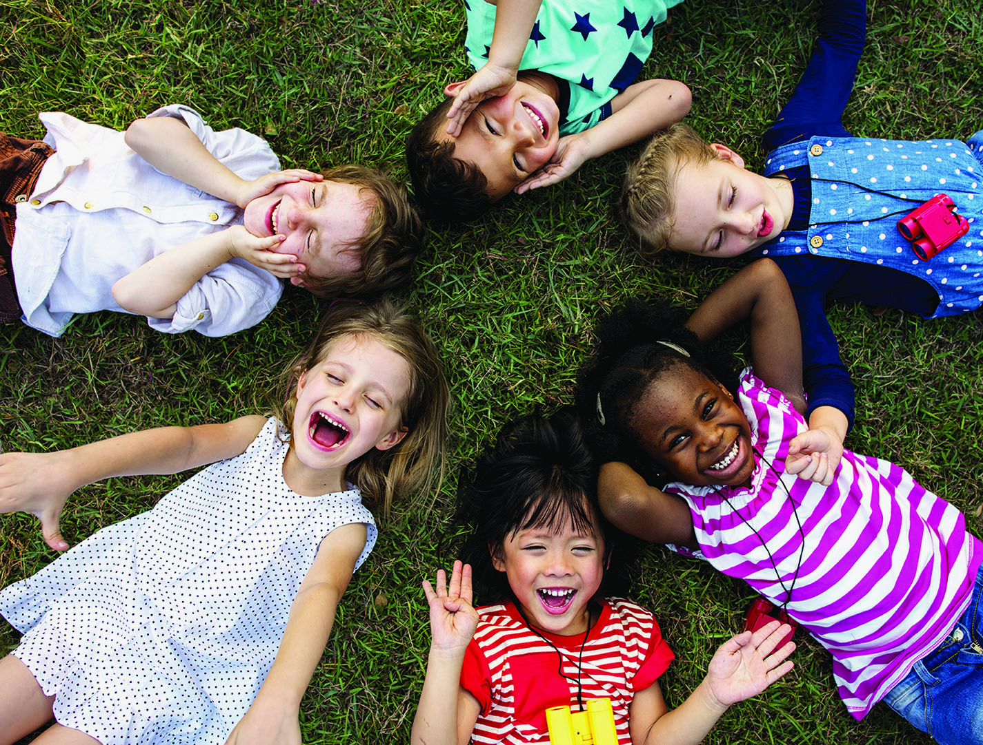
Communication Barriers
Ethnocentrism
Prejudice
Stereotyping
Unfair Discrimination
Mindfulness
Notes:
Estimated Time: 5 mins
Key Concepts
Communication Barriers
Ethnocentrism
Prejudice
Stereotyping
Unfair Discrimination
Mindfulness
Key Points
We tend to think our culture is the best (ethnocentrism).
Ethnocentrism leads to an attitude of prejudice—an unfairly biased and intolerant attitude toward others who belong to an out-group.
Stereotypes are exaggerated generalizations about a group.
Unfair discrimination deprives people of opportunities and equal treatment.
Become more mindful by continually reminding yourself that every individual reflects a unique collection of experiences and cultures that generalizations cannot describe.

Slide 28
First Impressions Activity
Notes:
Estimated Time: 10 mins
Activity: First Impressions
(handout provided)
The object of this activity is to see what assumptions students make about someone based on first impressions.
IN PERSON: Directions for Instructor
Arrange for a volunteer the students don’t know to enter the room at the start of class and announce that you will be there in a few minutes. (The volunteer should then leave.)
Enter the room immediately afterwards and ask students to fill out the First Impressions handout provided here.
ONLINE: Directions for Instructor
Find a brief videoclip of an everyday person the class won’t recognize. Have students view it then fill out the First Impressions handout provided here.
Follow-Up Questions
How did you answer each question?
What about the person led you to make these guesses?
Is there evidence of ethnocentrism in your answers? How about stereotyping?
What are your take-away lessons from this activity?

Slide 29
“black-ish” Straddling Cultures
Notes:
Estimated Time: 10 mins
Video Connection (in Oxford Insight): “black-ish”
Introduction to the Video
In the TV show “black-ish”, the Johnson family appears to be living the American dream. They are well off, good looking, and they love one another. But a question nags at the Johnsons: Are they losing touch with their heritage?
“black-ish” Straddling Cultures
https://learninglink.oup.com/ebook/access/content/adler-rodman-dupre3e-supplemental-resources/adler-rodman-dupre3e-instructor-resources-black-ish-straddling-cultures
(1:11 mins)
Follow-Up Discussion
In what ways does the character shown (Rainbow Johnson) try to negotiate a sense of in-group membership?
Have you ever had a difficult time fitting in?
Have you ever felt that you fit in too much and lost your identity as an individual?
How did (or might) you use communication to manage these situations?

Slide 30
Cultural Exchange Activity
Notes:
Estimated Time: 35 mins
Activity: Cultural Exchange
(handout provided)
For this activity, students pair up (either online or in person) to solve a riddle. The catch is that each student represents a culture with one expectation that simply cannot be violated without causing offense. The process is designed to help students recognize that even seemingly small differences can have a profound effect on communication.
Procedure for Instructor
Give half the class instructions for Culture A and half the class instructions for Culture B. (Handouts with these instructions are provided at the end of this lesson plan. One version is designed for online use and one for the classroom.)
Pair each student in Culture A with someone in Culture B
to solve the riddle at the end of the instruction page.
Teaching Tip
If an activity calls for pairing up, but you have an odd number of students, assign one or more students to serve as silent observers. Their observations can be as useful as those of people who actively participated.
Instructions for Students
Work together in pairs as you follow directions on the worksheet. Keep count of how many times one of you is “offended,” based on the rules of the game.
Follow-Up Discussion
How many times during the discussion did people indicate that they were offended? How do you feel about that?
Was solving the riddle (communicating) more difficult because of your cultural differences? If so, how?
Did you figure out the rules that make these two cultures different? If so, what do you think they are?
Did anyone feel like giving up (a symptom of culture shock)? If so, what happened?
Did anyone solve the challenge? If so, what do you think the answer is?
INSTRUCTOR NOTE: The correct answer is that you give your 10th friend the basket with the last apple still in it. Thanks to buzzle.com for this riddle!

Slide 31

Culture (Adjustment) Shock
Don’t be too hard on yourself.
Homesickness is normal.
Expect setbacks.
Reach out to others.

Slide 32
Cultural Competence
Notes:
Estimated Time: 20 mins
Discussion Starters: Cultural Competence
(handout provided)
Teaching Tip
When several discussion questions apply to one topic, we provide them on a handout.
You might use the handout for yourself as an easy-reference guide.
Alternatively, you might share the handout with students and ask them to respond individually or in small groups— either to all questions or to questions that you assign to particular people or groups.
Discussion Questions (included on the handout)
Have you ever felt unsure how to communicate with someone from a different culture? If so, how did you handle it?
Have you ever surprised someone, or been surprised, by a gesture or statement that is acceptable in one culture but out of place in another?
Imagine that you were commissioned to write a book or create a video titled “About the Americans” for people from other parts of the world who will visit the United States for the first time. What communication-related topics would you include? What advice would you give?
Think of a time when you met someone who seemed very different from you at first but eventually became a close friend or colleague. Create a timeline that illustrates turning points in your relationship when you learned more about each other and developed rapport.
How do you rate yourself in terms of intercultural sensitivity and open-mindedness? What steps might you take to keeping growing in this regard?

Slide 33
Review of Learning Objectives
3.1 What is the difference between in-groups and out-groups?
3.2 How do values and norms affect communication between members of different cultures?
3.3 How does the concept of intersectionality relate to communication, and in what ways does communication help shape cocultural identity?
3.4 Explain how communication patterns differ within and between different age groups.
3.5 What communication practices tend to promote understanding between people of different races?
3.6 How might thinking mindfully help people overcome prejudiced assumptions that influence communication?
3.7 What stages are involved with adapting to communication in a new culture?

Slide 34
Wrap-Up

